Slide 1
K-Frame NMOS Training (v14.6.0)
April

Slide 2
Goals
Provide some introductory training to Service and Support about NMOS in general.
Explain the specifics about how the K-Frame X and V Series have implemented NMOS in v14.6.0.
Provide resources and links if further information is needed by Service and Support.

Slide 3
Agenda
NMOS Cliff Notes
Menu Configuration
NMOS IS-04 Cliff Notes (K-Frame Specific)
NMOS IS-05 Cliff Notes (K-Frame Specific)
Troubleshooting
Additional Resources

Slide 4
NMOS Cliff Notes
NMOS is a collection of open standards/specifications published by AMWA, currently over 10 specs. (IS-04, 05, 06, 07, 08, 09, 10,MS-04,BCP-002-01, BCP-003-01, and BCP-003-02)
Many customer’s interest in the NMOS collection of standards is they are designed to offer “Best of Class” interoperability.
Switcher’s release of “NMOS” is a release of “NMOS IS-04/05” only.
Notes:
* Often people are referring to IS-04/05 functionality as NMOS. But when customer facing it is important that we remember that there are 12 other standards. For example IS-07 is a protocol used for Tally, which we aren’t supporting.

Slide 5
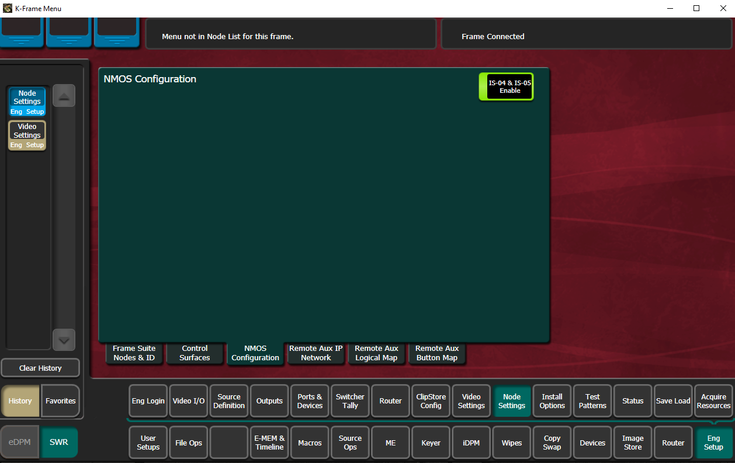
Menu Configuration
Just make sure that you have the enable button green…

Slide 6
NMOS IS-04 Cliff Notes
IS-04 has three main parts:
Discovery – This is the act of the Node (K-Frame IP IO boards) finding the Registry’s IP Address and Port (Could be a control system).
NMOS only applies to the 16x8 and 8x4 IP Boards 10G/25G. Does not apply to PTP Mezz or the first generation MOD IP IO board.
Registration – This occurs after the Node has discovered the Registry. The Node will publish information about itself to the Registry and the Registry will store it for later use. As Node settings are changed the Node will continue to publish to the Registry to keep it up to date.
Heartbeat – Once a Node is registered, the Registry will expect periodic messages to be sent to ensure that the Node is still Active.

Slide 7
NMOS IS-04 Cliff Notes (cont…)
The K-Frame will accomplish IS-04 as follows:
Discovery – The K-Frame will use mDNS on the Media Network for discovery.
Registration – Each IP Board will be published as a Node and will have the Frame’s Name and Starting/Ending input/output of that board. All IP Boards for a K-Frame will also share the same grouping tag. All messages are HTTP and published in plain text.
Heartbeat– Each board will maintain its own connection to the Registry which helps ensure that we don’t have a single point of failure for all inputs/outputs.

Slide 8
NMOS IS-04 Cliff Notes (cont…) Discovery/Registration Process &mDNS
Media Network
(In-band)
mDNS Capable
NMOS Registry
K -Frame
Node
IP Board #1
Node
IP Board #2
Node
IP Board (etc…)
mDNS Cliff Notes
IGMP join group 224.0.0.251 (mDNS)
Node - mDNS Query (_nmos-registration._tcp)
Registry - mDNS responds to the Node with connection information

Slide 9
NMOS IS-05 Cliff Notes
IS-05:
Allows a Control Application to use the information published to the Registry to perform IGMP “Takes” not cuts. The quality of the “Take” is largely due to the network that is distributing the streams.
The typical use case that customers have asked for is the ability to rapidly reconfigure the Switcher’s Receivers from a Router Control Panel.
The “Take” occurs just as if the IGMP address was changed from the Menu. No changes to sources and not an RMEM.

Slide 10
Controller Application
NMOS Registry
Media Network
(In-band)
K -Frame
Node
IP Board #1
Camera 1
Node
IP Board #2
Camera 2
Node
IP Board (etc…)
GFX 1
The Controller application will need to be on the in-band network so it can get data from the registry and send information to the IP Boards 10G/25G SFPs. The registry is likely to be on both the control network and media network.
GFX 2

Slide 11
Troubleshooting
The “is it on” questions:
Is the enable button in the Menu green?
Is the Media network capable and configured for mDNS?
Is the Node Registry connected to the media (in-band) network?

Slide 12
Troubleshooting (cont…)
Some preliminary things:
The board logs for the IO boards contain the information needed for detailed analysis and troubleshooting. Probably easiest to troubleshoot one board at a time.
To verify that the board has properly started NMOS related SW look for the following message sequence in the log for that board:
INFO 27 Mar 2013 20:03:30 IPController: enableNmos: Enabling NMOS
INFO 27 Mar 2013 20:03:30 IPController: reseConnectNmos: /usr/local/jv/nmos.is04-server.jar PID = 2045
INFO 27 Mar 2013 20:03:30 IPController: reseConnectNmos: RESE Connected to NMOS JAR Server
These get generated at a power cycle, frame reset, board reset, or NMOS enable/disable from the Menu.

Slide 13
Troubleshooting (cont…)
NMOS IS-04 Discovery troubleshooting
When a board finds a registry it will print specific messages about that registry. The absence of these messages implies that there is possibly a problem with mDNS. Standard networking troubleshooting procedures are needed if that occurs.
INFO 27 Mar 2013 20:03:30 IPController: registryThreadWork: NMOS Registry Thread started. IPNMOS status = 31
INFO 27 Mar 2013 20:03:30 IPController: registryThreadWork: NMOS RESE initial status: 'Not connected to Registry.'
INFO 27 Mar 2013 20:03:30 IPController: registryThreadWork: Running loop to check health
INFO 27 Mar 2013 20:03:55 IPController: registryThreadWork: IPNMOS status = 63, new NMOS RESE status='Connected Registry Status:
api_version: "V_1_2"
name: "gvc-100"
url: "http://10.16.19.15:4041"
ip: "10.16.19.15“
These get generated at a power cycle, frame reset, board reset, or NMOS enable/disable from the Menu.

Slide 14
Troubleshooting (cont…)
NMOS IS-05 “Take” troubleshooting:
The board will log each take request it receives whether it is valid or not. This should help identify if the board actually received a message. The log messages are shown below. If the log messages are absent when the Control Application sends a “Take” then the board hasn’t received the message and standard networking troubleshooting should be performed.

Slide 15
Troubleshooting (cont…)
The following will be needed by TAC and Engineering to help a customer:
Network configuration and model info.
Registry – Type and version compatibility and current version setting if available.
SW Diags – The logs have the information required for troubleshooting. For best results perform a frame power cycle and start capturing diags at about 5 minutes after the boot.

Slide 16
Additional Resources
AMWA NMOS Documentation
(https://amwa-tv.github.io/nmos/
mDNS and multicast DNS-SD
https://tools.ietf.org/html/rfc6762
https://tools.ietf.org/html/rfc6763

