Slide 1

Introduction to NMOS
What is it??

Slide 2
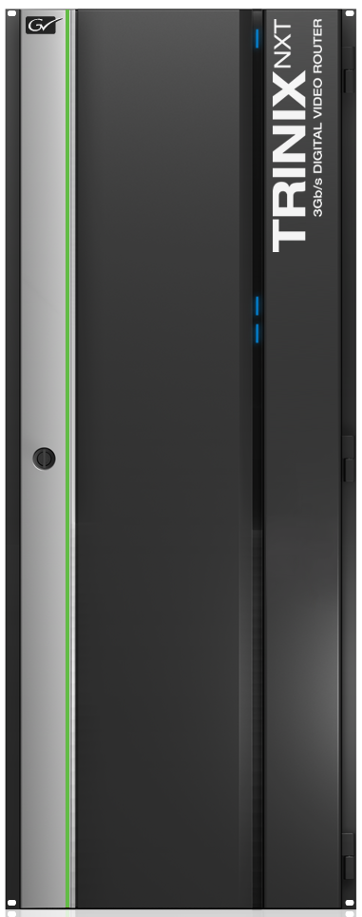
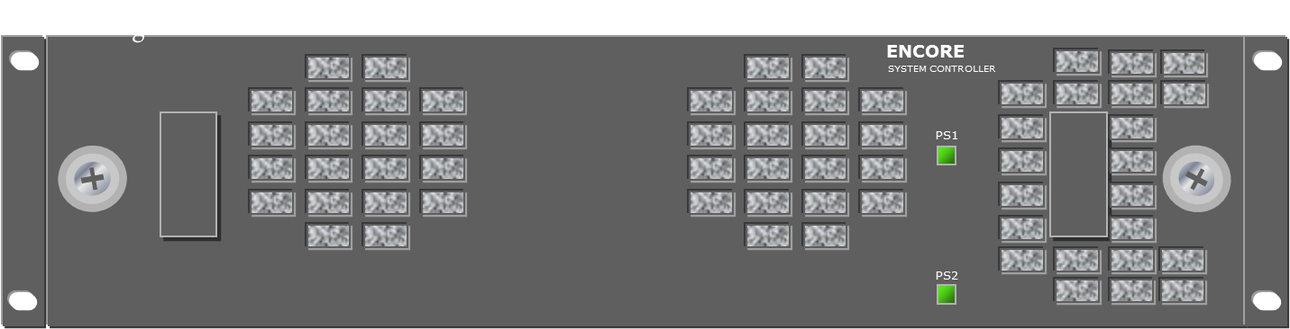
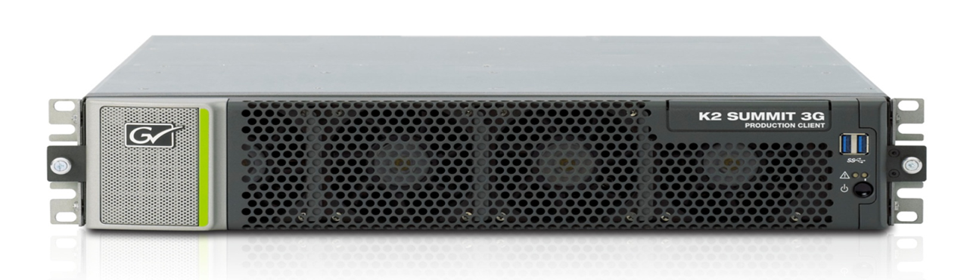
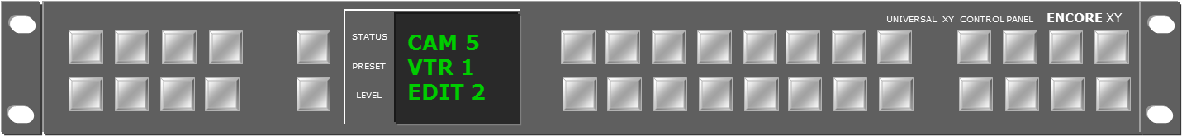

Traditional Routing
Control
Video &
Audio
Control Panel
Video &
Audio
Notes:
The sources and destinations were wired directly into a routing matrix. The control system was manually programmed and controlled the matrix.

Slide 3
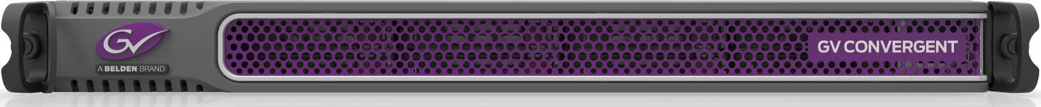
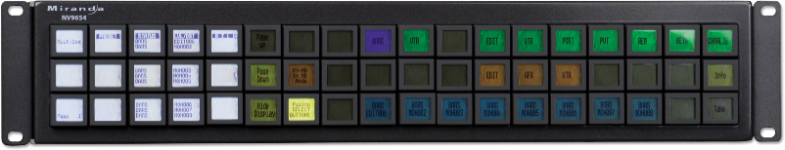
Video over IP Routing
The New World
IP Cloud
Control
Video &
Audio
Video &
Audio
Notes:
The router control doesn’t talk to a matrix. It interfaces with the source.
How does the equipment ‘know’ what is connected and what to route? That is NMOS IS-04 and IS05.

Slide 4

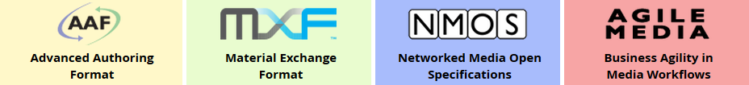
Advanced Media Workflow Association
https://www.amwa.tv/
Interface Specifications –
IS-04
IS-05
etc.
Notes:
AMWA is an industry body and has developed the Networked Media Open Specifications (NMOS). This activity complements the work of other well established technology associations, such as the Audio Engineering Society (AES), the European Broadcasting Union (EBU), the Society of Motion Picture and Television Engineers (SMPTE) and the Video Services Forum (VSF).
The AMWA continues its support for the Media Exchange Format (MXF), the Advanced Authoring Format (AAF) and the Framework for Interoperable Media Services (FIMS). (https://www.amwa.tv/)
The Interface Specifications are assigned to different standards within NMOS. Currently, there are IS-04, 05, 06, 07, 08, 09, 10,MS-04,BCP-002-01, BCP-003-01, and BCP-003-02. We are supporting IS-04 and IS-05.

Slide 5
Reference Architecture
Joint Task Force on Networked Media
Operation
Application
NMOS APIs
Platform
Infrastructure
Notes:
The Joint Task Force on Networked Media (JT-NM) was formed by the European Broadcasting Union, the Society of Motion Picture and Television Engineers and the Video Services Forum to help the transition from SDI to Video over IP. To help this, they created this architecture.
Operation Layer: This layer describes a business process overseen by humans. Technology is not involved at this level. Think about the items in this layer as the business functions the organization would like to accomplish, such as live studio operations, post-production workflows and network origination functions.
Application Layer: This layer consists of software applications and user interfaces that are used to accomplish the business processes. While traditionally this layer may have consisted of a piece of hardware such as a video switcher or a CCU unit, now it is common to find software user interfaces such as virtual router control panels using the computing power in the Infrastructure Layer.
Platform Layer: The software services in this layer provide the System Capabilities that are required by the Application Layer above. Examples of System Capabilities include timing, synchronization, and discovery & registration. These services exploit the resources provided by the Infrastructure Layer below.
Infrastructure Layer: This layer consists of two sub-layers: the Data Center & Specialty Hardware and the Network sub-layers. Typical items included in the Data Center layer are PC servers, storage arrays, GPU farms, hardware accelerators, IP/SDI gateways, etc. The Networks sub-layer consists of network switches, various network transport protocols, and physical transport mechanisms.
(https://jt-nm.org/RA-1.0/JT-NMReferenceArchitecturev1.0%20150904%20FINAL.pdf)
The NMOS APIs tie application to the platform.

Slide 6
Definitions
NMOS Model and Terminology
Node
C1EBC658-F5D5-4CFB-
9ABB-55566AF4E1A6
0D38A030-8563-4079-
9A2B-6FC20B8486E8
Device
Receiver
Sender
Receiver
Sender
Device
B18471BO-0EB2-4351-
8349-3DA56F91B225A
Receiver
Sender
B1847AC5O-0EB2-4351-
8349-3DA5391B225A
Not all of the resource addresses are shown.
Notes:
Device represents a logical block of functionality.
Receivers and Senders are the logical inputs and outputs of a Device.
Devices, Senders and Receivers are all Resources. A Resource is a uniquely identified with a UUID and is addressable part of a networked system. The address is in hex.
A universally unique identifier (UUID) is a 128-bit number used to identify information in computer systems.
A Node is the host for one or more Devices.
Website - https://amwa-tv.github.io/nmos/branches/master/NMOS_Technical_Overview.html

Slide 7
Definitions
NMOS Model and Terminology
Node
Device
Receiver
Sender
Node
Receiver
Sender
Device
Device
Receiver
Flow
Sender
Receiver
8DADB8F3-6073-4D64-
8E36-F3E71E62344B
Not all of the resource addresses are shown.
Notes:
A Flow is a sequence of video, audio, or time-related data, which can flow from a Sender to a Receiver or Receivers. A Flow is treated as a resource and has a unique ID.
Website - https://amwa-tv.github.io/nmos/branches/master/NMOS_Technical_Overview.html

Slide 8
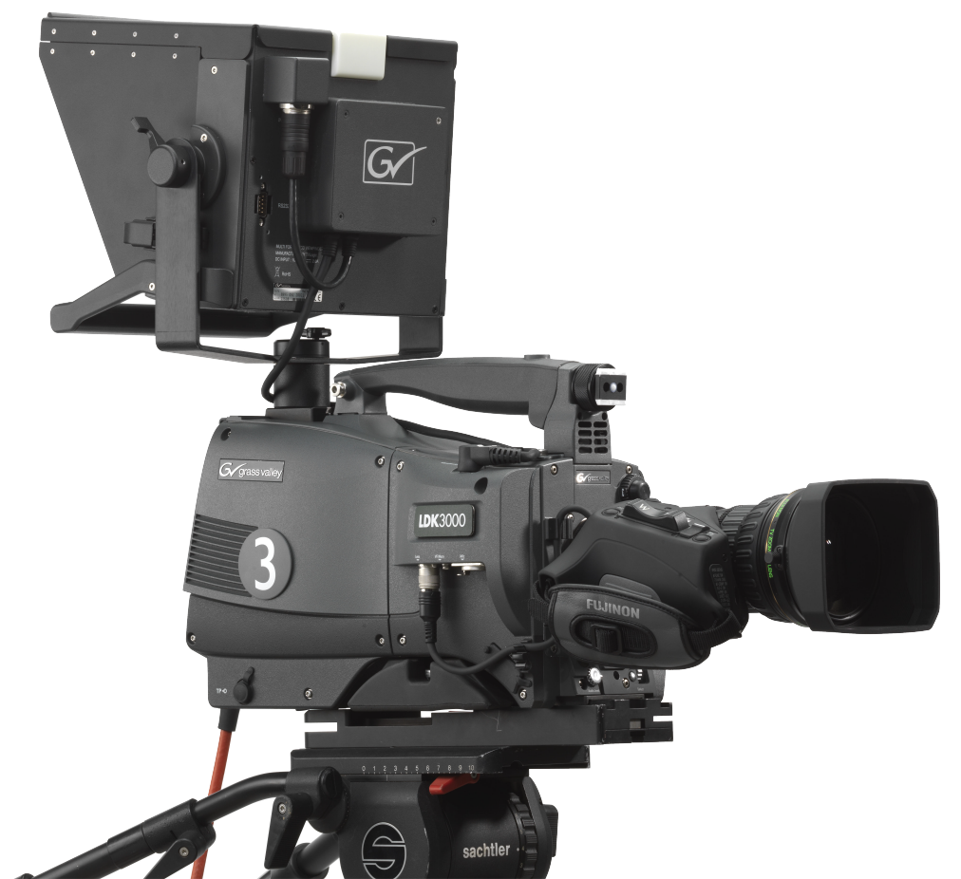

Definitions
K-Frame - An Example
IP Board #1
Mixer
Flow
Flow
Receiver
Sender
Receiver
Sender
Keyer
Receiver
Sender
Notes:
For example, the K-Frame’s IP boards are nodes with a mixer as a device. Each mixer can have multiple receivers and senders. The receivers would get flows from cameras. The senders would monitors or multi-viewers.

Slide 9
NMOS IS-04
Discovery Process
Media Network
(In-band)
mDNS Capable
1. IGMP join request
2. mDNS Query
NMOS Registry
GV Orbit Services
IP Board #1
Registry IP Info
Mixer
Receiver
Sender
Receiver
Sender
Keyer
Receiver
Sender
Notes:
IS-04 has three parts – Discovery, Registration and Heartbeat. All of the messaging is in plain text and uses HTTP formatting.
Discovery is the act of the Node (for example, K-Frame IP boards) finding the Registry’s IP Address and Port (For example, GV Obit Services).
The Discovery process steps are –
The IP board sends a IGMP join request for group 224.0.0.251 (mDNS),
After joining the IGMP group, the Node sends mDNS queries,
The NMOS Registry is listening and responds to the mDNS queries by sending the NMOS Registry connection information. to the node.
Multicast DNS (mDNS) provides the ability to perform DNS-like operations on the local link in the absence of any conventional Unicast DNS server.

Slide 10
NMOS IS-04
Registration and Heartbeat Process
Media Network
(In-band)
mDNS Capable
Node Information
Heartbeat
NMOS Registry
GV Orbit Services
IP Board #1
Mixer
Receiver
Sender
Receiver
Sender
Keyer
Receiver
Sender
Notes:
IS-04 has three parts – Discovery, Registration and Heartbeat. All of the messaging is in plain text and uses HTTP formatting.
Registration occurs after the Node has discovered the Registry. The Node will publish information about itself to the Registry and the Registry will store it for later use. As Node settings are changed the Node will continue to publish to the Registry to keep it up to date.
Using the K-Frame, each IP Board will be published as a Node. The registry information will include the K-Frame’s name, and inputs and outputs of that board. This would include interface IP Addresses and multicast addresses.
Heartbeat – Once a Node is registered, the Registry will expect periodic messages to be sent to ensure that the Node is still Active.
In a K-Frame, each IP board will maintain its own connection to the Registry which helps ensure that we don’t have a single point of failure for all inputs/outputs.

Slide 11
NMOS IS-05
Take Process
Media Network
(In-band)
mDNS Capable
Sender Multi-cast
Information
IGMP Join Request
Multi-cast
Stream
GV Orbit Services
IP Board #1
Controller Application
Mixer
IP Camera
Receiver
Sender
Receiver
Sender
NMOS Registry
Keyer
Camera
Receiver
Sender
Sender
Notes:
IS-05 allows a Control Application to use the information published to the Registry to perform IGMP “takes”. The quality of the “take” is largely due to the network that is distributing the streams.
It is assumed the everything has been registered to the NMOS Registry.
The process is –
An operator takes a source to a destination using the control panel. In NMOS terms, the operator choose a sender and a receiver.
The Controller Application looks up the sender and receiver information in the NMOS Registry.
The Controller Application sends the sender information (multi-cast IP address and port) to the receiver.
The Receiver sends a leave request followed by an IGPM join request with the new sender information to the Media Network.
The Media Network forwards the multi-cast stream to the Receiver.

Slide 12

Questions?
12

Slide 13





Thank You
Join the Conversation
www.grassvalley.com

