Slide 1
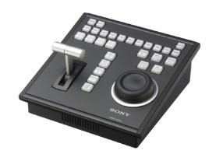
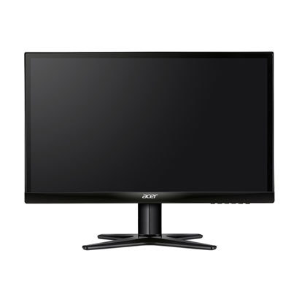
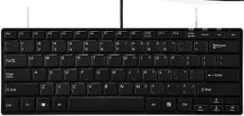
4K Replay
PWSK-4403
PC Monitor
Keyboard
Mouse
HDMI
USB
USB
USB
PWS-100PR1
SDI1
SDI2
LAN
SLOT2 LIVE HD-SDI
SLOT2 REPLAY HD-SDI
BPU4800
Replay 4K out
Live 4K out
4K REPLAY Monitor
4K LIVE Monitor
HD SDI Monitor
3G SDI/HD SDI Monitor

Slide 2
HD Replay
PWSK-4403
PC Monitor
Keyboard
Mouse
HDMI
USB
USB
USB
PWS-100PR1
SDI1
SDI2
LAN
SLOT2 LIVE HD-SDI
SLOT2 REPLAY HD-SDI
BPU4800
Replay HD out
Live HD out
HD REPLAY Monitor
HD LIVE Monitor
HD SDI Monitor
3G SDI/HD SDI Monitor

Slide 3
HD Cutout
PWSK-4403
PC Monitor
Keyboard
Mouse
HDMI
USB
USB
USB
For Touch Panel
USB
PWS-100PR1
SDI3
LAN
SDI1
SDI2
SLOT2 LIVE HD-SDI
SLOT2 Live
Set on HD-SDI
SLOT2 REPLAY HD-SDI
BPU4800
SLOT1 Replay
Set on HD-SDI
Replay
HD Cutout
Live 4K out
HD Cutout Monitor
4K LIVE Monitor
HD SDI Monitor
3G SDI/HD SDI Monitor

Slide 4
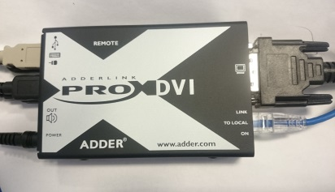
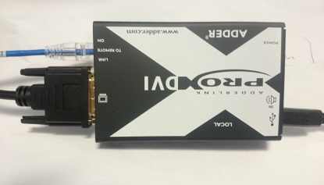
Extend Remote Operation Control Area
PWSK-4403
PC Monitor
DVI
Keyboard
Mouse
USB-B
Operation
Control
Area
USB-B
USB
All USB-A
USB-B
DVI
AC pack
DVI
Equipment
Engine
room??
USB-A
HDMI
Cables with Red: shipped this time

Slide 5
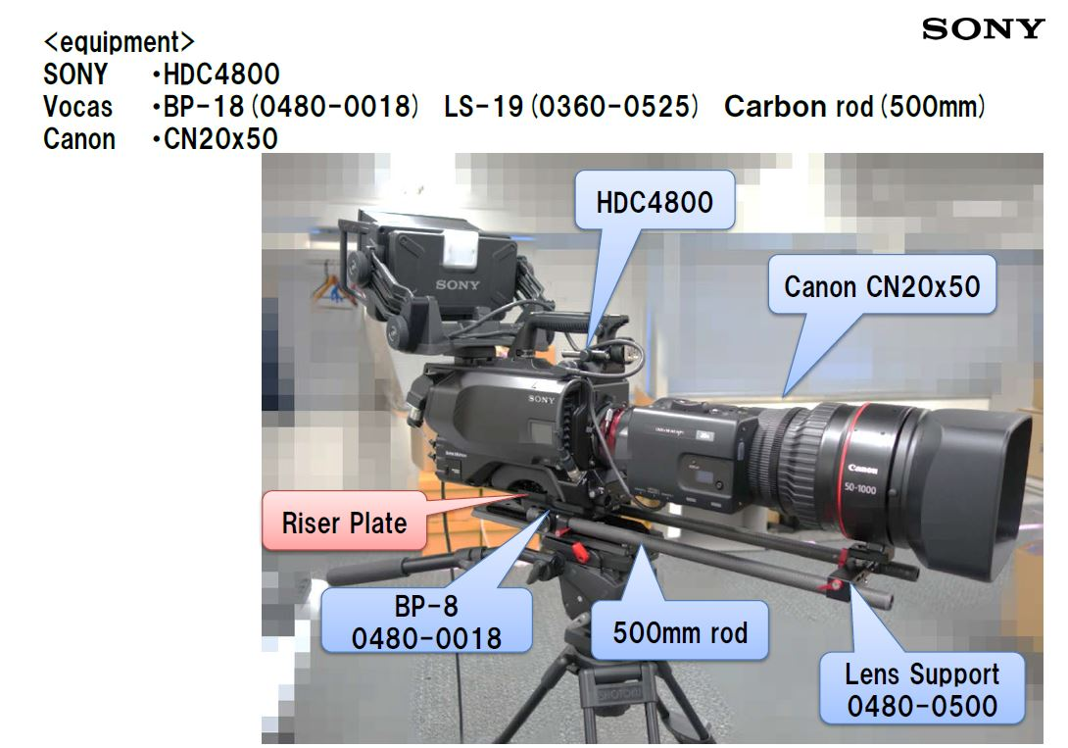
35 mm lens configuration

Slide 6
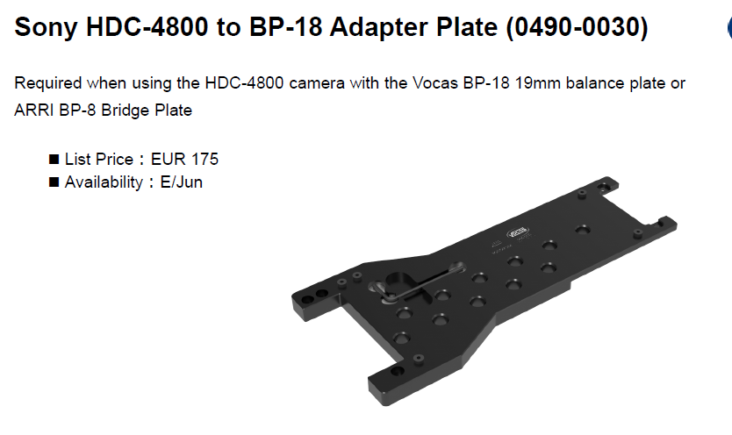
Riser Plate(Sony)

