Slide 1
MVS-6520/6530/3000 メカニカルブロック
ICP Overview
2012.11 PSG CCS Dept.1

Slide 2
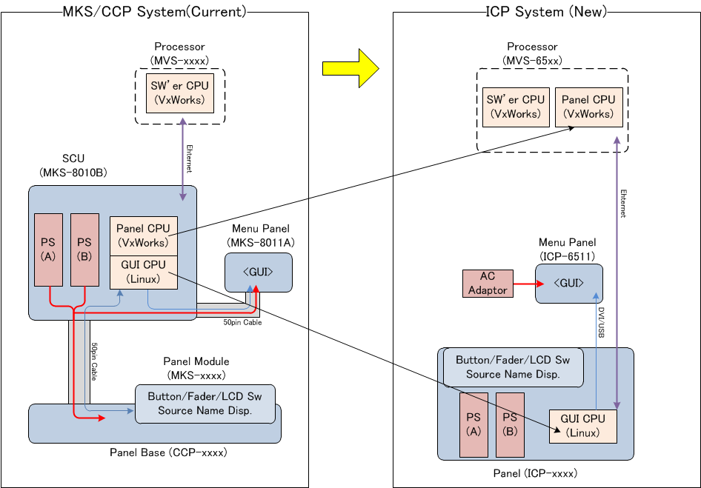
Difference of Systems

Slide 3
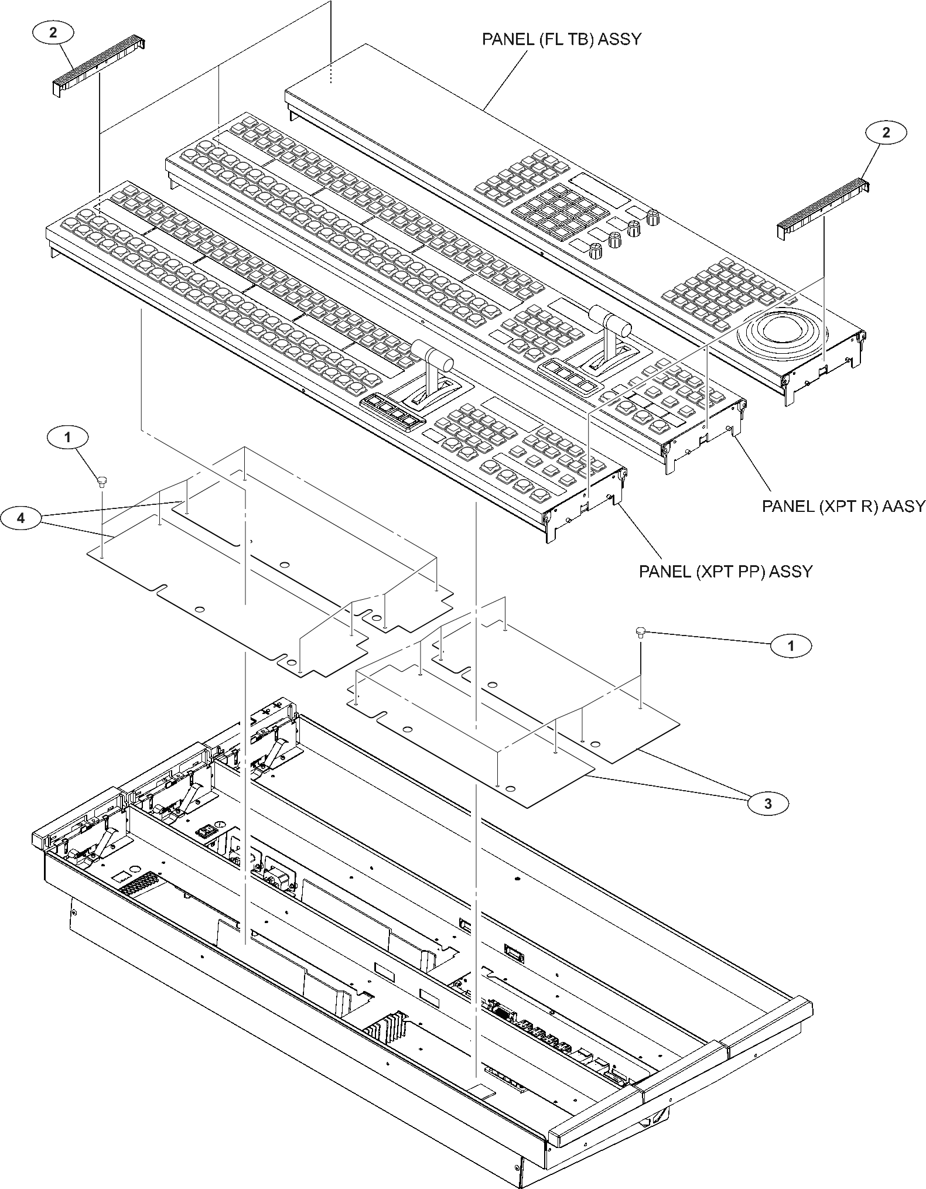
Structure of New Panel
(Example of ICP-3000)
Panel module
Insulating sheet
Harness
Sheet(metal)
Tub
Bottom case
Base ASSY

Slide 4
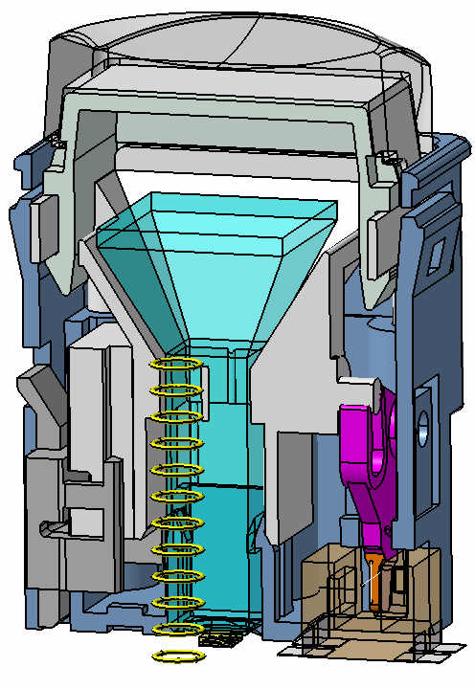
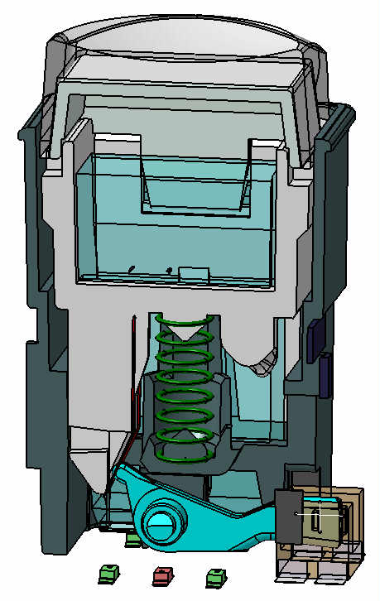
Difference of Switches
ICP-6520/6530/3000
CCP-8000/6000 series
Reference
Cap, Diffusion plate
( common)
Reflector
Light guide
Light guide
Spring x2
Spring
Shutter
Photo sensor
(common)
Shutter
19.5
23.5
LED(RGB x1)
LED (Rx2 Gx4)
Height (panel to PC board)

Slide 5
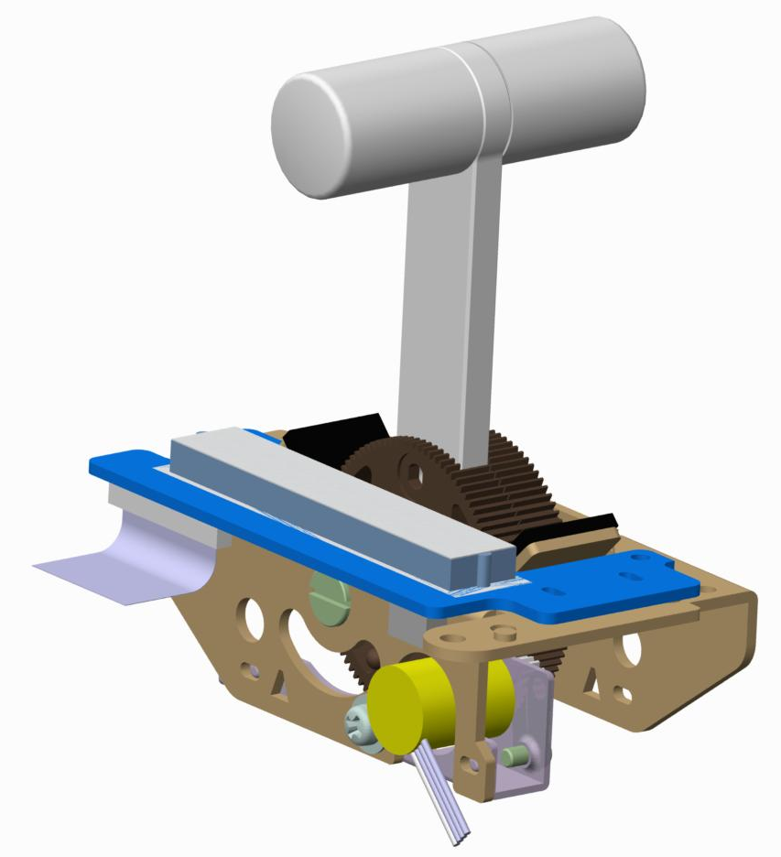
New Fader
ICP-6520/6530/3000
CCP-8000/6000 series
Reference
LE
Gear
Optical encoder
Slit plate
Optical encoder

Slide 6
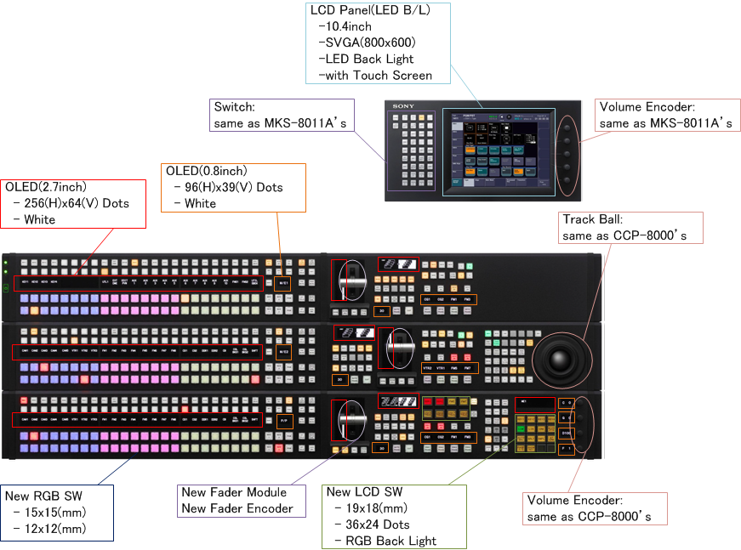
New Device

Slide 7
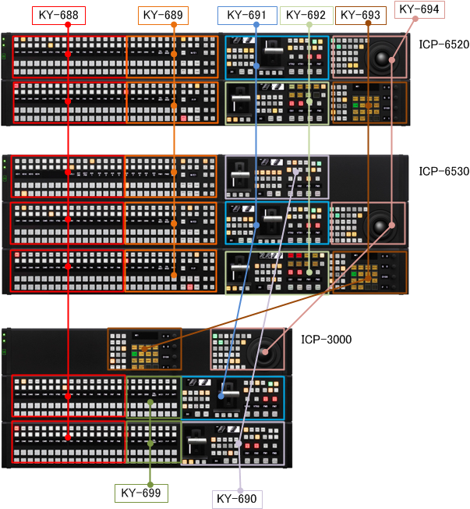
KY Board Arrangement

Slide 8
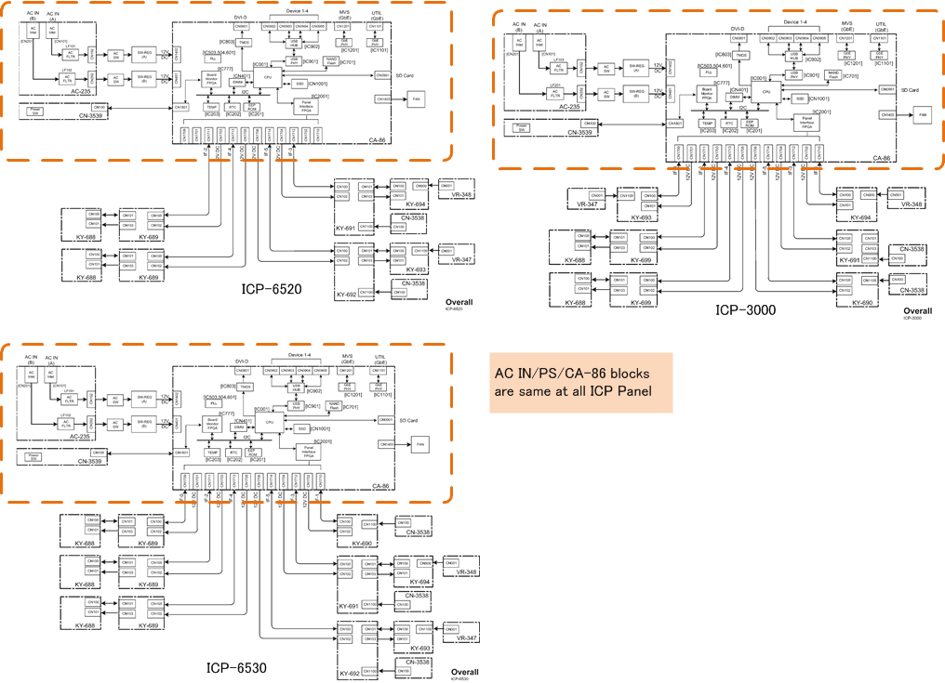
Difference of Overall Block Dia.

Slide 9
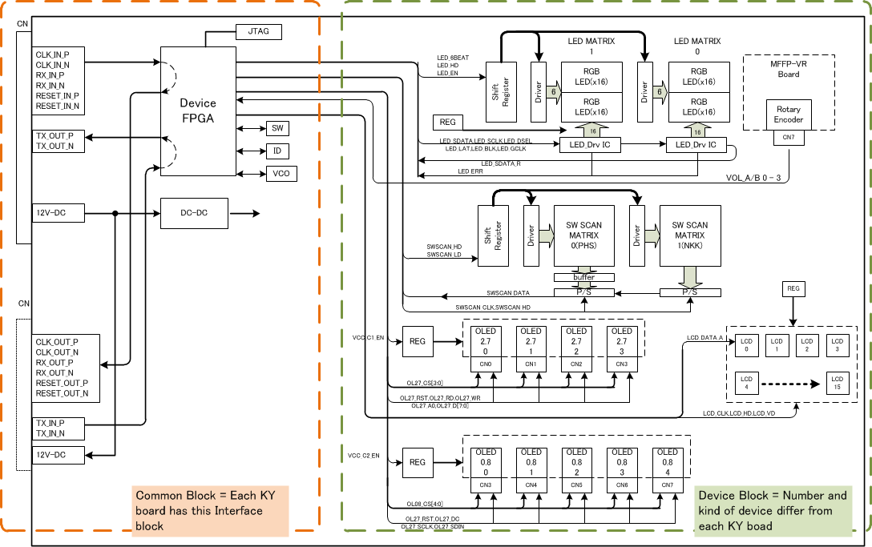
KY Board Master Block Dia.

