Slide 1
MVS-6520/6530/3000 メカニカルブロック
ICP Setup
2012.11 PSG CCS Dept.1

Slide 2
Installation into the console
Example of ICP-6520
USB Hub (Recommended when ICP-6511 is not connected)
70
100
10～20mm
AC cable
DVI-V cable

Slide 3
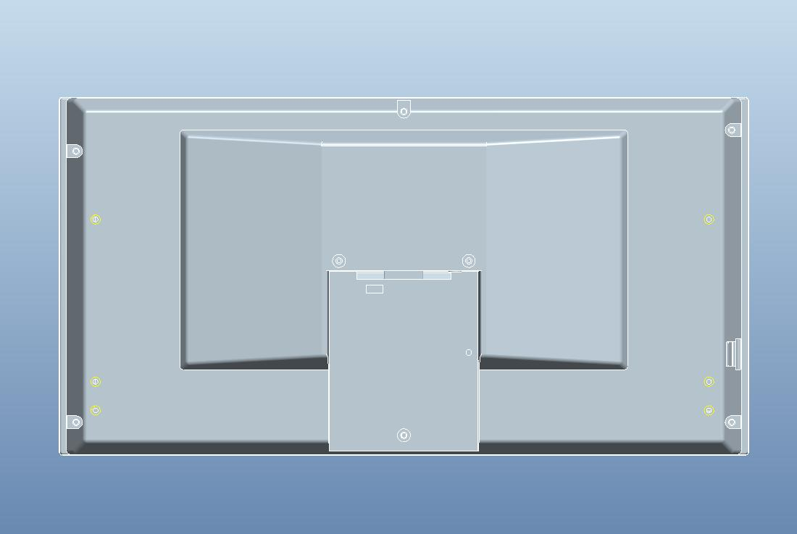
ICP-6511 Back Side Cable Wiring
DVI-D cable （attached)
Cable of AC adaptor
(attached)
USB cable (attached)
Clamp on the external chassis ﾟ
USB
Banding band
(Commercial item)

Slide 4
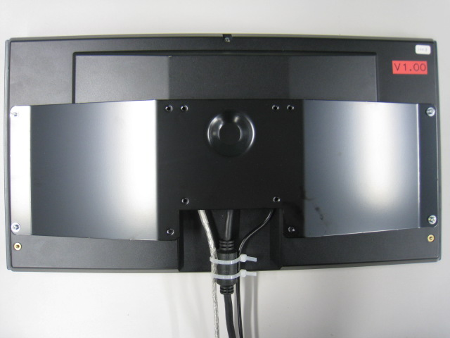
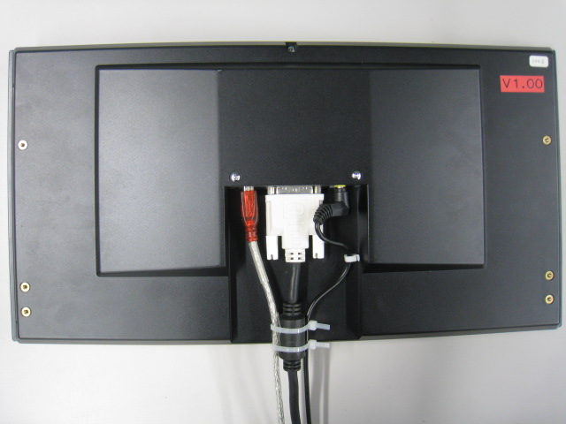
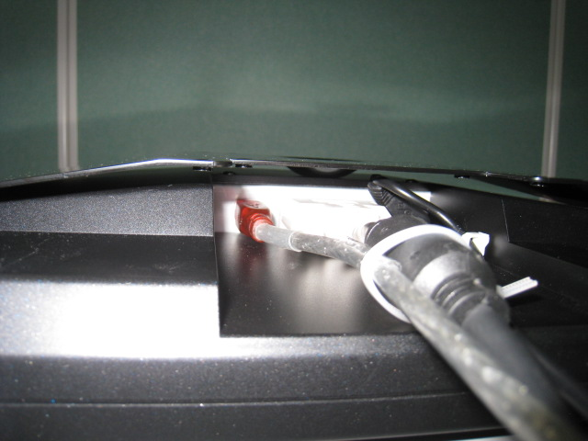
VESA Adaptor mounting
Arrow
VESA Adaptor (3-872-255-01)
(attached)
Space between cable and adaptor

Slide 5
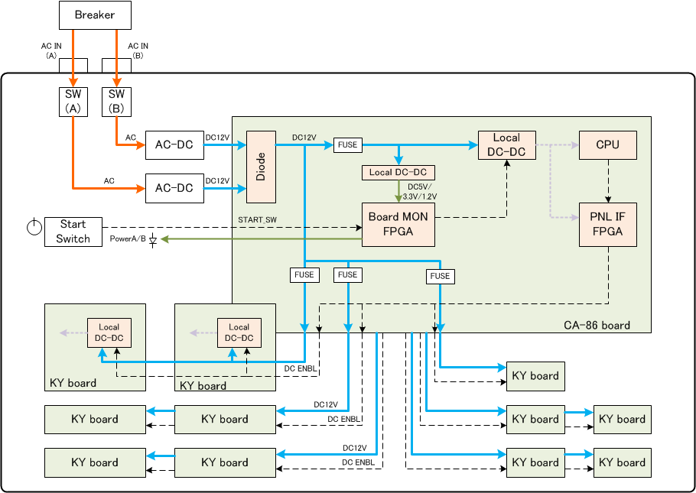
Power Line in ICP

Slide 6
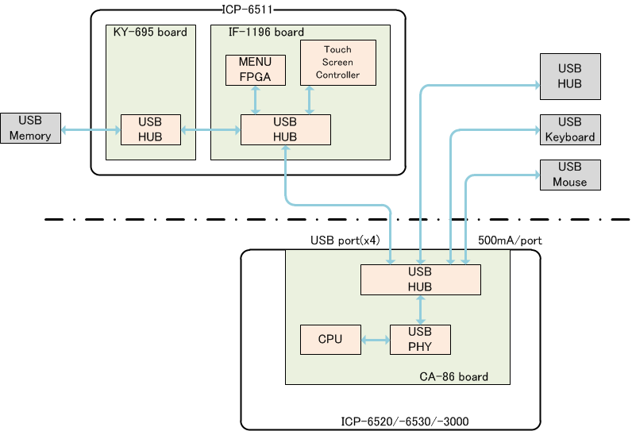
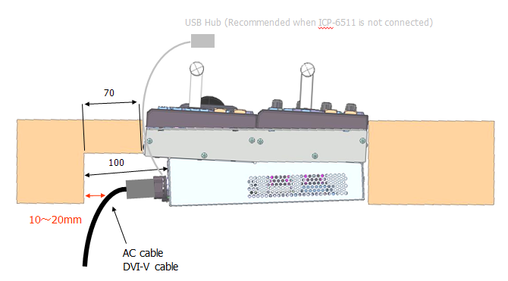
USB Connection

Slide 7
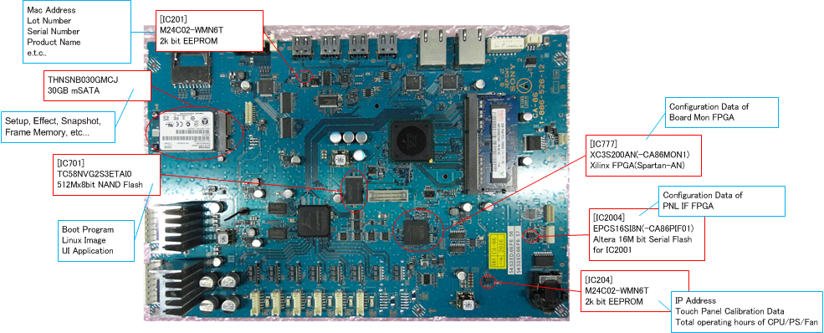
Where is saved Data ?

Slide 8
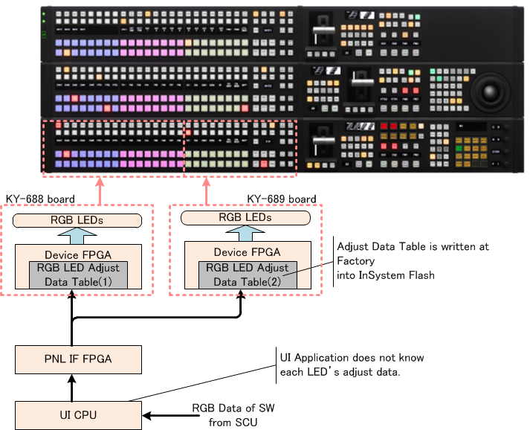
LED s are calibrated and saved

Slide 9
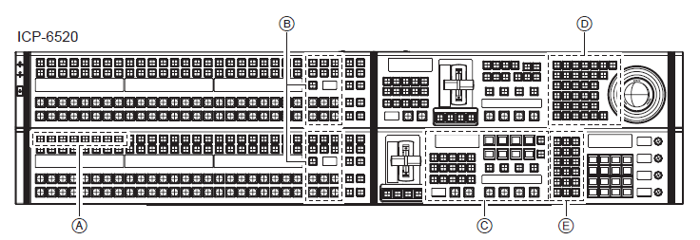
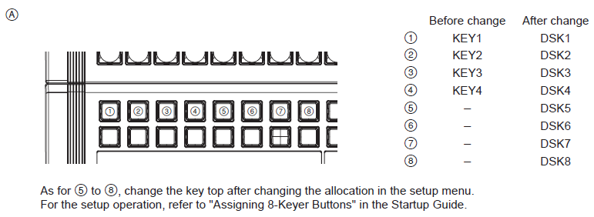
About Serigraph Labels
for example)
in Combination with
MVS-6520
in Combination with
MVS-6530

Slide 10
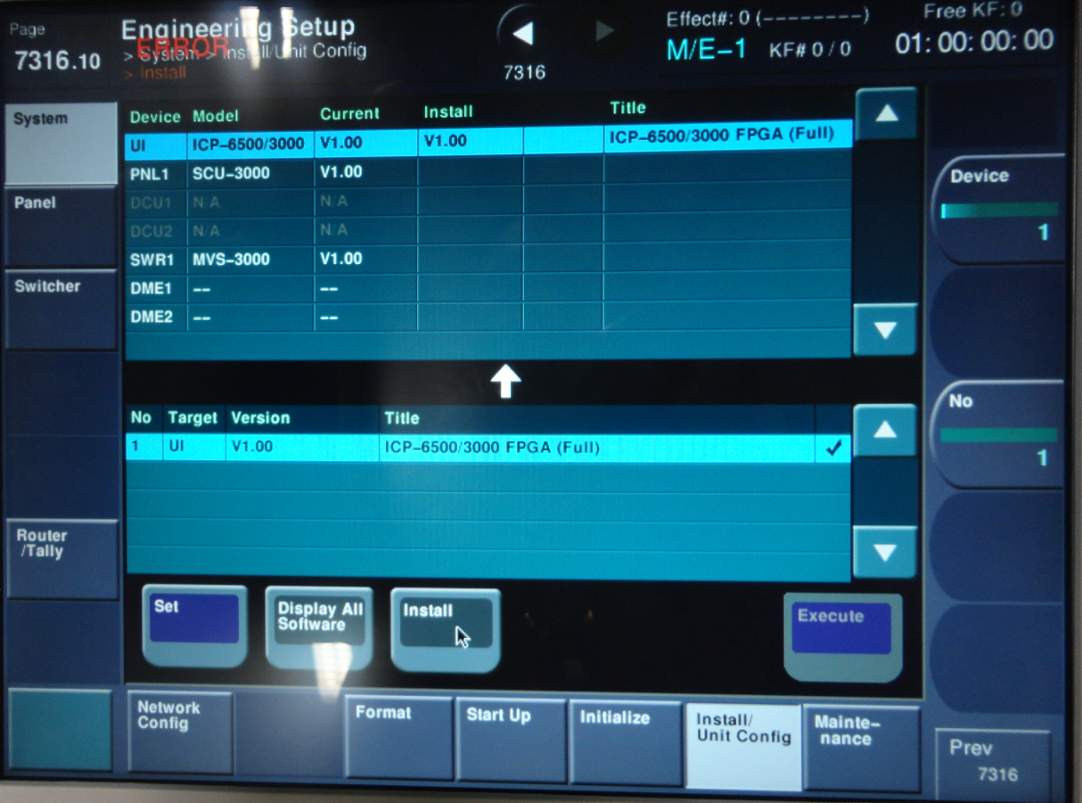
About Version UP on DEMO Panel
In the case of Installation Official Software to DEMO Panel , Error occurs at FPGA Data File.
So, please check off FPGA File.
[FPGA information in DEMO Panel]
FPGA on CA-86 : not available software configuration
FPGA on KY-xxx : One pixel noise appears at corner sometimes.

