Slide 1
MVS-6520/6530/3000 メカニカルブロック
ICP Panel Operation Details
-Electrical Description-
2012.11 PSG CCS Dept.1

Slide 2
Agenda
Overall block diagram
CA-86 （CPU base board）
KY-xxx（Panel control board ）
Electrical details
Power supply design
Panel Control design
cable connection
data flow
new devices
memory devices
Menu Panel

Slide 3
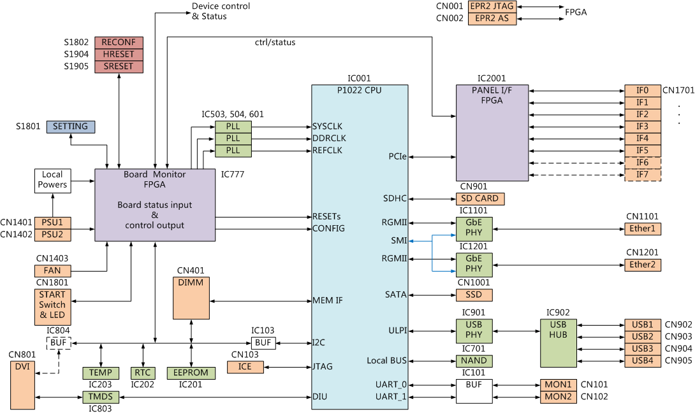
Overall block diagram (CPU board : CA-86)

Slide 4
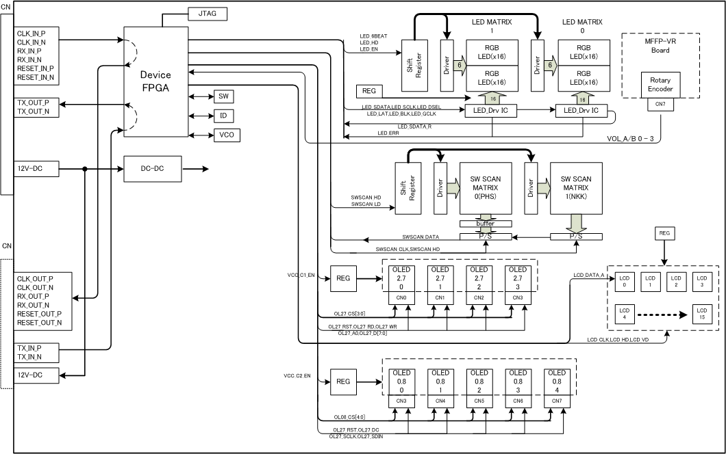
Overall block diagram(Panel Module : KY-xxx)

Slide 5
Agenda
Overall block diagram
CA-86 （CPU base board）
KY-xxx（Panel control board ）
Electrical details
Power supply design
Panel Control design
cable connection
data flow
new devices
memory devices
Menu Panel

Slide 6
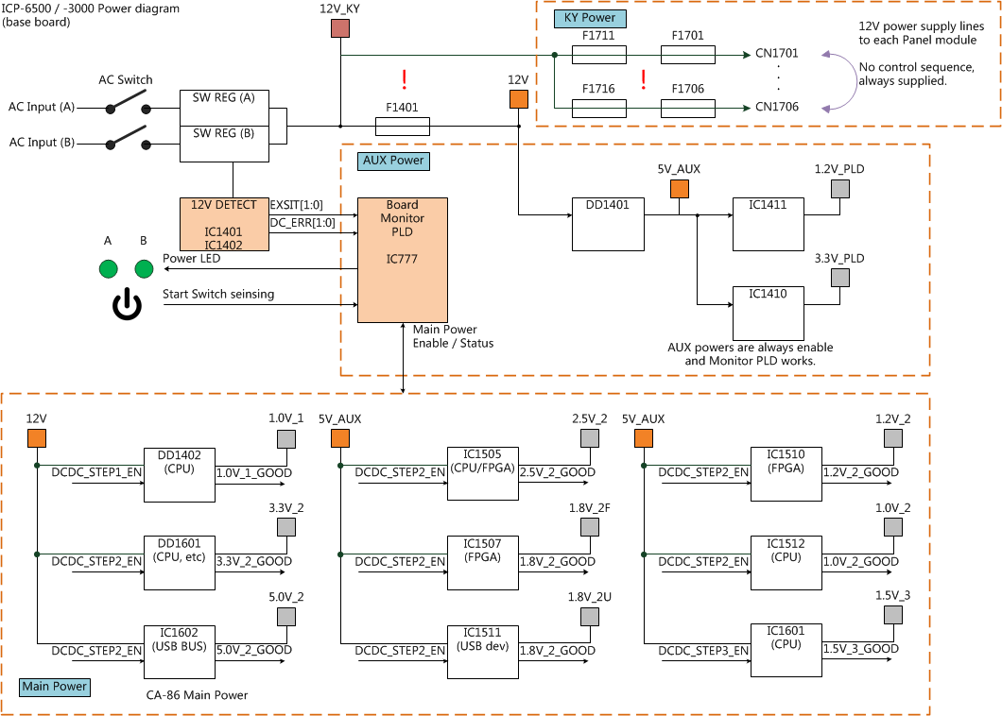
Power Diagram (CA-86)

Slide 7
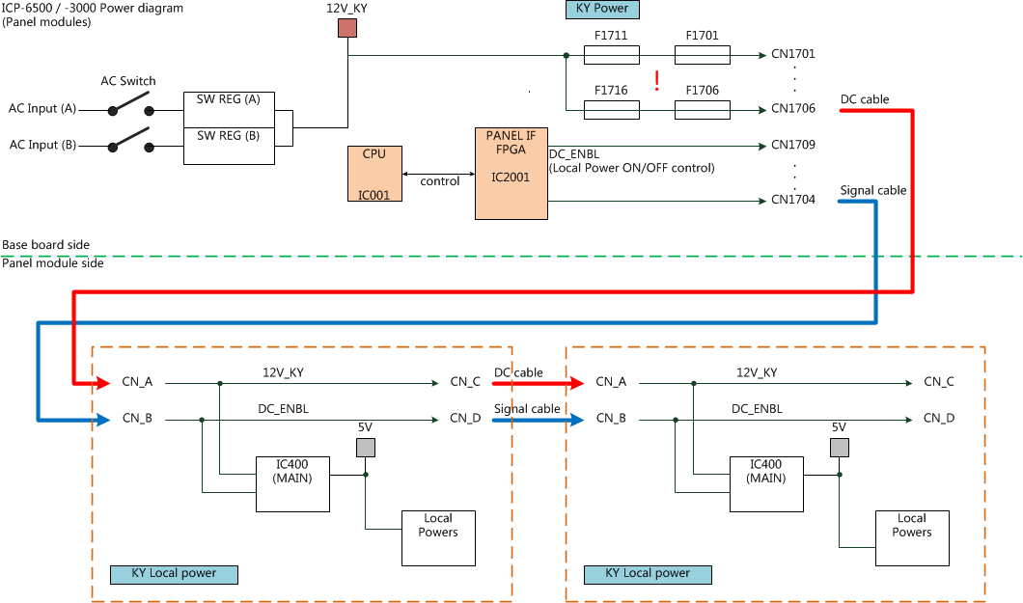
Power Diagram (KY-xxx)

Slide 8
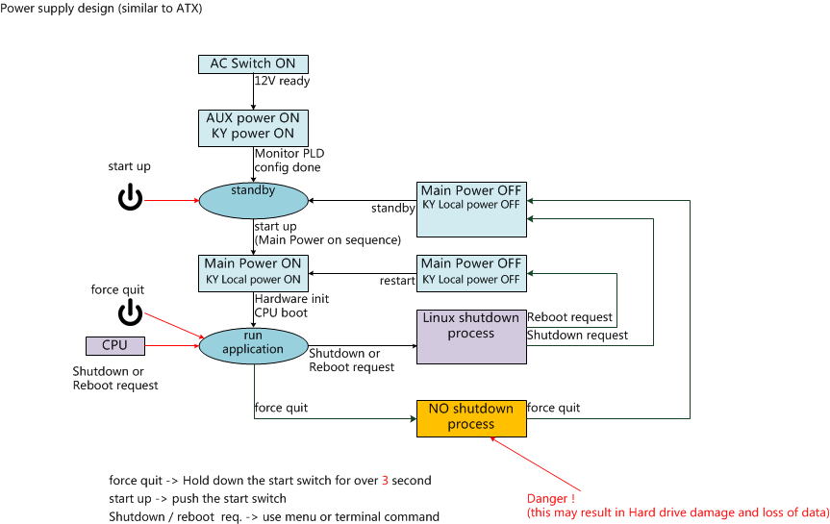
ICP Power Supply Design

Slide 9
Agenda
Overall block diagram
CA-86 （CPU base board）
KY-xxx（Panel control board ）
Electrical details
Power supply design
Panel Control design
cable connection
data flow
new devices
memory devices
Menu Panel

Slide 10
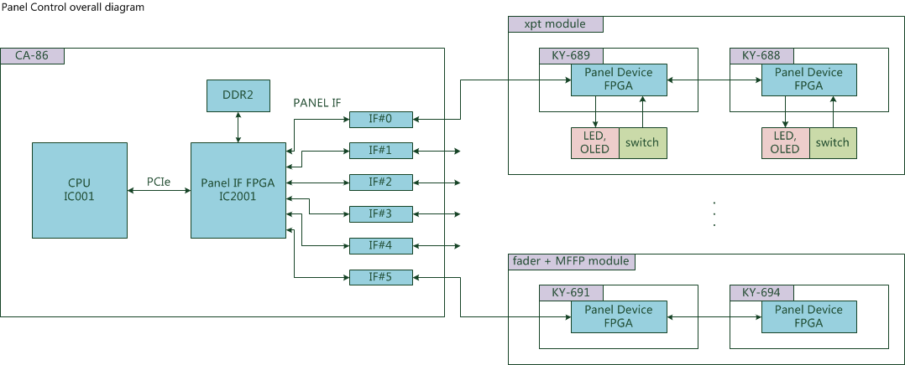
Panel Control Overall

Slide 11
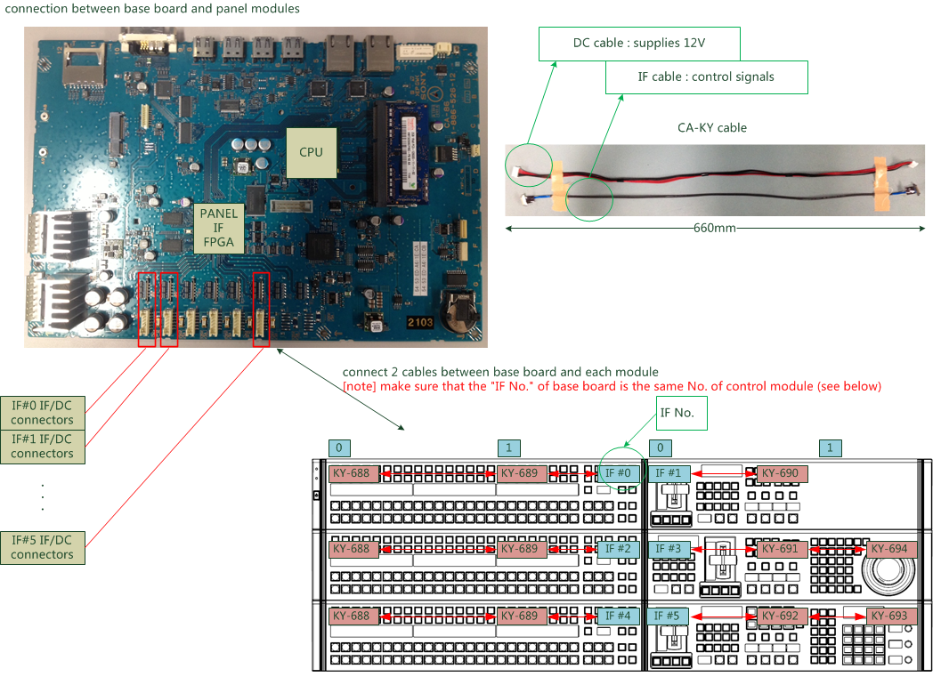
Connection b/w Base Board and Panel Module
No hot-swappable !

Slide 12
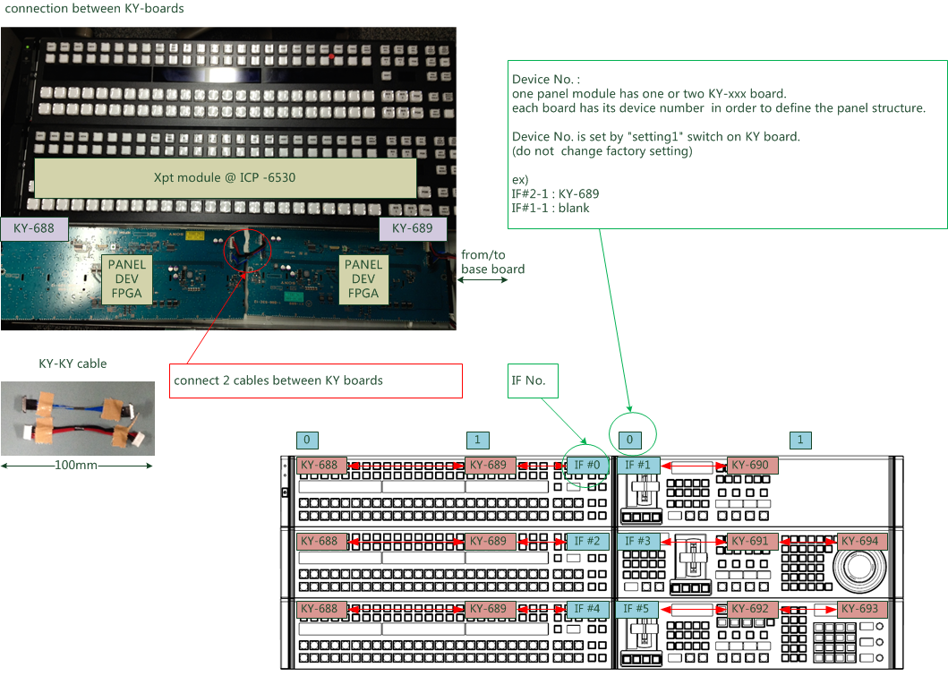
Connection b/w KY-boards

Slide 13
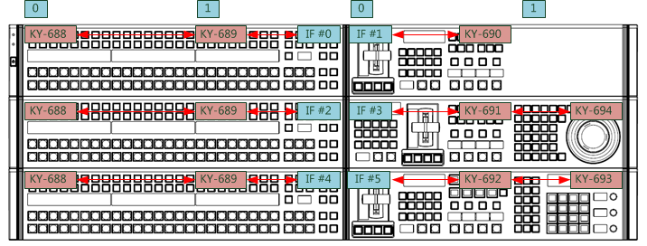
Connection Rule (ICP-6530)

Slide 14
Connection Rule (ICP-6520)

Slide 15
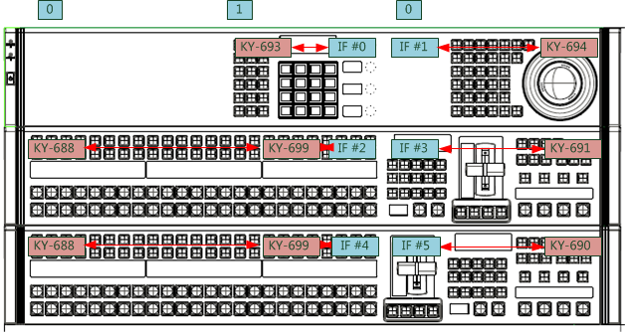
Connection Rule (ICP-3000)

Slide 16
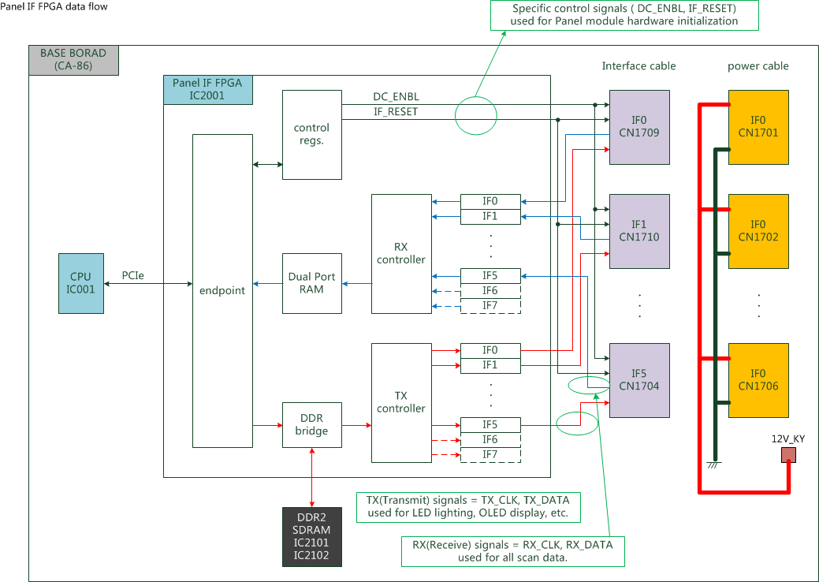
Panel I/F FPGA data flow

Slide 17
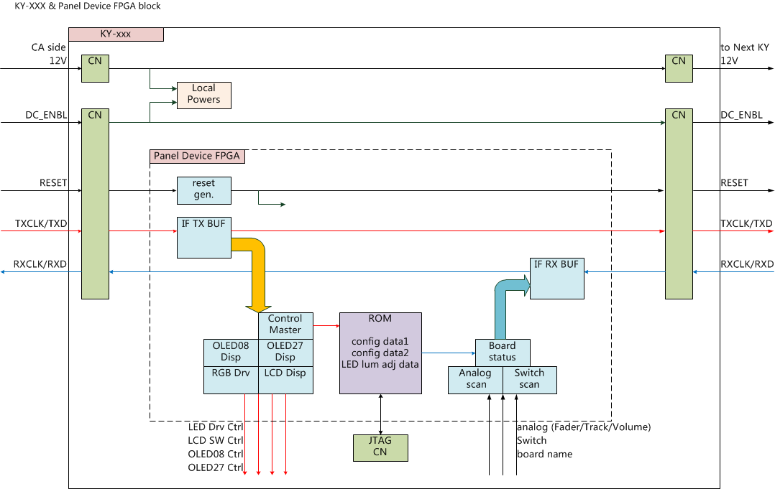
KY-xxx & Panel Device FPGA

Slide 18
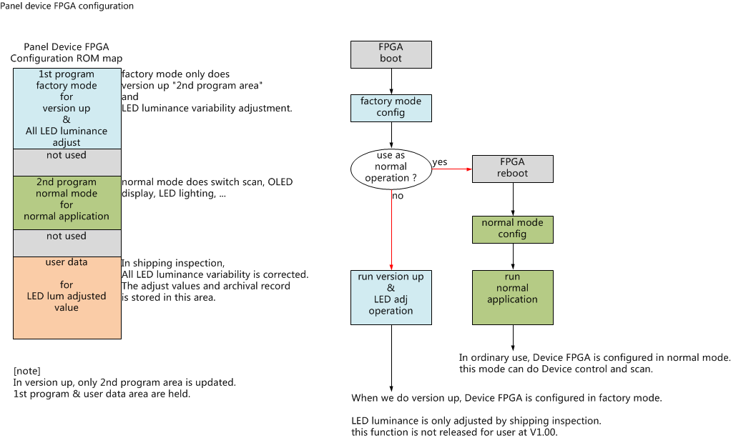
Panel device FPGA configuration

Slide 19
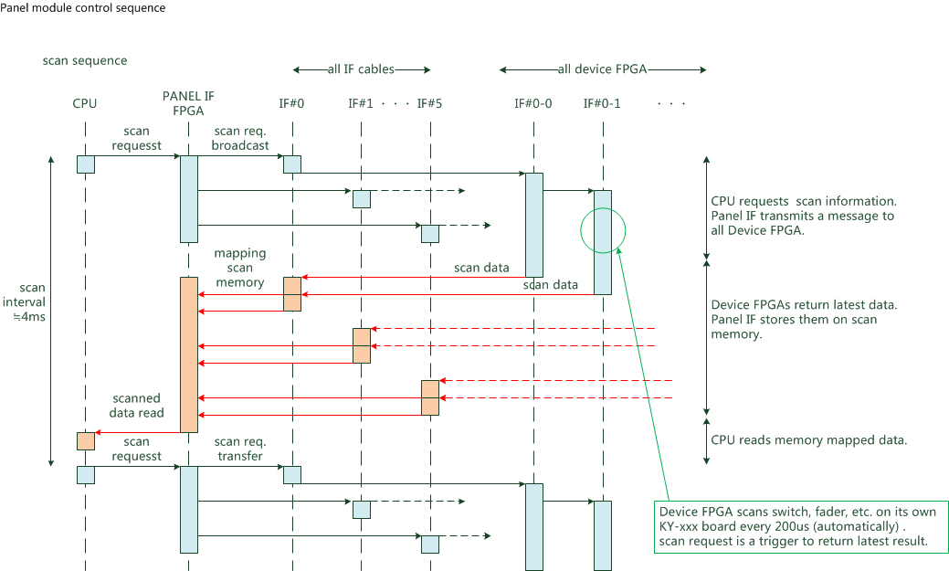
Panel module control sequence (scan)

Slide 20
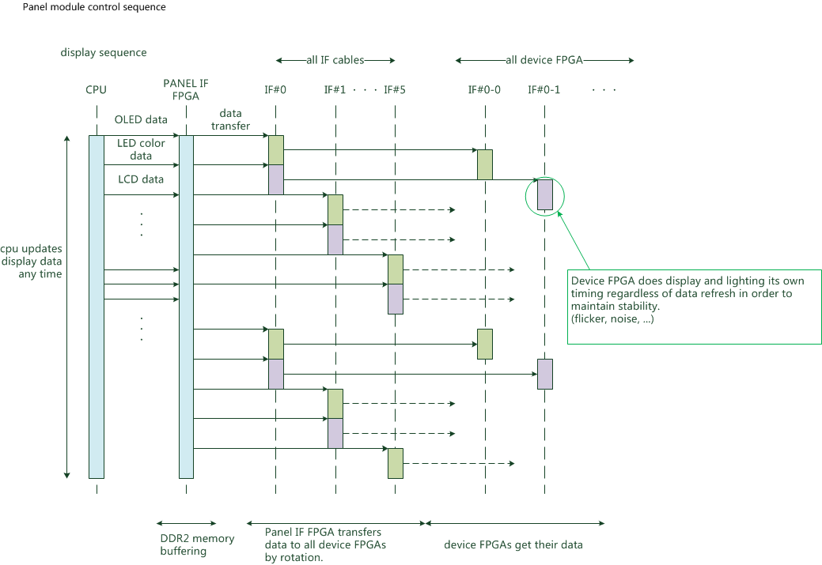
Panel module control sequence(display)

Slide 21
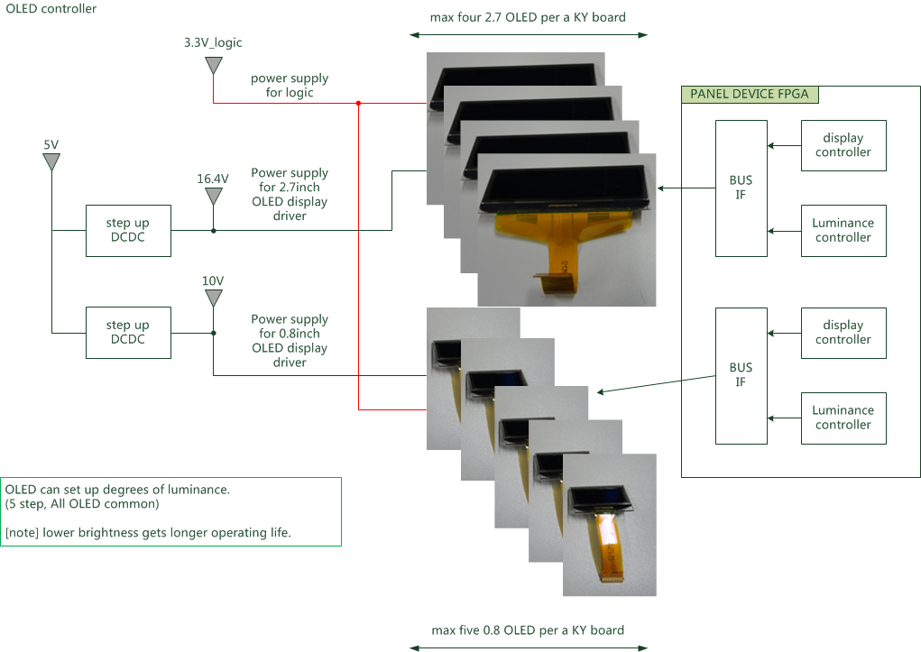
OLED Controller
high contrast

Slide 22
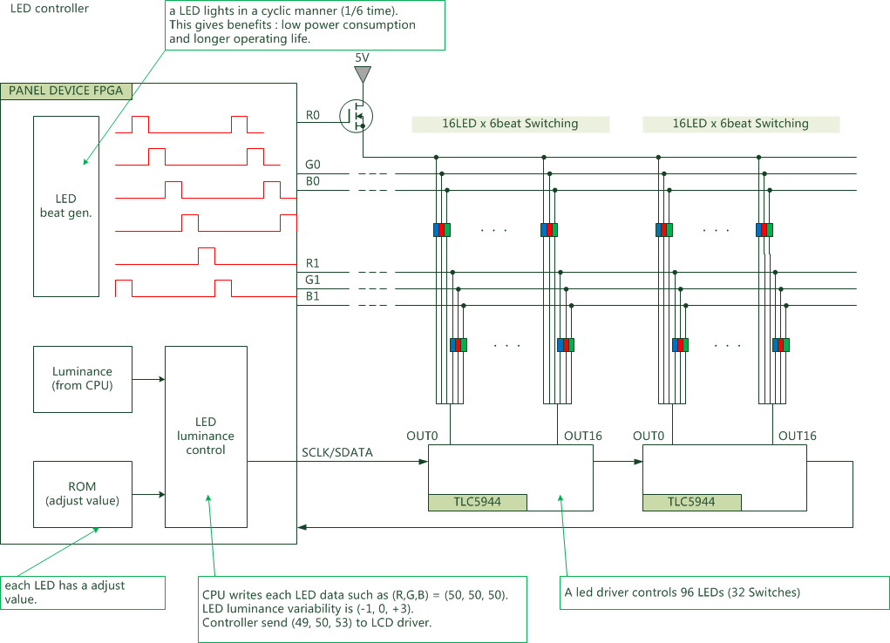
RGB LED Controller

Slide 23
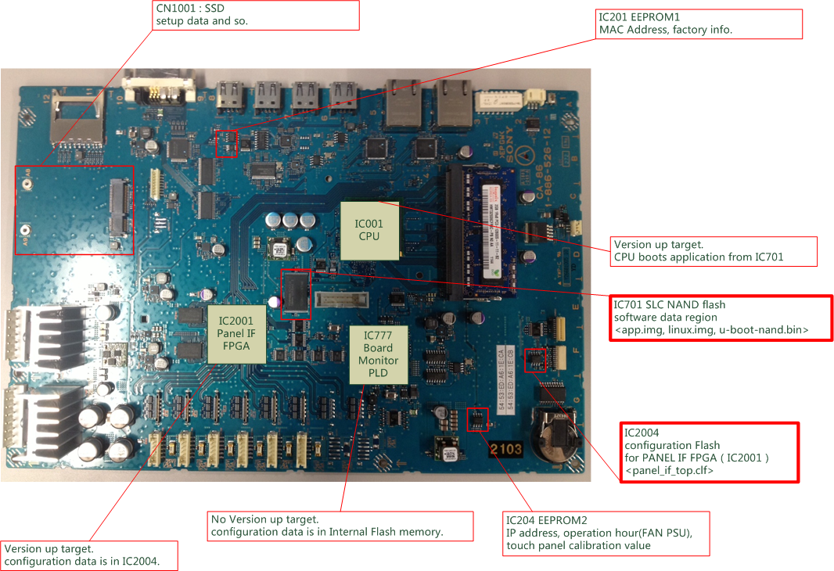
Memory devices (base board)

Slide 24
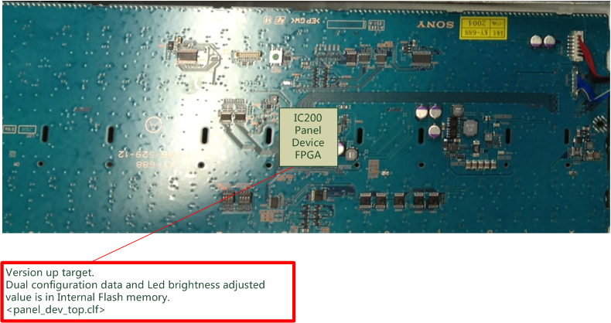
Memory devices (KY-xxx)

Slide 25
Agenda
Overall block diagram
CA-86 （CPU base board）
KY-xxx（Panel control board ）
Electrical details
Power supply design
Panel Control design
cable connection
data flow
new devices
memory devices
Menu Panel

Slide 26
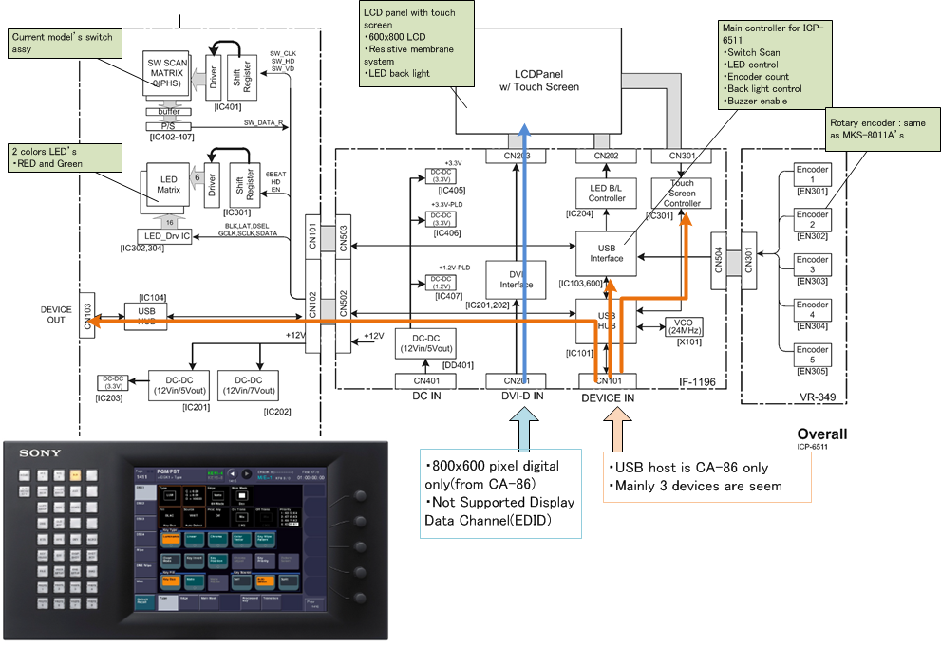
ICP-6511 Overall block diagram

Slide 27
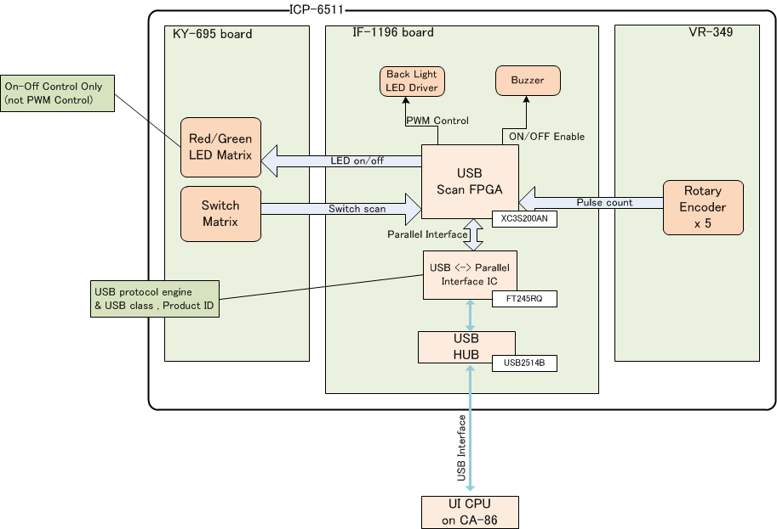
ICP-6511 Control Flow

Slide 28
ICP-6511 & Touch Monitor

