Slide 1
MVS-6520/6530/3000 メカニカルブロック
ICP Maintenance
2012.11 PSG CCS Dept.1

Slide 2
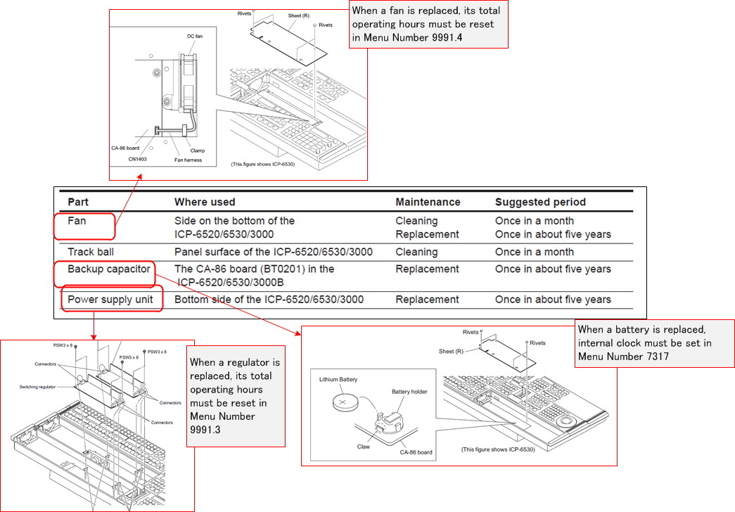
Periodic maintenance parts

Slide 3
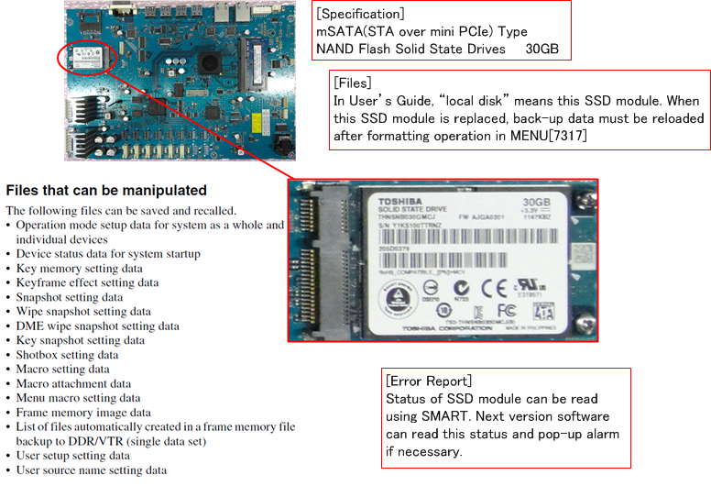
Maintenance SSD on CA-86

Slide 4
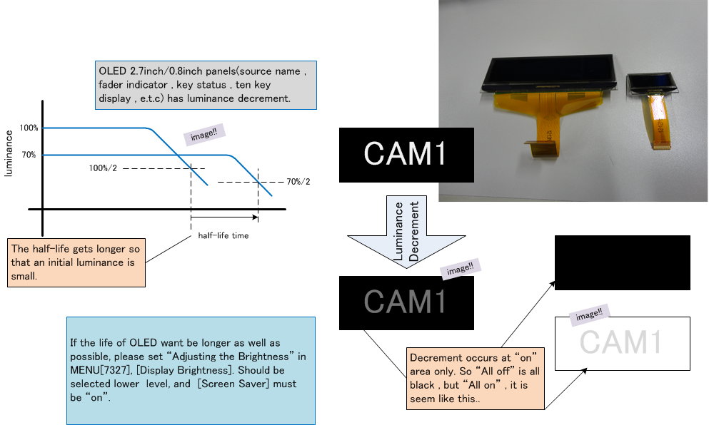
OLED Deterioration

Slide 5
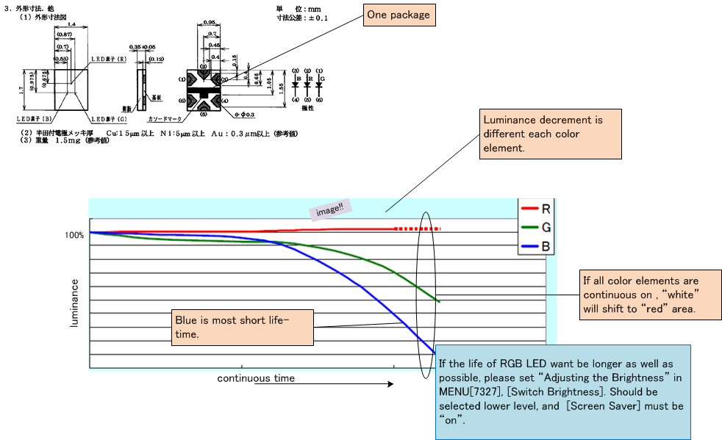
RGB LED Deterioration

