Slide 1
MVS-6520/6530/3000ニカルブロック
ICP Panel Troubleshooting
2012.11 PSG CCS Dept.1

Slide 2
Possible Trouble (boot sequence)
A problem that we faced during development.
check points to identify a factor.
This order corresponds to sequence of panel behavior.
Identified causes
No. | Symptoms | Check Points | Causes （Countermeasures）
1 | Panel application does not run | 1. AC Switches (Power LED A, B) 2. cable to start switch 3. connection b/w DIMM and CPU 4. status LEDs on CA-86 5. 232C terminal log | ・AC switches are turned off ・cable connection ・Local powers ・FPGA configuration ・flash data destruction ・CPU hangs up

Slide 3
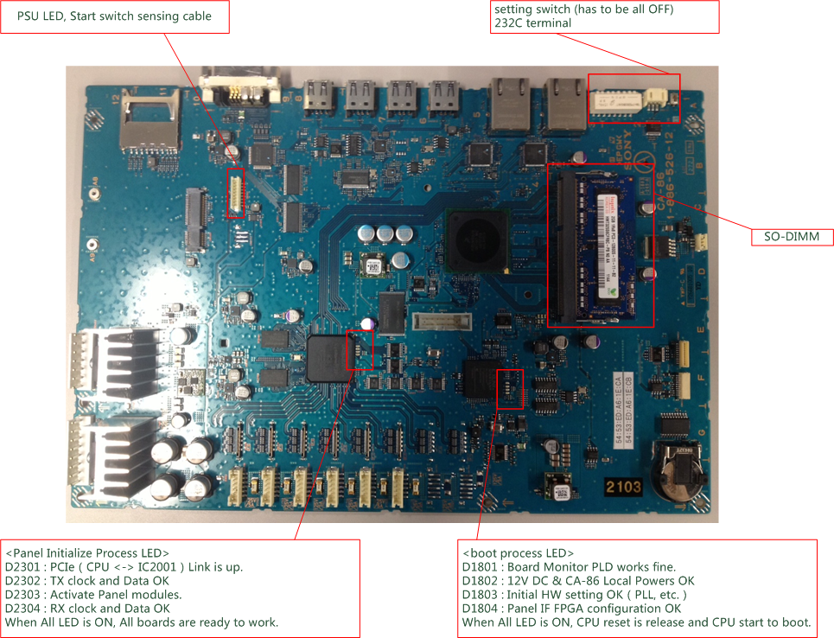
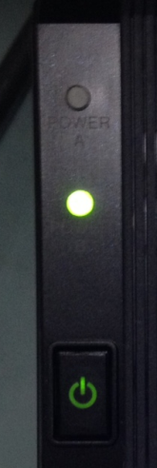
CA-86 boot sequence check

Slide 4
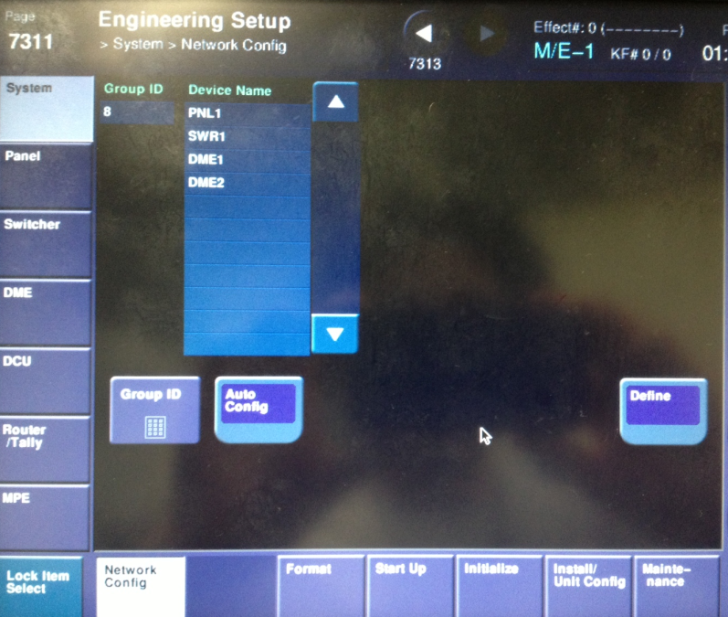
Possible Trouble (Ethernet)
No. | Symptoms | Check Points | Causes （Countermeasures）
1 | Ethernet connection | 1. Link / Act LED 2. connect directly to MVS (if using HUB) 3. reset Group ID | ・cable or HUB ・CA-86 board problem (PHY) ・IP address mismatch
[note] Reset and redefinition of group ID
reconfigure IP address of ICP.

Slide 5
Possible Trouble (display devices)
No. | Symptoms | Check Points | Causes （Countermeasures）
1 | All or Almost OLED and LED remain in blank. | 1. Ethernet connection 2. status LEDs on CA-86 | ・Ethernet connection ・PANEL IF or Device FPGA
2 | Some OLED and LED remain in blank | 1. All or A part of one module？ 2. CA-KY cable connection | ・bad cable connection ・Device FPGA
3 | An OLED remains in blank or is noisy. | 1. FPC connection | ・bad connection ・bad device
4 | A LED remains in black | --- | ・bad device ・initialization failure
5 | A LED color is different from others. | 1. Reboot Panel | ・bad device (maybe EOL) ・initialization failure

Slide 6
Possible Trouble (scan devices)
No. | Symptoms | Check Points | Causes （Countermeasures）
1 | No switch response | 1. Identify area. 2. Reboot panel | 1. Mechanical problem 2. Photo sensor 3. FPGA
2 | XPT is switching without operation. | --- | ---
3 | No smooth transition with fader operation | 1. Stop other operations (ex. USB file save) | 1. CPU is busy

Slide 7
Possible Trouble (version up)
No. | Symptoms | Check Points | Causes （Countermeasures）
1 | Unsuccessful version up or data destruction | ・what type of data --- soft (u-boot, Linux, application) --- FPGA(Panel I/F, Panel Device) | ---
Try again until the package is successfully installed without turning power OFF.
< in the case of destruction of data >
u-boot : impossible to recover by usual operation -> need factory inspection
（Low-potential because this area is read only）
Linux / application : turn off / on AC switch, and recover software runs.
PANEL IF FPGA : impossible to recover by usual operation
（replace IC2004 with new parts 6-720-361-01）
PANEL DEVICE : turn off / on AC switch, and try again.

Slide 8
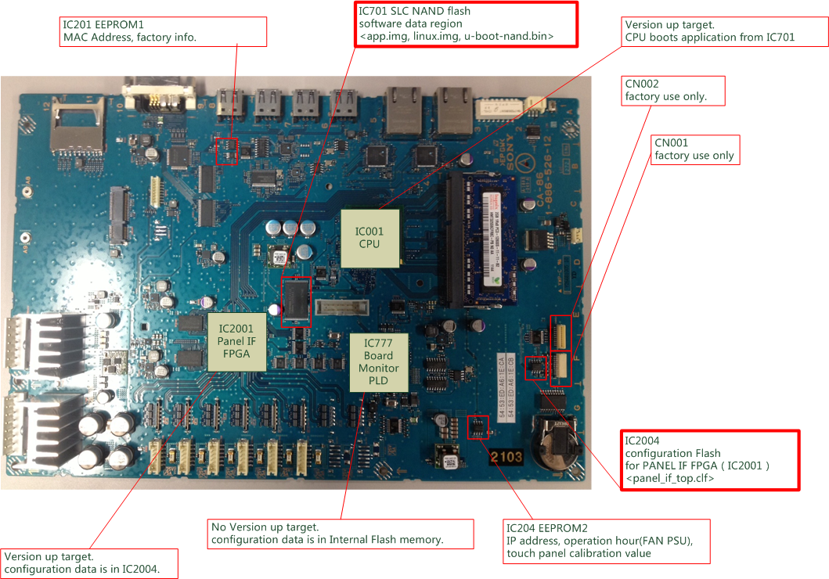
memory devices (CA-86)

Slide 9
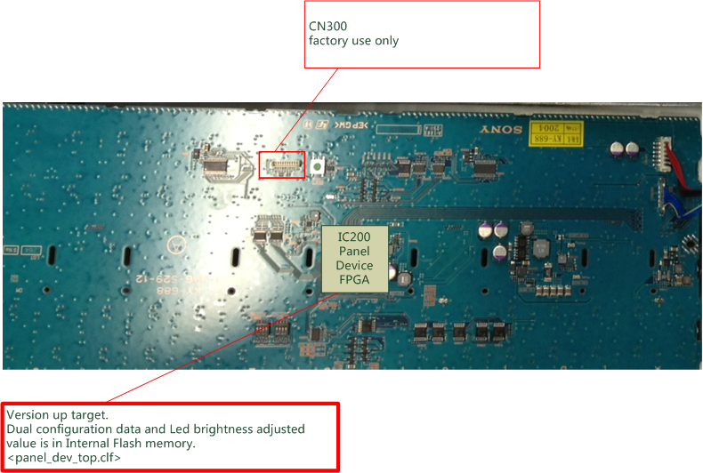
memory devices (KY-xxx)

Slide 10
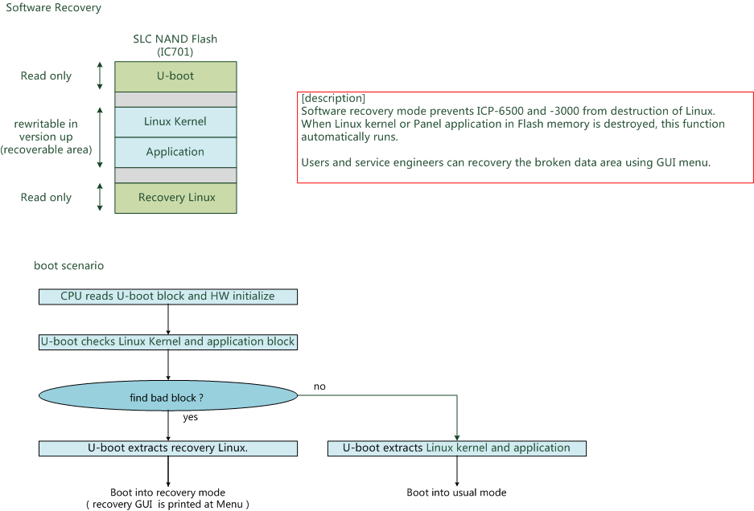
recover software

Slide 11
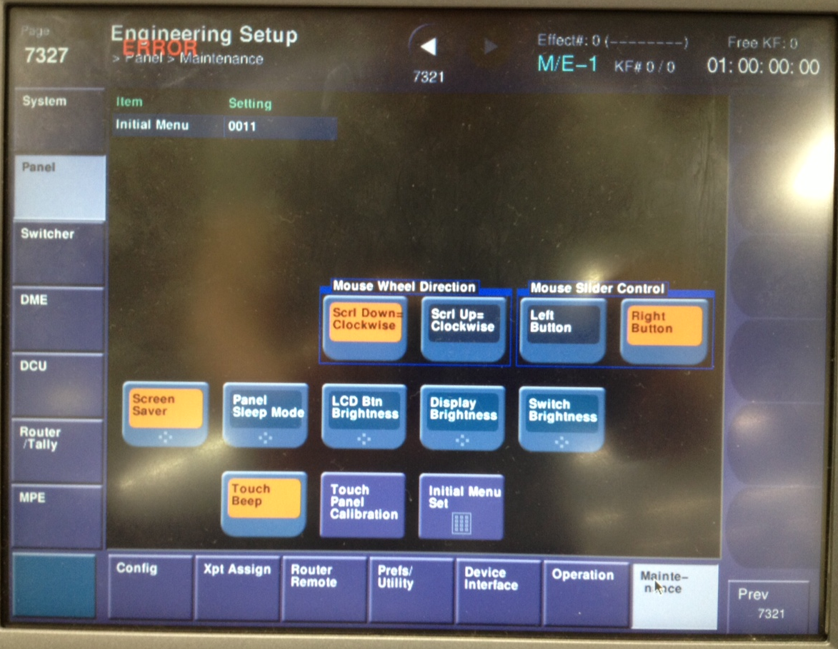
Possible Trouble (others)
No. | Symptoms | Check Points | Causes （Countermeasures）
12 | LED or OLED is too bright. | 1. Brightness setting | ---
<brightness setting>
we recommend to set lower brightness for long service life.
<panel sleep mode>
After a certain period of latest operation, ICP panel goes to the lowest brightness(1).

