Slide 1
MVS-6520/6530/3000 メカニカルブロック
Processor Comparison
2012.11 PSG CCS D1 Dept

Slide 2
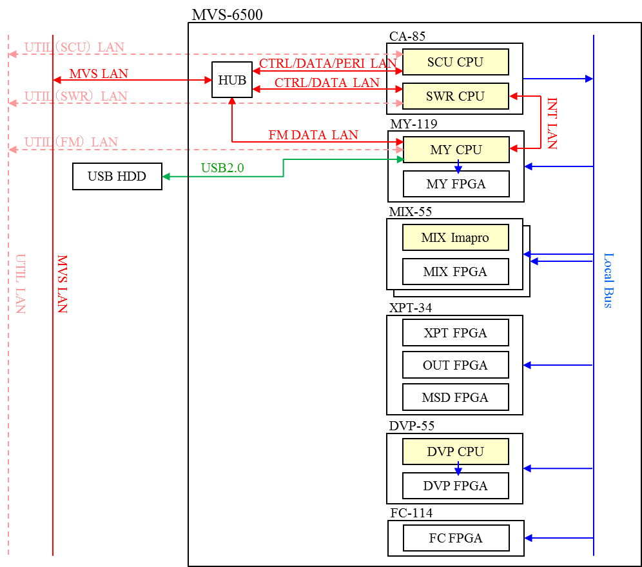
Design Differences from the existing models
Control system of the Processor
The control by multiple CPU modules is abolished. Instead, two CPU-DPs controls each video board.
The CPU-DP module each is mounted only on the CA-85 and MY-119 boards.
The DVP CPU on the DVP board means the PowerPC(PPC440) inside the Xilinx Virtex5FXT FPGA and processes only the Non-linear Effect of the Wave and the Ripple etc.
Relation between each board and CPU modules

Slide 3
Design Differences from the existing models
SCU/DCU Control Method
The CPU (CPU-DP) for the processor and the CPU (P1022) for the SCU/DCU are mounted on the CA-85 board in the processor.
By mounting the SCU/DCU block in the processor, the basic function (GPI IN/OUT, TALLY, Device Control, S-BUS) is available even without connecting the external SCU and the DCU
By doing this, the MVS-6500/3000 can directly connect to the ICP-6500/3000 with one Network and establish the minimum system.
MVS-6000
Control system
MVS-6500/3000
Control system

Slide 4
Design Differences from the existing models
Control system of peripheral devices
The control of the peripheral devices was realized by the combination of the processor, SCU and DCU. For MVS-6500/3000, it realizes by only the processor.
The existing GPI OUT uses the Open Collector and relay outputs. MVS-6500/3000 uses only the Open Collector output.
 | MVS-6500/3000 | MVS-6000（PROC） | MKS-8010B（SCU） | MKS-2700 （DCU）
RS-422 | Remote x 4 Serial Tally x1 Swer Remote x2 | Remote x 4 (Editor/AUX/DME） | EDITOR x 1 (PIE Panel/ Serial Tally） | Remote x 6 （P-BUS, VTR, DDR, Mixer）
GPI | GPI OUT x 48 GPI IN x 18 （Tally/Control） | GPI IN x 8 GPI OUT x 8 （Swer Control） | ---- | GPI OUT x36 GPI IN x34 （Tally / Control）
S-BUS | x1 | ---- | x1 | -----
External I/O

Slide 5
Design Differences from the existing models
Notes on the silk-less printing on a board
The reference numbers are not printed for small components (registers, condensers etc.) on a board.
For the reference numbers of small electric parts, refer to the section of the circuit board in the Maintenance Manual.
Example of the silk printing
(Existing model)
Example of the silk-less printing
(MVS-6500/3000)

Slide 6
Design Differences from the existing models
Downsizing the board size
Compared to the size 317x310mm of front board for MVS-6000, the depth is shorten 73 to 121 mm.
Board | Function | Board Size
MIX-55 | Mix/Effects(2M/E) | 317x237mm
DVP-55 | Digital Multi Effects | 317x189mm
XPT-34(A) | XPT & OUT & MSD | 317x237mm
FC-114 | Format Converter | 317x237mm
MY-119(A) | Frame Memory | 317x237mm
CA-85 | CPU(Proc/SCU/DCU) | 317x237mm
CNI-39 | SDI Input | 278x121mm
CNO-39 | SDI Output | 278x121mm
CN-3537 | Device Control | 278x121mm
CN-3536 | TALLY/GPI/USB | 278x121mm
CN-3535 | Interface | 278x121mm
MB-1196(A) | Mother Board | 428x168.6mm
HN-401 | FAN | 110x23mm

Slide 7
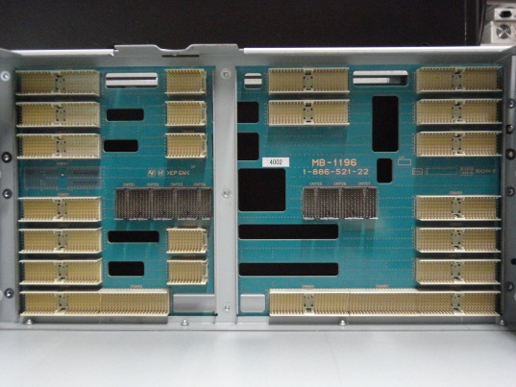
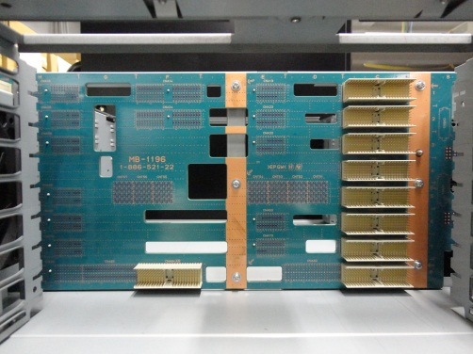
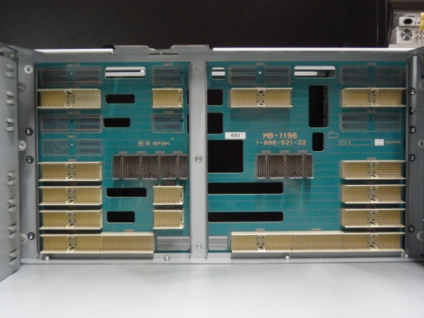
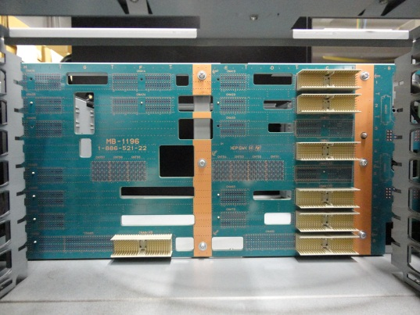
Differences and Similarities between three models
MB-1196/MB-1196A
The connectors for the front and rear boards are deleted for the MB-1196.
The connectors of MIX-55 board at the front side (top slot) are deleted.
→ Therefore, it become the 2M/E configuration
The connectors for the rear CNI-39 and CNO-39 boards are deleted.
→ Therefore, it became the 32 Input and 16 Output configuration.
Front Side
Rear Side
MVS-6520/6530
(MB-1196)
MVS-3000
(MB-1196A)

Slide 8
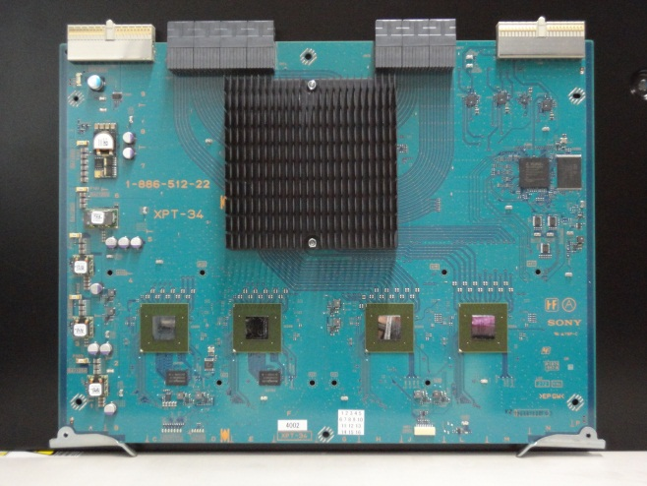
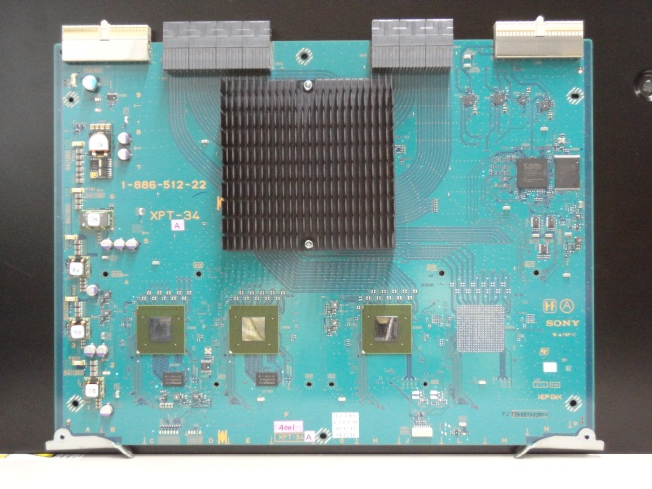
Differences and Similarities between three models
XPT-34/XPT-34A
The FPGA is deleted for the XPT-34A.
One of two OUT-FPGAs is deleted.
→ The configuration is changed from the 24 OUT to the 12 OUT.
MVS-6520/6530
(XPT-34)
MVS-3000
(XPT-34A)

Slide 9
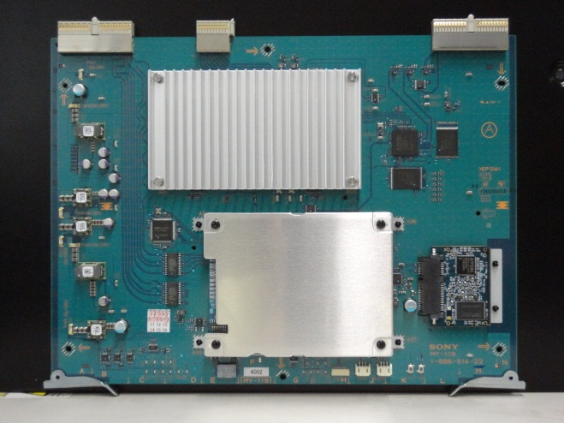
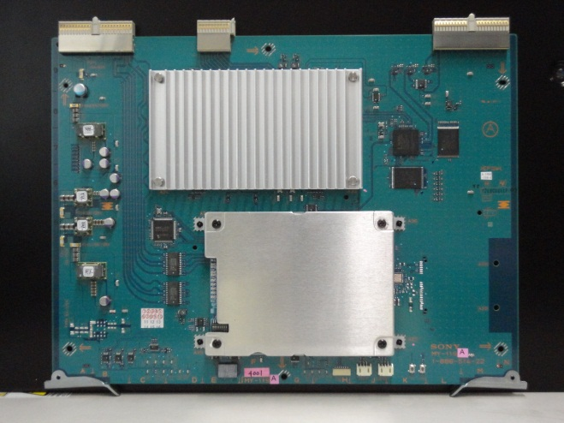
Differences and Similarities between three models
MY-119/MY-119A
The SSD and the SSD peripheral circuit is deleted for the XPT-34A.
Deletes SSD, Bridge IC and Connector
→ The Non-volatile Memory of the future function is not supported.
削除
MVS-6520/6530
(MY-119)
MVS-3000
(MY-119A)

