Slide 1
MVS-6520/6530/3000 メカニカルブロック
Mechanical Block
2012.11 PSG CCS MD Dept

Slide 2
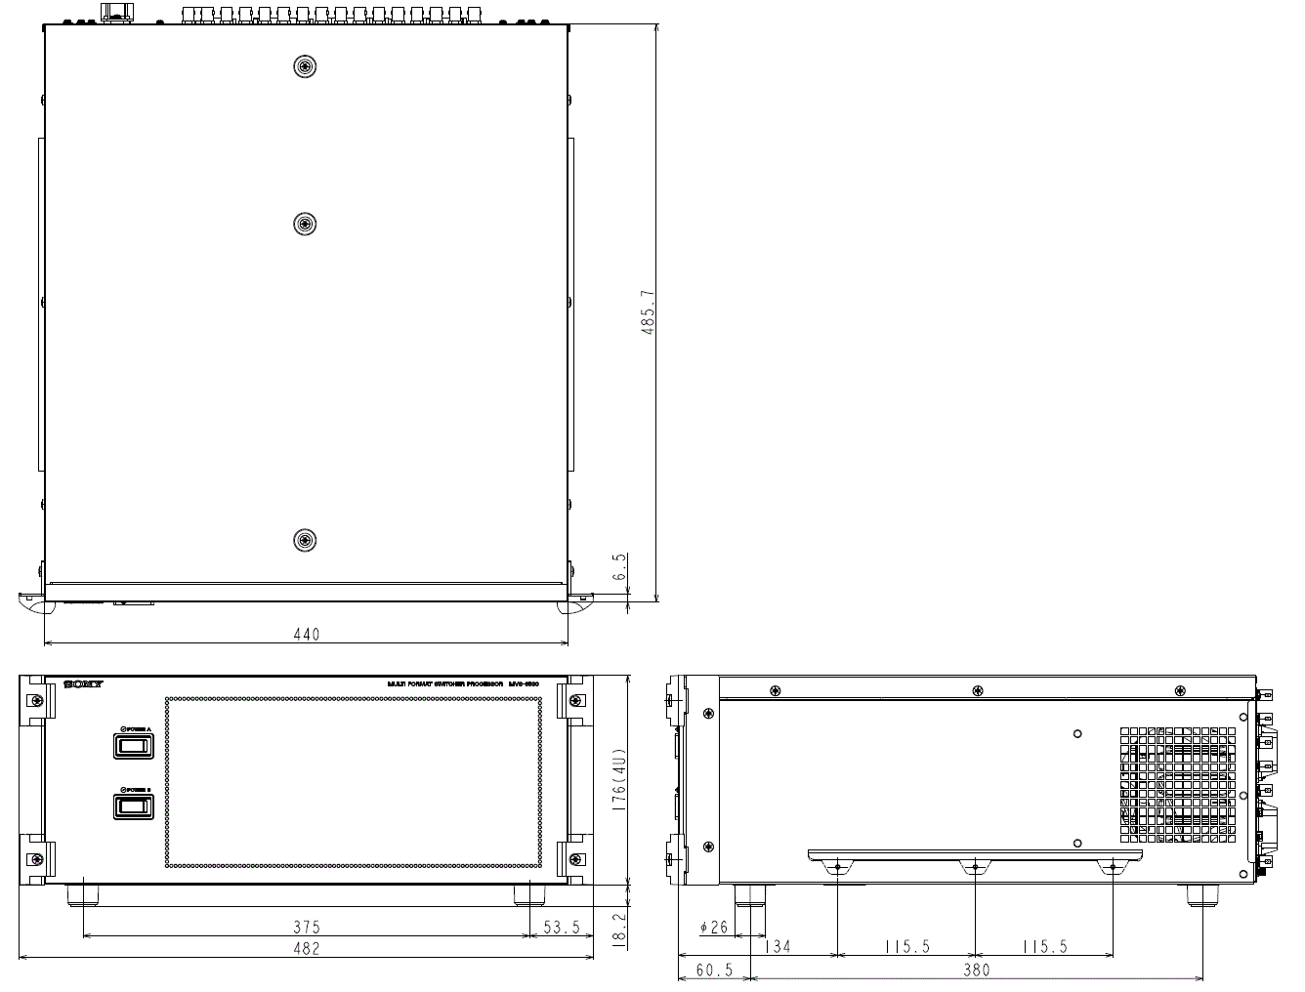
Overview
Size
Compared to MVS-6000, the wide is same and the depth is shorten.
(Dimension: 440W x 485.7D x 443H) (520D for MVS-6000)

Slide 3
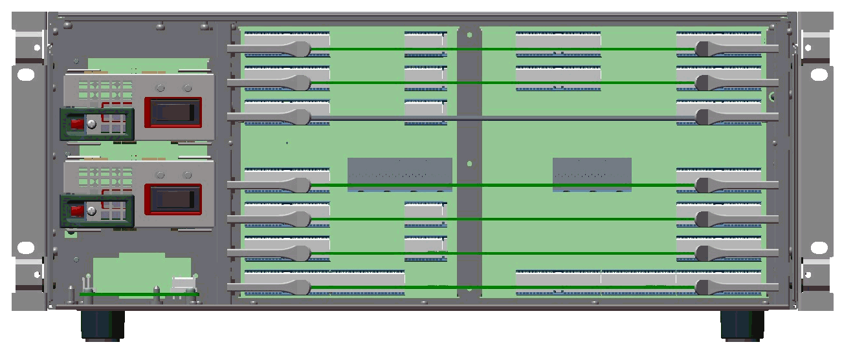
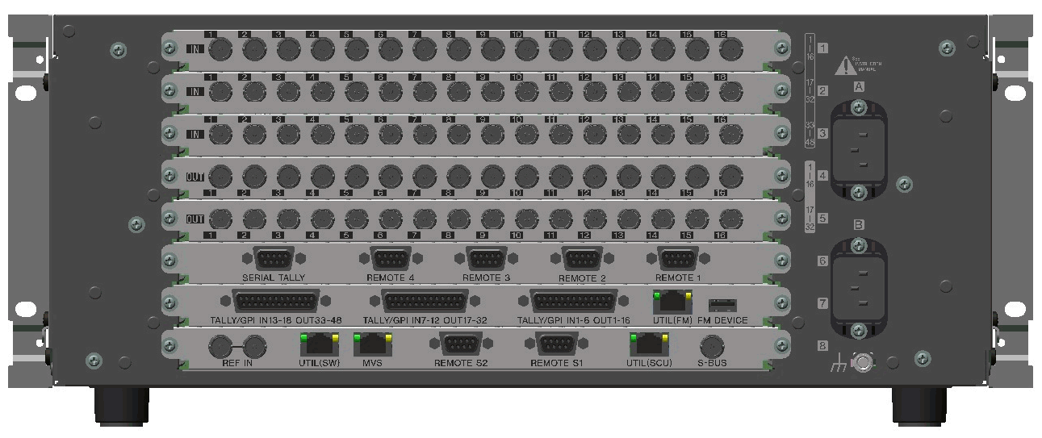
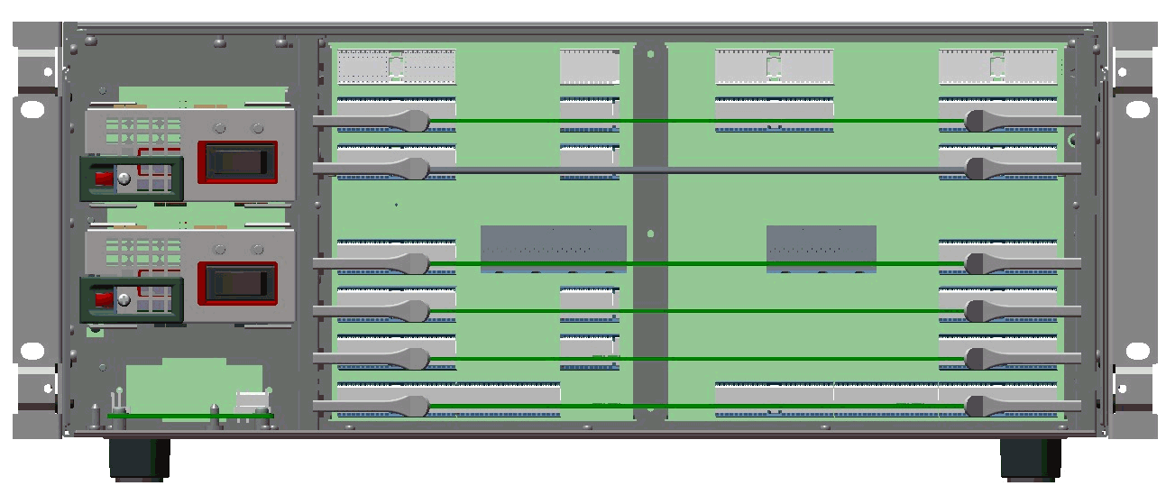
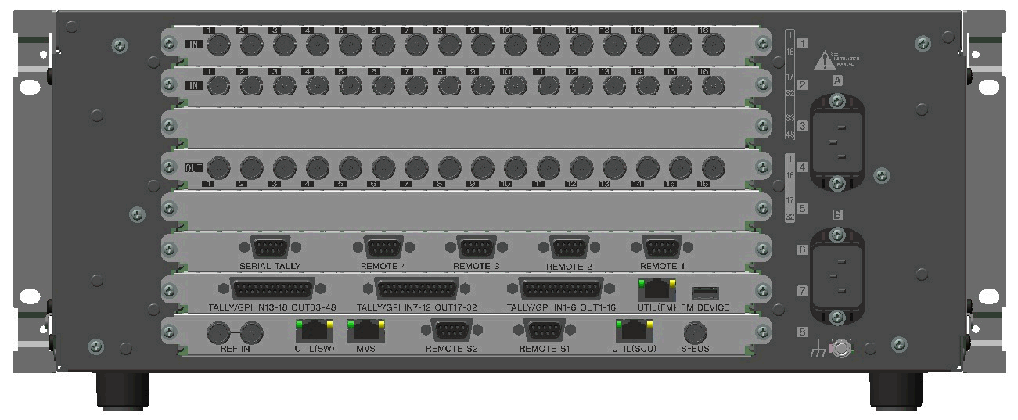
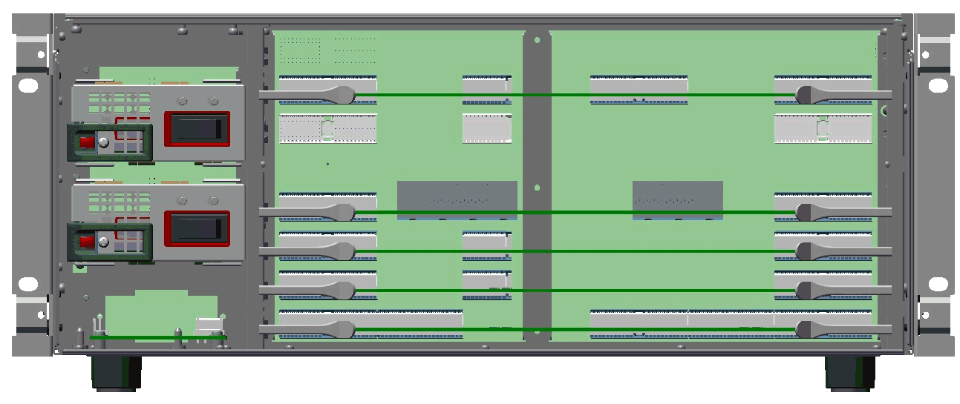
Overview
Board layout
MVS-6530
MIX-55
MIX-55
DVP-55(MKS-6570)
MB-1196
XPT-34
FC-114(MKS-6550)
MY-119
CA-85
CNI-39
CNI-39
CNI-39
CNO-39
CNO-39
CN-3537B
CN-3536
CN-3535
3ME
48 Input
32 Output
DME
FMEM
FC
MVS-6520
MIX-55
DVP-55(MKS-6570)
MB-1196
XPT-34
FC-114 (MKS-6550)
MY-119
CA-85
CNI-39
CNI-39
-
CNO-39
-
CN-3537A
CN-3536
CN-3535
2ME
32 Input
16 Output
DME
FMEM
FC
MVS-3000
MIX-55
MB-1196A
XPT-34A
FC-114(MKS-6550)
MY-119A
CA-85
CNI-39
CNI-39
-
CNO-39
-
CN-3537
CN-3536
CN-3535
2ME
32 Input
16 Output
FMEM
FC
Notes:
各機種の基板構成です。

Slide 4
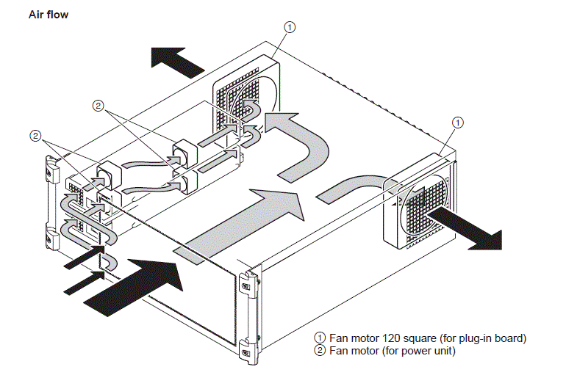
Overview
Mechanical Structure
The front air intake and the rear air exhaust are the same as MVS-6000.
The fan motor 120 square（for plug-in board）and fan motor (for power supply unit) is air-cooled.
When the air exhausts on both sides and the air intake at the front are occupied or the fan stops, this may be the cause of the trouble of the power supply unit etc.
Therefore, leave a space of more than 10 cm on the sides of the unit and at the front of the unit.

Slide 5
Service Tools
The following tools are provided for MVS-6520/6530/3000.
Name | Part Number | Use
Extension board EX-1235 | A-1874-359-A | For extending the plug-in board
Extension board EX-1236 | A-1874-360-A | For extending the plug-in board

Slide 6
How To
- Removal of Front Door Assembly
- Removal/Installation of Plug-in Board
- Removal/Installation of Connector Board
- Replacement of Power Supply Unit
- Replacement of Fan
- Rack Mounting
- How to extend Plug-in Board
- Replacement of SSD Board
- Replacement of CPU-DP Module
*Note
Before replacement, be sure to turn OFF and plug out all the power cords.

Slide 7
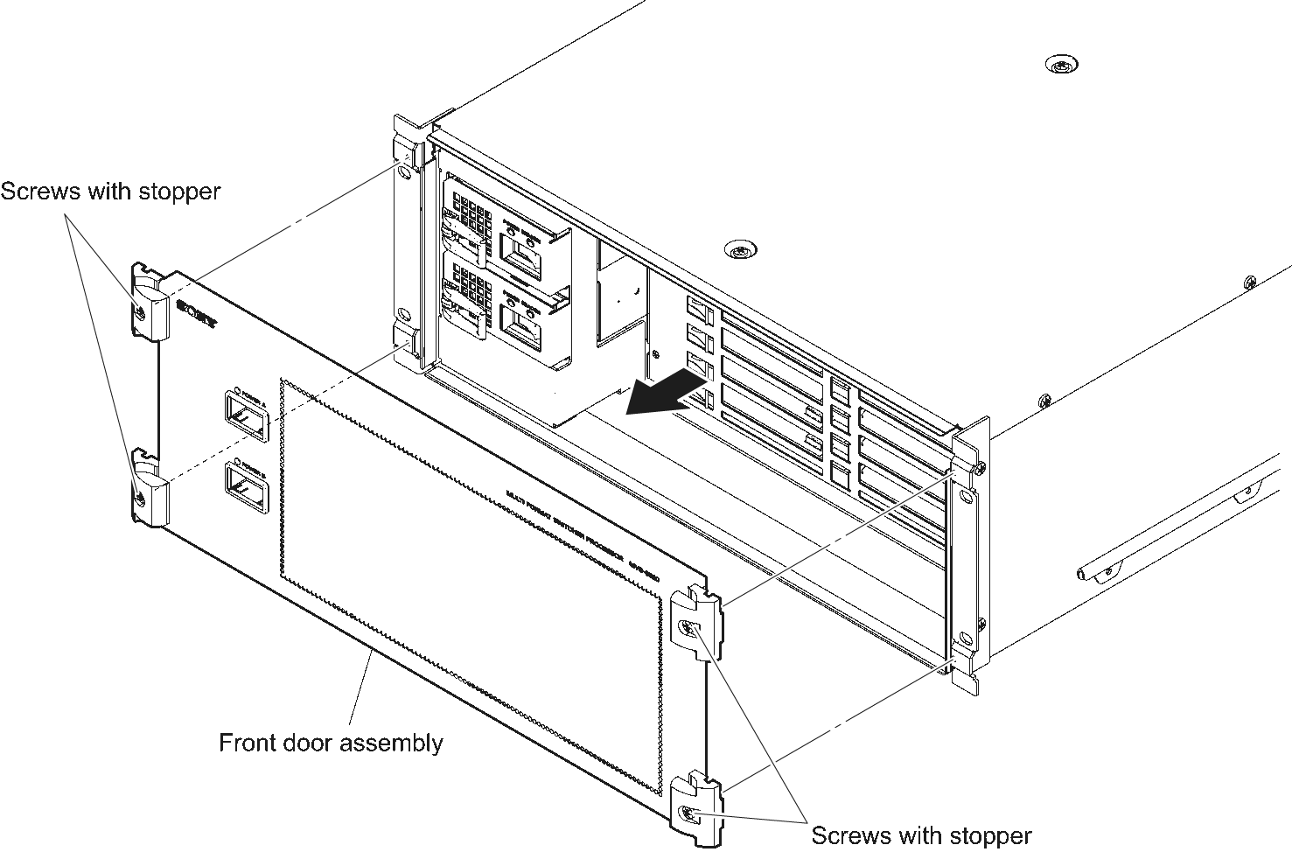
Removal of Front Door Assembly
Removal of Front Door Assembly (DOOR ASSY,FRONT)
Loosen the four screws with stopper to detach the front door assembly in the arrow direction.

Slide 8
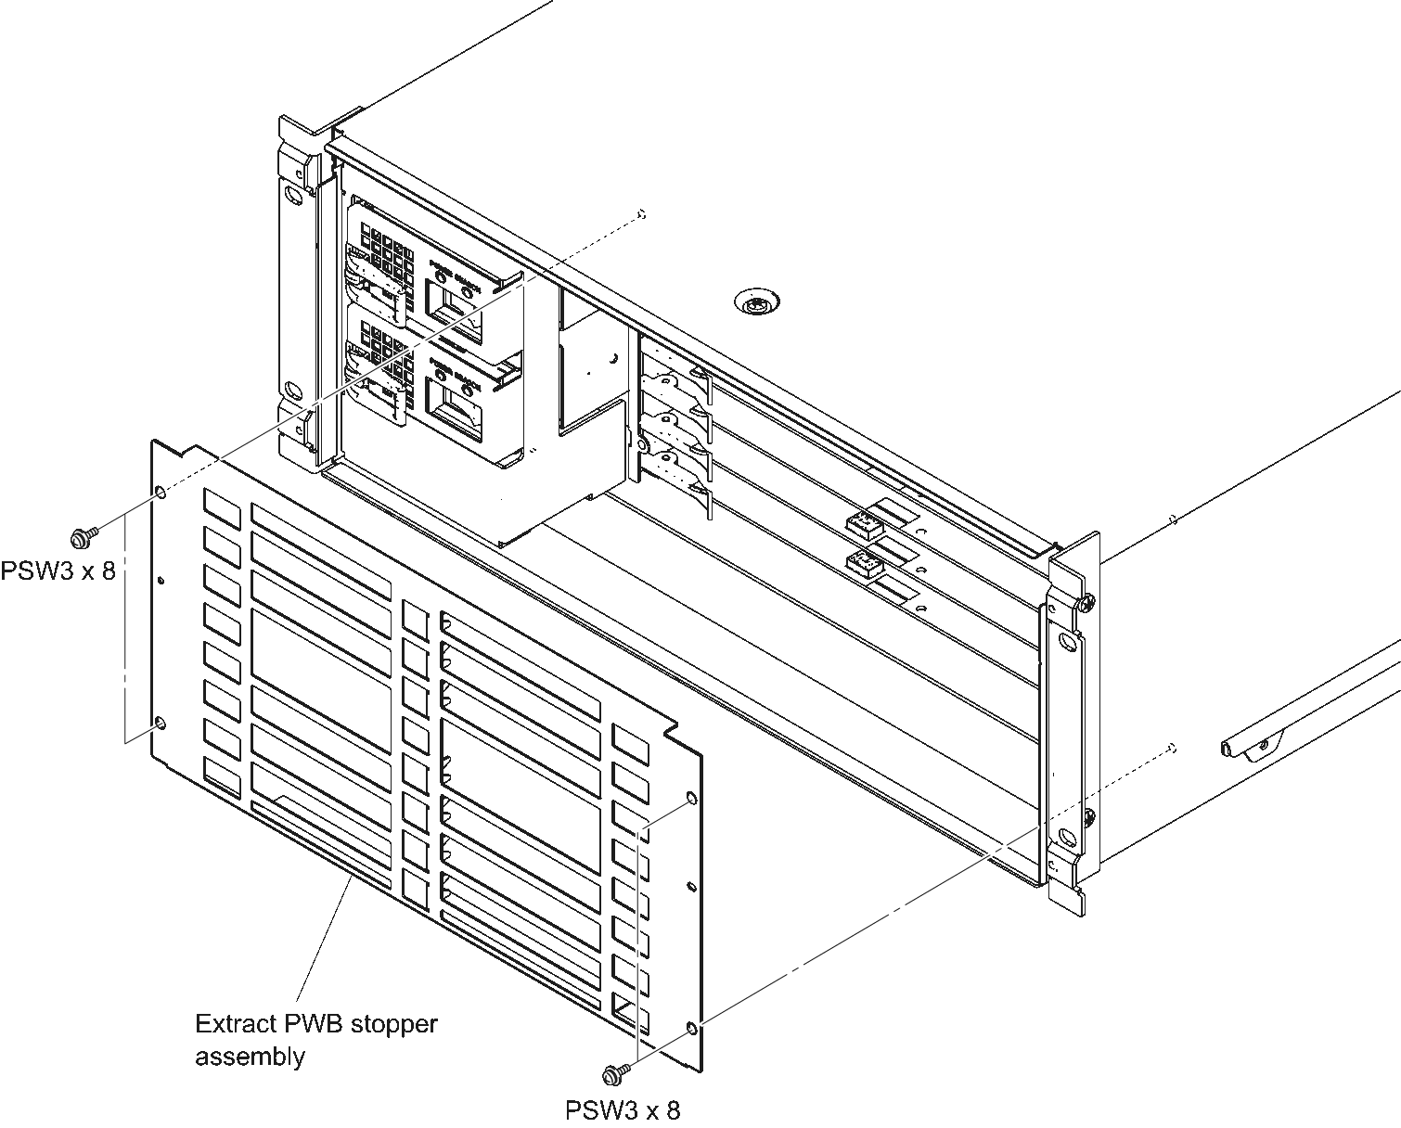
Removal of Front Door Assembly
Removal of the PC board bracket Assembly (BRACKET ASSY, PC BOARD).
Remove the four screws (PSW3 x 8）to detach the Extract PWB Stopper Assembly.

Slide 9
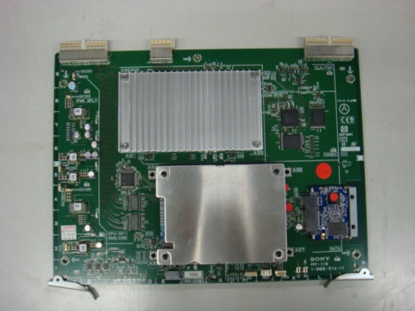
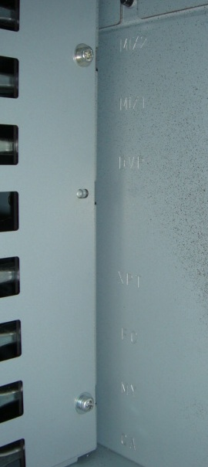
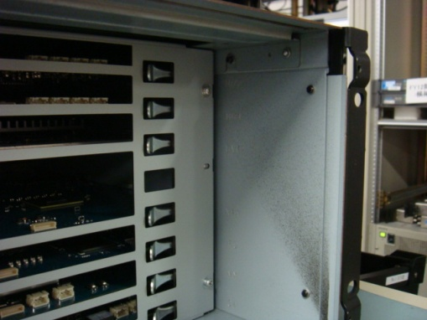
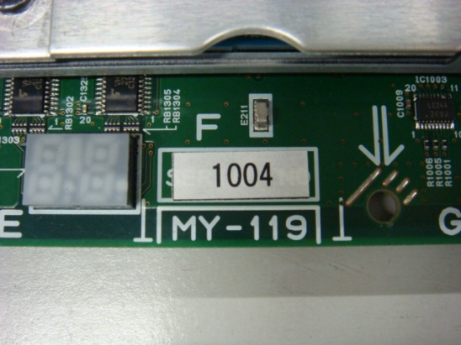
Removal/Installation of Plug-in Board
Note
In MVS-6520/6530/3000, the slot for installing each plug-in board is specified.
Install each board in the specified slot correctly according the indications as described in 1 and 2 below.
1. The board is indicated close to the left-of-center of each plug-in board.
2. The board name is indicated on the right surface of the inside of front panel of MVS-6520/6530/3000.
The heat sink on removed the plug-in board may be hot. Be careful not to burn yourself.

Slide 10
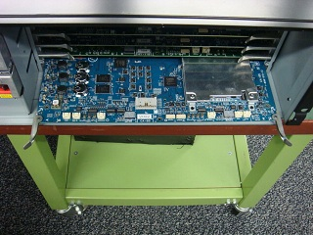
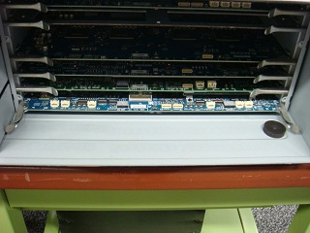
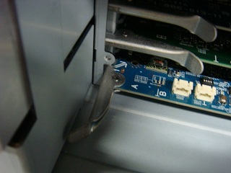
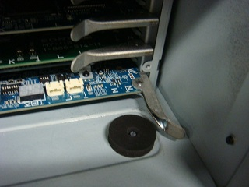
Removal/Installation of Plug-in Board
Installation
Open the eject levers and insert the plug-in board into the board guide rails.
Insert the eject levers into the rail plates until hitting on.
Close the eject levers in the direction of arrow ① and insert the plug-in board.
Removal
Remove the plug-in board by reversing the steps of installation.
①
①

Slide 11
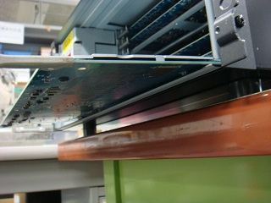
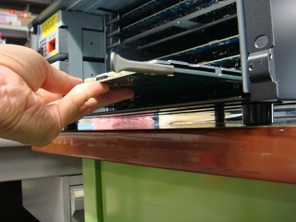
Removal/Installation of Plug-in Board
*Note
There is no shield plate on the B side.
In the process of pulling the plug-in board, it is strayed from the board guide rails.
When removing/installing the plug-in board, be careful not to heat against the chassis and break the parts on the B side.
×
○

Slide 12
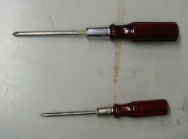
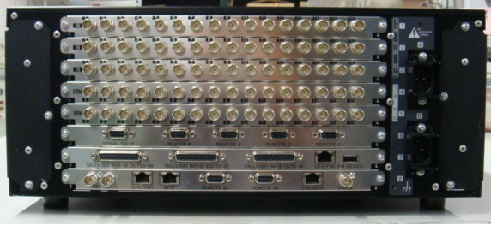
Removal/Installation of Connector Board
Note
In MVS-6520/6530/3000, the slot for installing each plug-in board is specified.
Install each board in the specified slot correctly.
Take CN-3535 board as an example and explain the removal/installation of connector board.
CNI-39, CNO-39, CN-3536 and CN-3537 boards are replaced with the same
procedure. Prepare a M2.6 driver.
1. Turn the power OFF and pull out the power supply code out of the outlet.
2. Remove one screw each for the right and left on the CN-3535 board.
For M3,M4
Removal
For M2.6
CNI-39 Board
CNO-39 Board
CN-3537 Board
CN-3536 Board
CN-3535 Board

Slide 13
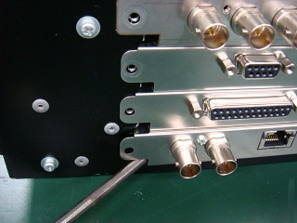
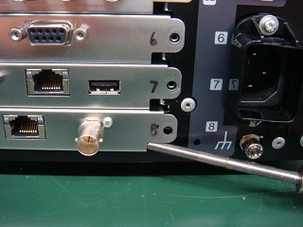
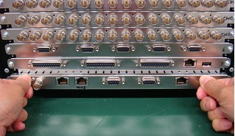
Removal/Installation of Connector Board
3. Insert a M2.6 driver into the right and left spaces under the CN panel to float the connector board from the chassis.
4. Remove the connector board holding the CN panel.

Slide 14
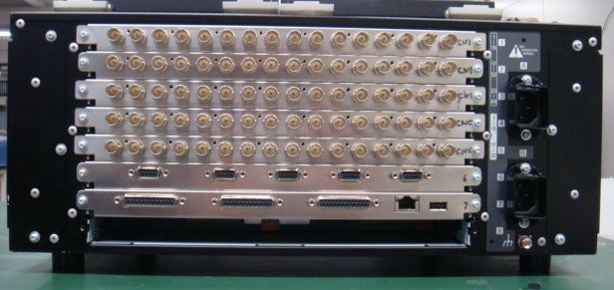
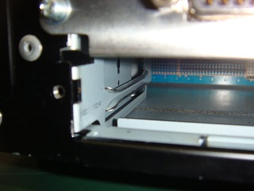
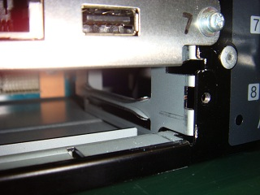
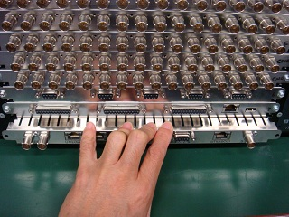
Removal/Installation of Connector Board
Installation
1. Insert the connector board along the guide rails.
2. insert the CN board under the one-upper CN panel, push the topside plate spring,

Slide 15
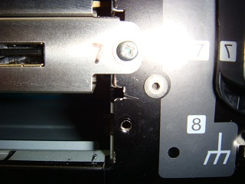
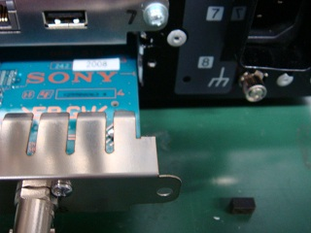
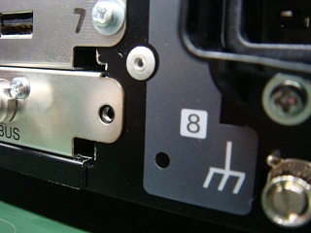
Removal/Installation of Connector Board
3. Insert the right and left bend of the CN panel into the right and left notch on the chassis.
4. Push the connector board until the space
between the chassis and the CN panel is filled.

Slide 16
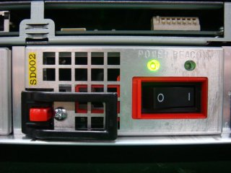
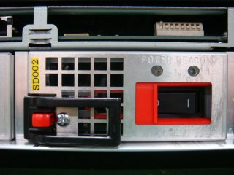
Replacement of Power Supply Unit
- Protection mechanism at removing/installing the power supply unit
The power supply cannot be removed when the power is on.
Lever button: Locked
When the power is off, the switch cover can be slid.
Switch cover
Lever button: Released

Slide 17
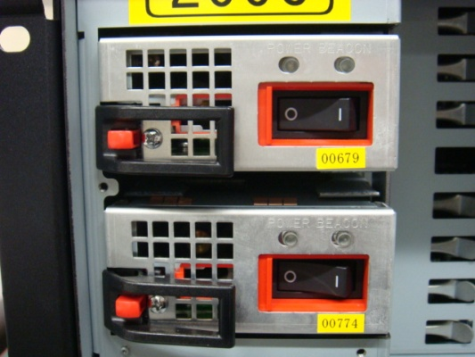
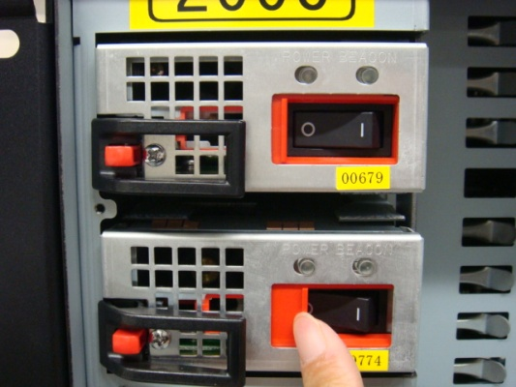
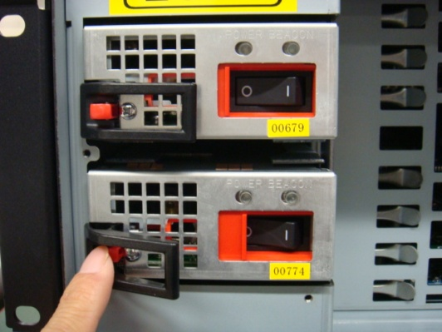
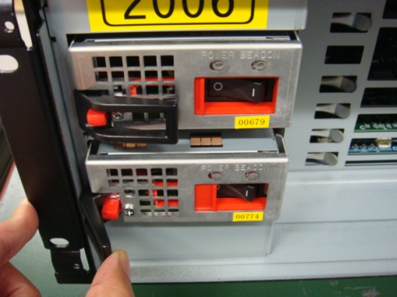
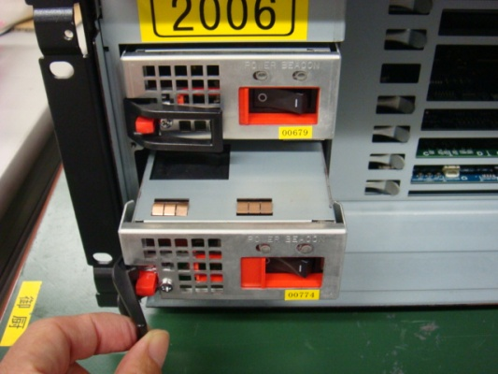
Replacement of Power Supply Unit
Removal
1. Turn off the power switch and slide the switch cover right.
OFF
Switch cover
2. Push the unlock button (red). Open the eject lever.
Unlock button
3. Pull out the power supply unit.
Installation
Open the eject lever and install the power supply unit by reversing the steps of installation.

Slide 18
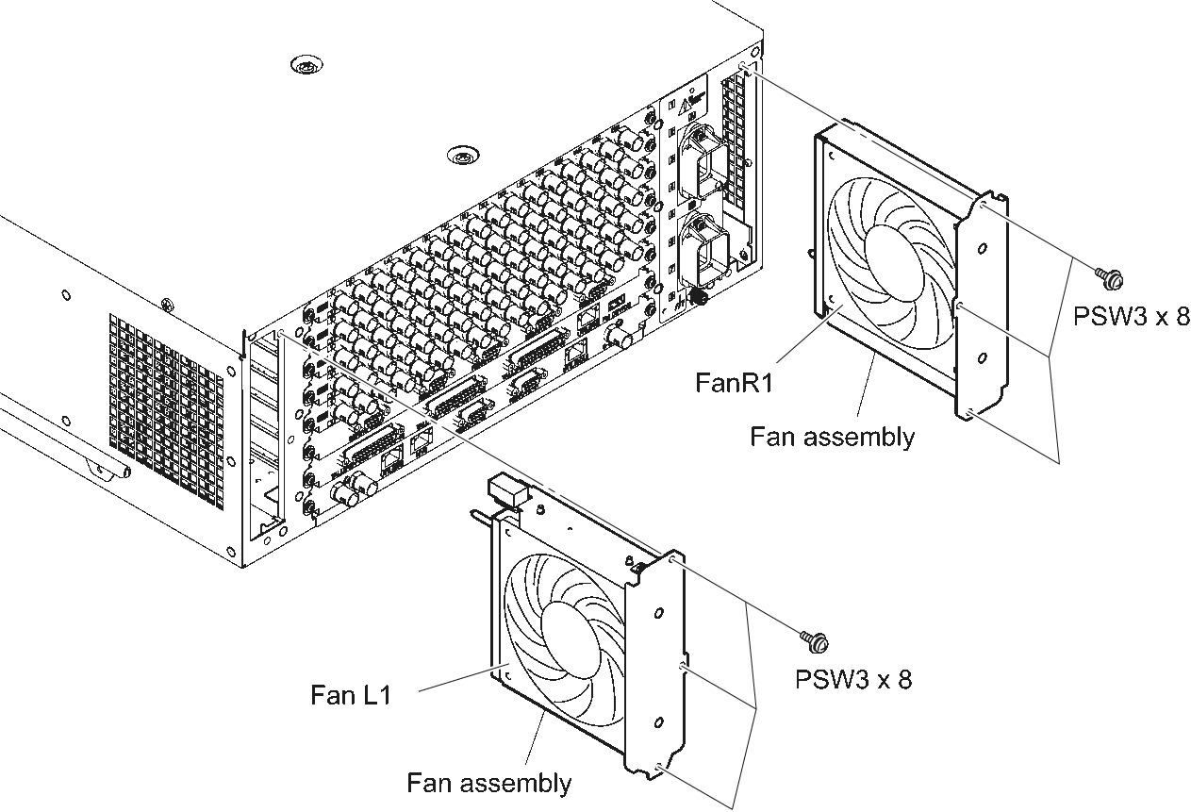
Replacement of Fan
1. Remove the six screws to detach the two fan assemblies.
2. Pull out the two fan assemblies.

Slide 19
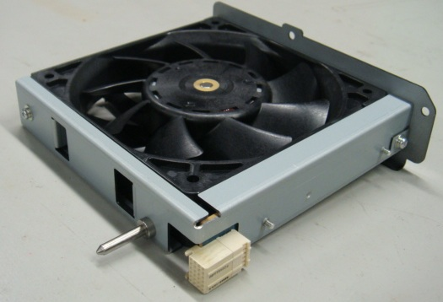
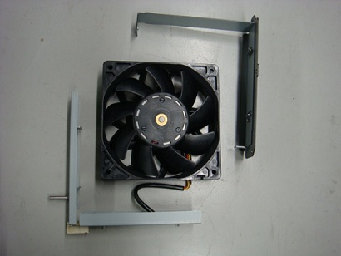
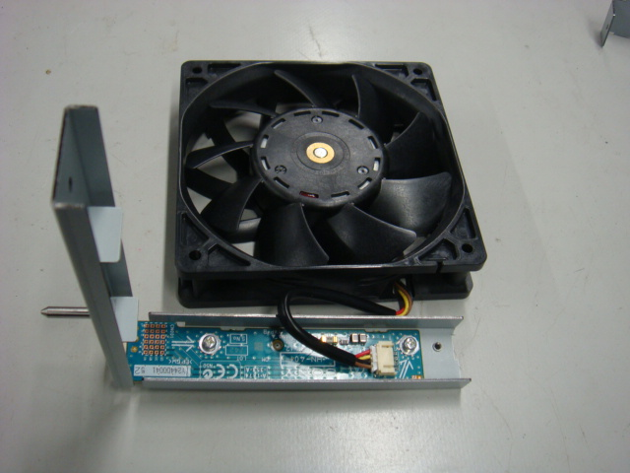
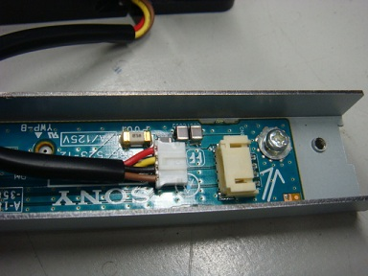
Replacement of Fan
3. Remove the two screws to detach the fan panel assembly and the fan frame assembly.
4. Disconnect the harness from the connector (CN002) on the HN-401 board to detach the fan assembly.
PANEL ASSY, FAN
FRAME ASSY, FAN

Slide 20
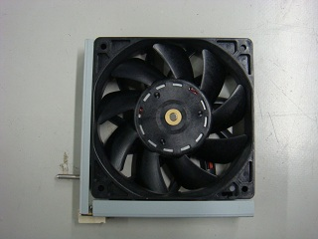
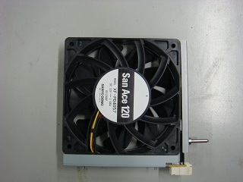
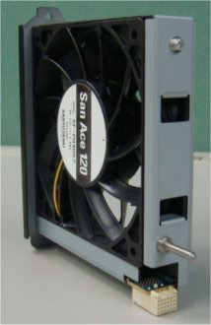
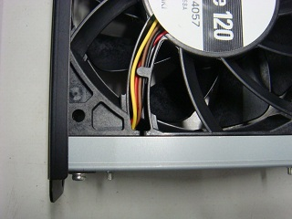
Replacement of Fan
Note
Install the fan carefully paying attention to the label side and the harness position.
When installing the fan, do not catch the harness.
5. Install the fan assembly by reversing the steps of installation.
6. Install the fan harness into the connector (CN002) on the HN-401 board.
7. Interfold the fan harness not to go out of the fan frame assemble.
Be careful not to hold the opposite harness.
attention to the
label side
FRAME ASSY, FAN
LAVEL
Support Pin
CN

Slide 21
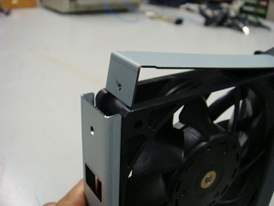
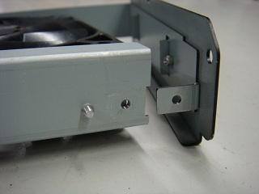
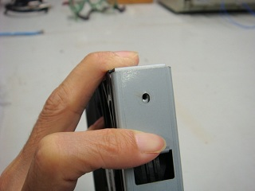
Replacement of Fan
8. Position the notch on the right of fan frame assembly and the bend on the fan panel assembly.
9. Insert another bend of the fan panel assembly into the inside of the fan frame assembly.
10. Tighten a screw on the notch positioned in step 8.
11. Tighten a screw on another notch holding the bend not to float it.
9
8
11
10

Slide 22
Rack Mounting
・Rack mounting
The rack mount kit is not supplied with MVS-6520/6530/3000.
Use the specified rack mount kit when mounting a unit on the rack.
Specified rack mount kit: RMM-10
For the mounting procedure, refer to the Installation Manual.
J/E： 4-446-372-01

Slide 23
How to extend Plug-in Board
There are two kinds of extension boards to extend plug-in boards for MVS-6520/6530/3000.
Name: Extension board EX-1135 Name: Extension board EX-1136
Part No.: A-1874-359-A Part No.: A-1874-360-A
*Note: Extension board EX-1135 cannot be used for the slot used with Extension board EX-1136.
Extension board EX-1136 cannot be used for the slot used with Extension board EX-1135.
Extension board EX-1135 cannot be used for the one upper slot of the MIX SLOT.
Use it for the one lower slot of the MIX SLOT instead.
Notes:
このようにマウントされているコネクターが違いますので指定のSLOTでご使用ください

Slide 24
How to extend Plug-in Board
Use the extension board EX-1135 when checking the plug-in boards below.
・CA-85, MY-119, MY-119A, FC-114, DVP-55, MIX-55 (one lower slot of the MIX SLOT)
Use the extension board EX-1136 when checking the plug-in boards below.
・XPT-34, XPT-34A
MVS-6530
MIX-55
MIX-55
DVP-55(MKS=6570)
MB-1196
XPT-34
FC-114(MKS=6550)
MY-119
CA-85
Do not use EX-1135 board
Use EX-1135 board
Use EX-1136 board
Use EX-1135 board
MVS-6520
MIX-55
DVP-55(MKS-6570)
MB-1196
XPT-34
FC-114 (MKS-6550)
MY-119
CA-85
Use EX-1135 board
Use EX-1136 board
Use EX-1135 board
MVS-3000
MIX-55
MB-1196A
XPT-34A
FC-114(MKS-6550)
MY-119A
CA-85
Use EX-1135 board
Use EX-1136 board
Use EX-1135 board

Slide 25
How to extend Plug-in Board
1. Turn the power off and then pull the power code out of the outlet.
2. Remove the front panel and the PC board bracket assembly.
3. Pull out the plug-in board to be inspected.
4. Insert the extension board, EX-1135 or EX-1136 into the slot instead of the removed plug-in board.
Extension Board
* EX-1136 in the figure

Slide 26
How to extend Plug-in Board
5. Close the EX lever in the direction of arrow A to lock.
6. Open the rails in the direction of arrow B.
A
Rail
A

Slide 27
How to extend Plug-in Board
7. Move the lever to the direction of arrow C.
8. Insert the board removed in step 4 into the rail grooves and connect the connector on the plug-in board and the connector on the extension board securely by hand.
Connectors
Connectors
C
C
This direction is NG.

Slide 28
How to extend Plug-in Board
9. Open the right and left levers in the direction of arrow A. and then remove the board inspected/adjusted.
D
D

Slide 29
Replacement of SSD Board
Explain how to replace the SSD module, which is used for the MY-119 board as an example.
1. Turn the power OFF and pull out the power supply code out of the outlet.
2. Remove the front panel and the PC board bracket assembly.
3. Remove the MY-119 board.
MY-119
MIX-55
MIX-55
DVP-55
MB-1196
XPT-34
FC-114
MY-119
CA-85
6-719-151-01
IC SHG2A08GVDHBCS-SSA
(MODULE,SSD)
Notes:
MY-119基板に搭載されている、SSDモジュールの交換手順を説明します
SLOTは下から2番目です
SSDはMY-119基板の右側のこれです

Slide 30
Replacement of SSD Board
4. Remove the nylon rivets and remove the SSD support.
5. Remove the SSD module from the connector.
6. Install the SSD module by reversing the steps of installation.
*Note: Use a new nylon rivet and insert it from the Side B.
Side A
B面
Side A
Side B

Slide 31
Replacement of CPU-DP Module
Use the MY-119 board as an example to explain how to replace the CPU-DP module.
Likewise, the CA-85 board can be replaced in the same procedure.
Turn the power OFF and pull out the power code
out of the outlet.
Remove the front panel and the PC board bracket
assembly.
3. Remove the MY-119 board.
MY-119
MIX-55
MIX-55
DVP-55
MB-1196
XPT-34
FC-114
MY-119
CA-85
CPU-DPモジュール
CA-85
CPU-DPモジュール

Slide 32
Replacement of CPU-DP Module
4. Remove the four screws and then remove the heat sink.
5. Remove the CPU-DP module from the connectors on the MY-119 board.
6. Remove the heat radiation sheet from the removed CPU-DP module.
*Note: The heat sink is reused.
CN602
CN601
PC BOARD, MOUNT
(CPU-DP MODULE)
1-857-571-11
PN2
PN1
SHEET,RADIATION
(30X30X1.5)
4-436-986-01
HEAT SINK
4-183-604-02
SCREW +B3x10
7-682-549-09

Slide 33
Replacement of CPU-DP Module
Installation
1. Attach a new heat radiation sheet onto a new CPU-DP module.
2. Check the orientation of CPU-DP module so that the connectors (PN1/PN2) of CPU-DP module can be inserted in the connectors (CN601/CN602) on the MY-119 board. Then, insert the CPU-DP module in the connectors on the MY-119 board.
*Note: Check that the connectors are firmly inserted.
*Note: Apply THREEBOND (TB-1401B) 200G(7-600-002-52) on the four screws (+B3x10).
3. Install the MY-119 board in the reverse procedure of removal.
4. Install the heat sink to position the CPU-DP bracket and the notch of the heat sink.
BRACKET,CPU-DP

Slide 34
Periodic Check and Maintenance
*Note
The replacement period shown in the following list are not guaranteed period of the parts. Use this list as guidelines form maintenance and inspection. The replacement period of each part is changed according to the environment and condition.
After replacing a power supply unit and/or a fan, reset their total operating hours. (See the section 1-9-6 in the maintenance manual.)
Part | Where used | Replacing parts | Maintenance | Replacement Period
Fan | Side on the rear |  | Clearing | Once a month
 |  | 1-855-201-11 | Replacement | Once in about four years
Filter | Front Panel |  | Clearing | Once every two months
 |  | 4-443-150-01 | Replacement
Power Supply Unit |  | HK-PSU05 | Replacement | Once every about four years and six months

