Slide 1
LPS Products
Service Training
Opening
Ken Kawamura
Deputy GM, CCS Design Dept. 1

Slide 2


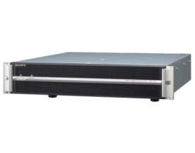

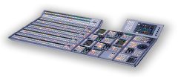


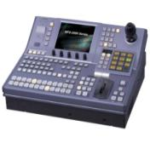
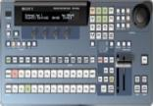
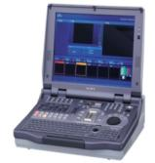
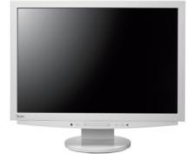


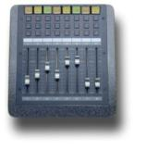
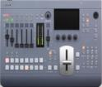

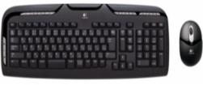
LPS Products Line-up (Last Year)
3D BOX
3D QC
2D to 3D
Converter
MPE-200
3G
MVS-8000X
Virtual
Camera
FX BOX
MVS-7000X
MVS-8000G
3G
MVS-6000
MFS-2000
DFS-900M
Anycast Station
MCS-8M
ELC Automation
Notes:
2

Slide 3
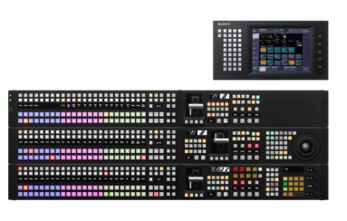
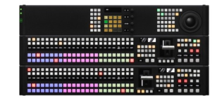
LPS Products Line-up
3D BOX
3D QC
2D to 3D
Converter
MPE-200
3G
MVS-8000X
Virtual
Camera
FX BOX
MVS-7000X
MVS-6500
MVS-3000
DFS-900M
Anycast Station
MCS-8M
ELC Automation
Notes:
3

Slide 4
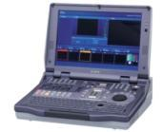
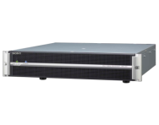
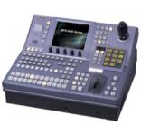
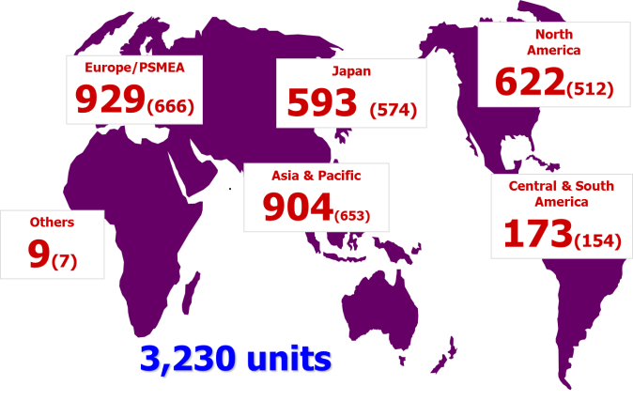
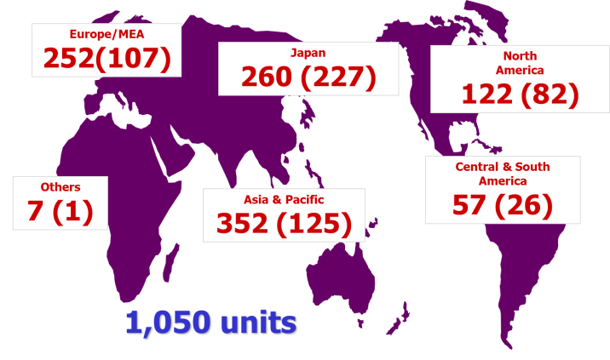
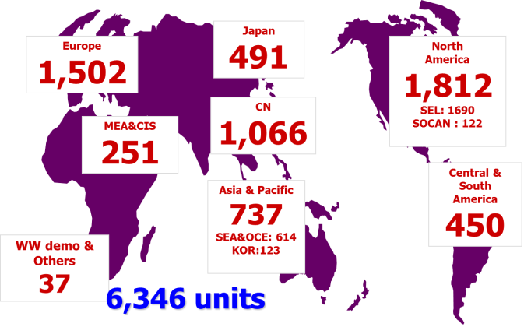
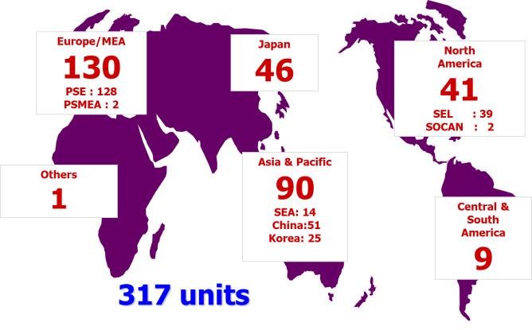
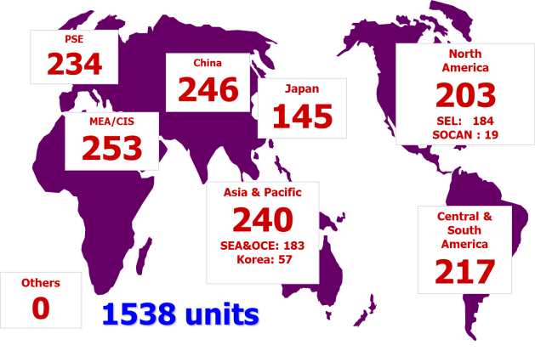
Sales Number
More than
3200
1000
6300
310
30
units were sold
MVS
MFS
Anycast
Customers choose Sony
not only “by Product”, but
“by TECHNICAL SUPPORT”.
Sony’s technical support is No.1!
Thank you!
MPE
MCS-8M

Slide 5
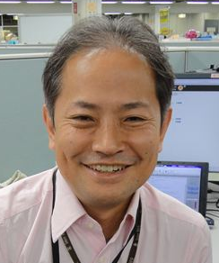
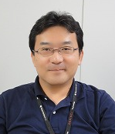
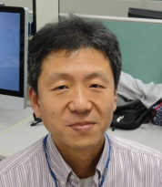
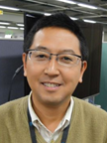
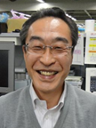
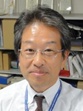
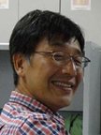
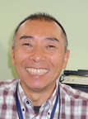
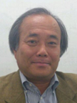
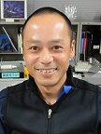
PDSG, PSG, CCS,Design Dept.1
Professional, Device & Solutions Group(PDSG )
Professional Solutions Group(PSG)
Content Creation Solutions Business Div( CCS)
General Manager
Susumu Shibagaki
PSSD, Dept No2
Deputy General Manager
K. Kawamura
General Manager
M.Yoshimoto
Sec 1
T. Inoue
Sec 2
Y. Nakamura
Sec 3
T. Katagiri
Sec 4
H. Matsui
Promotion sec
T. Okamura
PJM Gp
A. Suzuki
Sec 2
H. Yakushiji

Slide 6
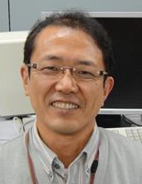

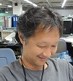

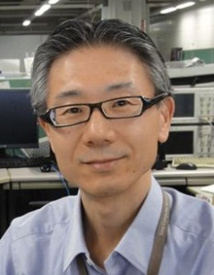

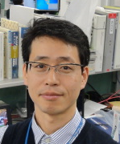
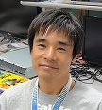
Projects
PM M.Noguchi
MVS
6500/3000 Proc
PL A.Takashima
6500/3000 Panel
PL S. yamashita
Soft
PL F.Higashi
PL S. Akahane
New Proj
SPEC PL T.Nakata
Elec PL
M.Ueta
Soft PL
N.Ozaki

Slide 7
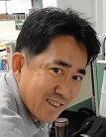
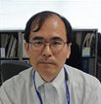
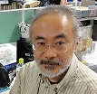
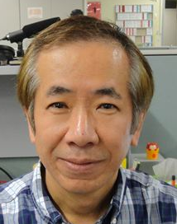
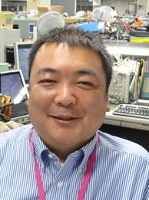

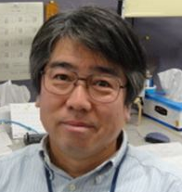


Support
Category M
H. Nishida
<Current model>
・ MVS-8000X/7000X
・ MVS-6000/6500/3000
・ MVE-9000/8000A
・ MKS-6470/2470
<Discon Model>
・MVS-8000/8000A/8000G
・ DVS-9000, MFS-2000,
・ MVE-8000, BKDS-9470
・ HDS-7000, HDME-7000
Category M
H. Sugimoto
K. Inoue
M. Noguchi
<Current model>
・ DFS-900M
R. Nonaka
<Discon Model>
・DFS-800
C. Nakasaka
<Current model>
・ CCP-8000A/9000A/6000
・MKS-8080/8082/8700/2700
・UCP-8060
・MKS-2050/8050
・BKS-R
<Discon Model>
・CCP-8000/9000
・ MKS-201X
・BKS-R
・BVE-700/BVE-700A
Category M
T. Nakata
M. Ueta
<Discon Model>
・AWS-G500
・BKAW-5XX
H. Nishida
<Current model>
・ MCS-8M
・IXS-6700/6700
・HKSP-R80
<Discon Model>
・HDS-X3400/X3600/X3700
・HDS-X5800
・ DVS-128/DVS-TC3232/RS1616
T. Shigata
<Current model>
・MPE-200
Category M
H. Noto
Y. Aoyagi
<Current model>
・ PFV-L
・PFV-SP
T. Ito
<Current model>
・ELC

Slide 8
Thank you for your support!

