Slide 1
CA-86 hardware analyzing procedure
Copyright 2015 Sony Corporation

Slide 2
Block diagram
MVS-6500/-3000A
panel module
panel module
On board
setting Switches
panel module
CA-85 board
video board
DVI & USB
ICP-6511
MVS LAN
CA-86 board
panel module
panel module
panel module
panel module
ICP-6500/-3000
Local signals

Slide 3
At first, please do check your system according to the following procedure from 1-1 to 1-6.
They are basic procedure to verify the validity of your system.
No. | Check item | Description
1-1 | Cable Connection | Check the wiring refer to block diagram.
1-2 | Group / Unit ID | Verify Unit / Group ID. ICP PANEL : Set Group ID by MENU 7311. MVS PROC : Set S1301 on CA-85 board.
1-3 | Bit 4 clear | Do SRAM clear procedure. (S3802 & S1302 on CA-85 board).
1-4 | System reboot | Reboot your system.
1-5 | Network | Check the network status by MENU 9999.
1-6 | Version | Check MENU 7316. UI / PNL / SWR version need to be matched.
1-7 | PNL Unit Config | Choose ICP Type (6530,6520,3000 or 3016) by MENU 7316.8.
Notes:
The first thing to do is to do this procedure to check if the system has no problems.
Half of problems must be solved with this procedure.

Slide 4
If the symptom is not recovered even after following the procedures 1-1 to 1-7, do the appropriate check items referring to the “Examples of trouble”.
Examples of trouble | Check item
Neither the whole panel nor Menu function. | 2-2. Board LED check 2-3. SO-DIMM
Panel functions. Menu does not function. | 2-4. MENU replace
The whole panel does not function. Menu functions. | 2-1. Module test 2-2. Board LED check
A part of the panel does not function. Menu functions. | 2-1. Module test

Slide 5
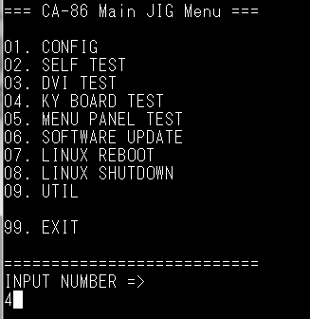
2-1 | Module test
Connect USB key board to MENU or PANEL USB port.
Ctrl + Alt +F4, change GUI menu to console screen
Login and start testing
login : jig
Password : jig
jigstart [enter]
4 [enter]
(choose KY test)
Notes:
This test focuses the suspected hardware from here.
Can almost make sense by doing module tests.

Slide 6
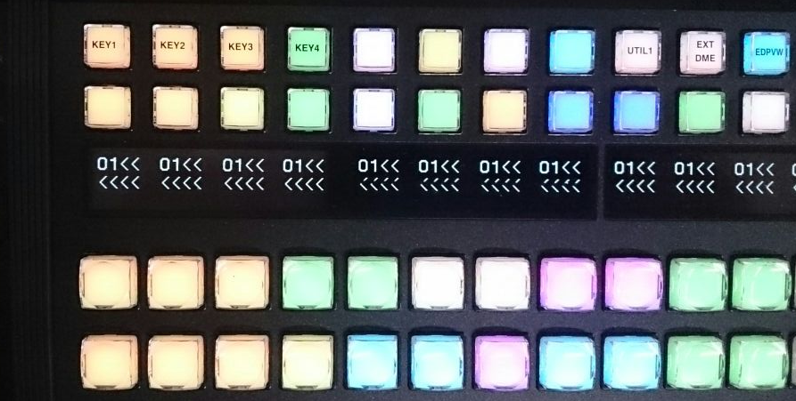
2-1 | Module test
4. Push LED switches
<result>
Every switch responded by lighting the LED and displaying OLED.
--- No problem.
Some switches responded, but others did not.
--- Some block in KY module may be broken. Share details.
ALL switches did not respond.
--- Probably communication error between CA-86 and modules.
--- Please check test 2-2.

Slide 7
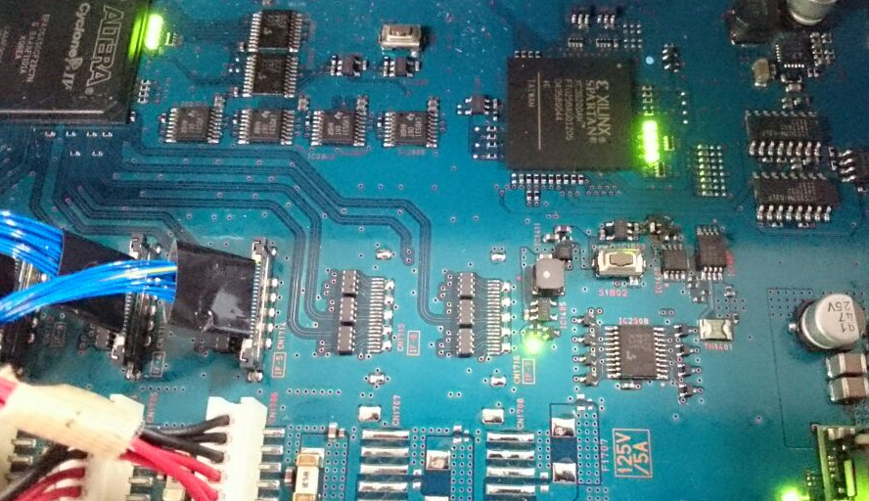
2-2 | Board LED check
<step1>
During normal operations, D1801 – 1804 must be bright.
If some of them are not, CA-86 board is probably broken.
<step2>
During normal operations, D2301 – 2304 must be bright.
If D2301, 2302 or 2303 is not bright,
give us “boot log” using 232C cable.
(Probably software does not work well.)
If D2304 is not bright, it is communication error between CA-86 and modules.
When identifying the symptom as communication error between CA-86 and modules, please send us the whole unit of the panel.
This could be unknown problem.

Slide 8
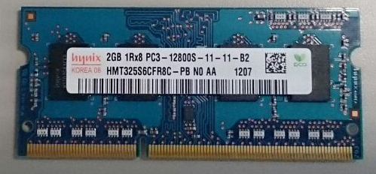
2-3 | SO-DIMM
Check software version and SO-DIMM parts name are matched.
Refer to technical memo SWEM14-035.
2-4 | MENU replace
* Replace MENU with another one or a DVI monitor.
Notes:
SO-DIMM

