Slide 1
Tally Setup while in Resource Share Mode

Slide 2
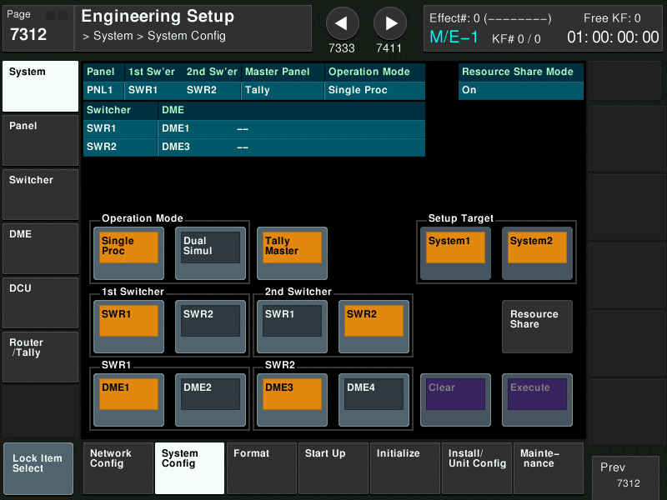
Panel 1 System Config
On Panel 1
1st Sw’er should be SWR1
2nd Sw’er should be SWR2
Tally Master should be Enabled

Slide 3
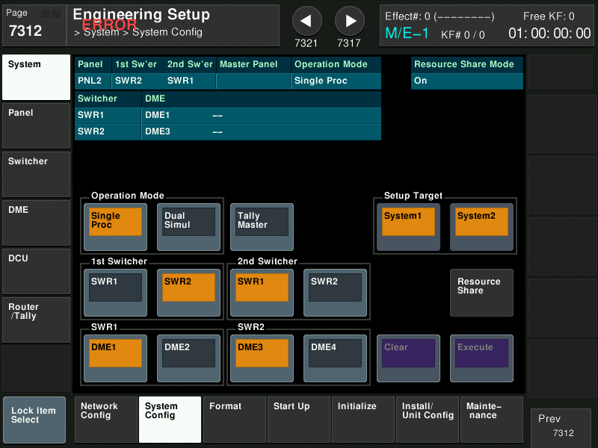
Panel 2 System Config
On Panel 2
1st Sw’er should be SWR2
2nd Sw’er should be SWR1
Tally Master should be OFF

Slide 4
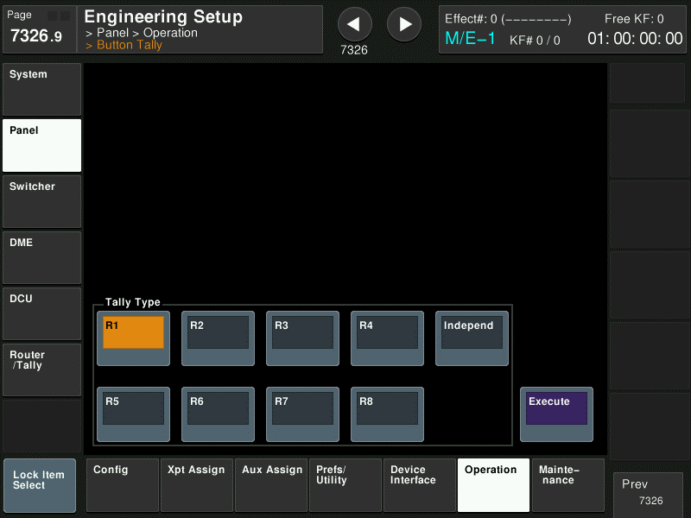
Panel 1 Button Tally
On Panel 1
Set Tally Type to be R1

Slide 5
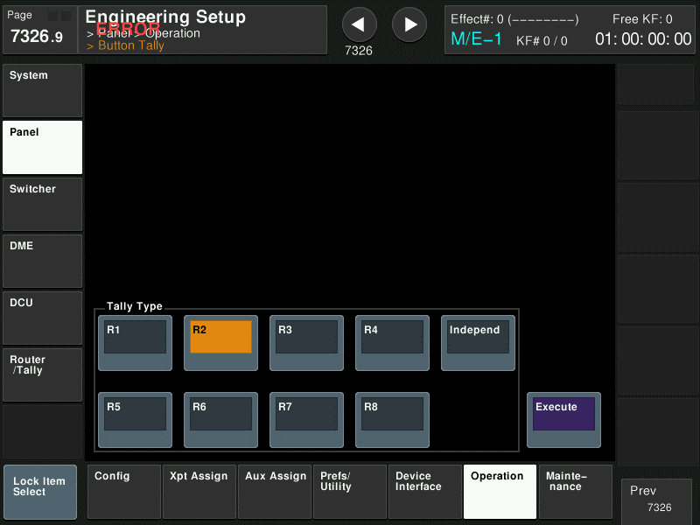
Panel 2 Button Tally
On Panel 2
Set Tally Type to be R2

Slide 6
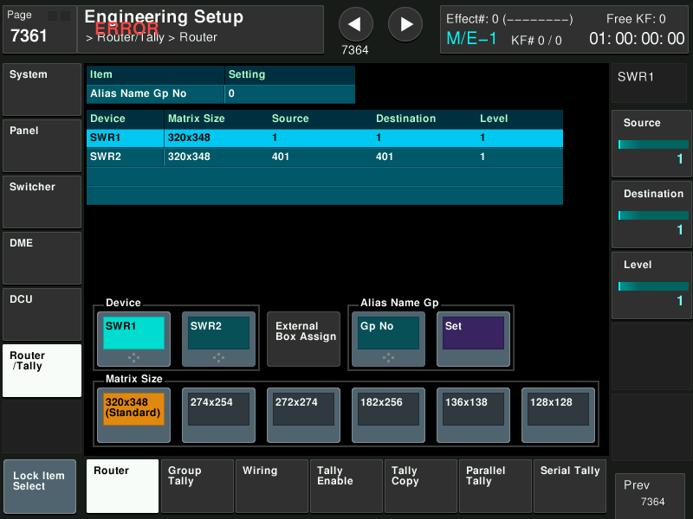
Panel 1 Router Address setting
On Panel 1
SWR1 should be at
Source = 1
Destination = 1
Level = 1
Matrix Size = 320x348
SWR2 should be at
Source = 401
Destination = 401
Level = 1
Matrix Size = 320x348
There is no setting for Alias Name Gp No

Slide 7
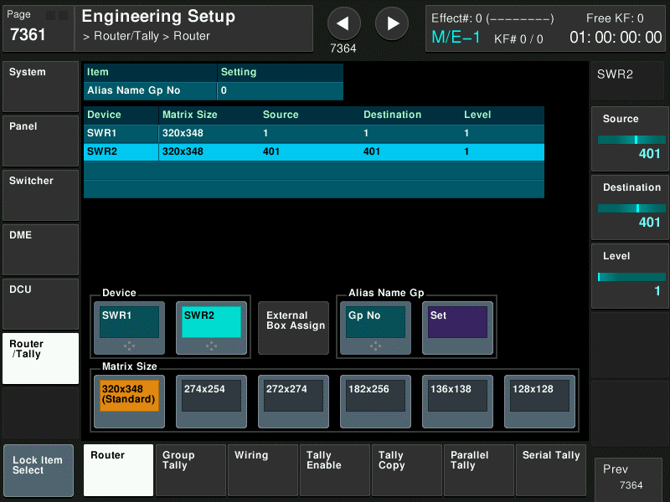
Panel 2 Router Address setting
On Panel 2 (same as Panel 1)
SWR1 should be at
Source = 1
Destination = 1
Level = 1
Matrix Size = 320x348
SWR2 should be at
Source = 401
Destination = 401
Level = 1
Matrix Size = 320x348
There is no setting for Alias Name Gp No

Slide 8
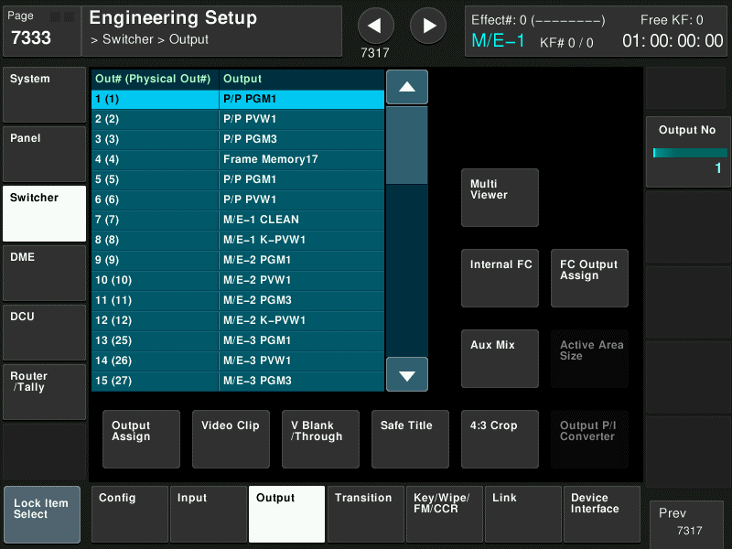
SWR1 Program Output confirmation
On Panel 1
Confirm the LOGICAL Out# for P/P PGM1
In this case, Logical is 1 and Physical is 1
This information is required to set the Tally Enable

Slide 9
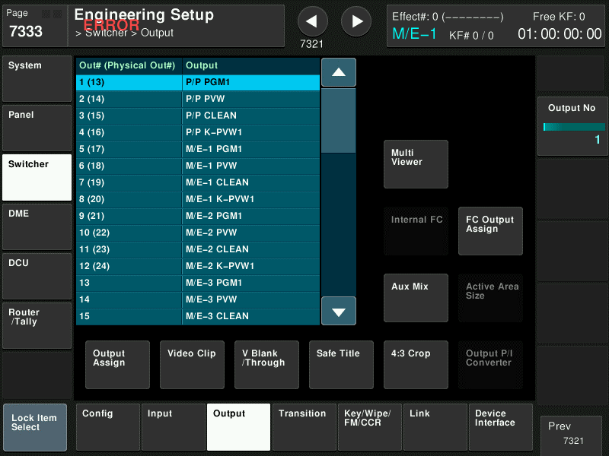
SWR2 Program Output confirmation
On Panel 2 (same as Panel 1)
Confirm the LOGICAL Out# for P/P PGM1
In this case, Logical is 1 and Physical is 13
This information is required to set the Tally Enable

Slide 10
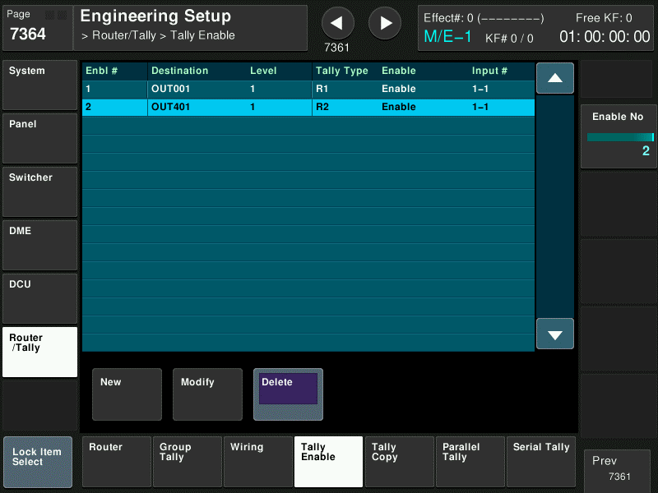
Panel 1 Tally Enable settings
On Panel 1
For SWR1, create a R1 Tally Enable for Destination OUT001
Based on P/P PGM1 logical assignment in menu 7333
For SWR2, create a R2 Tally Enable for Destination OUT401
Based on P/P PGM1 logical assignment in menu 7333 on Panel 2

Slide 11
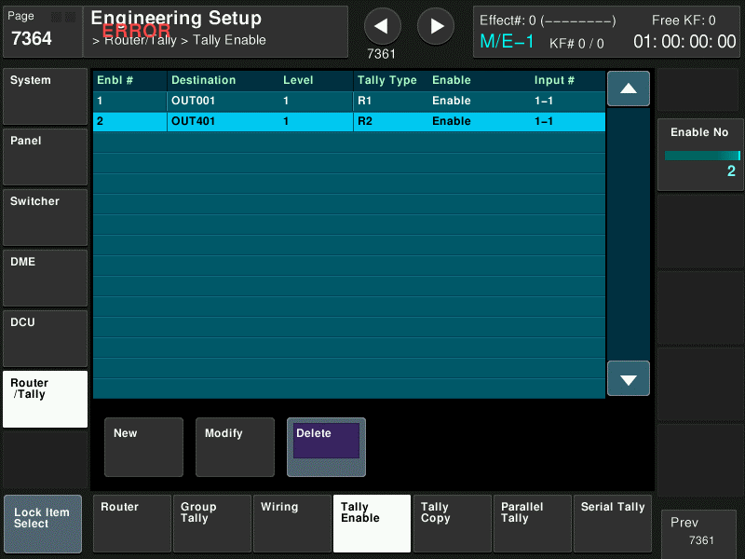
Panel 2 Tally Enable setting
On Panel 2 (same as Panel 1)
For SWR1, create a R1 Tally Enable for Destination OUT001
Based on P/P PGM1 logical assignment in menu 7333 on Panel 1
For SWR2, create a R2 Tally Enable for Destination OUT401
Based on P/P PGM1 logical assignment in menu 7333

