Slide 1
Software V 4.2
Peter Weber
Product Manager Vista Series Consoles
30.06.2009

Slide 2
Vista V4.2 Software contains two - completely different - new feature sets :
Dynamic Automation for Vista 5
Theatre features (for all Vistas models)

Slide 3
V 4.2 : Dynamic Automation for Vista5
Peter Weber
Product Manager Vista Series Consoles
30.06.2009

Slide 4
Dynamic Automation (Autotouch+)
Up to now only available on Vista7 and Vista 8
Now with V4.2 also on Vista5
Makes the Vista5 even more versatile
We can compete against Lawo mc²66 and mc²56 - smallscale consoles that feature dynamic automation.

Slide 5
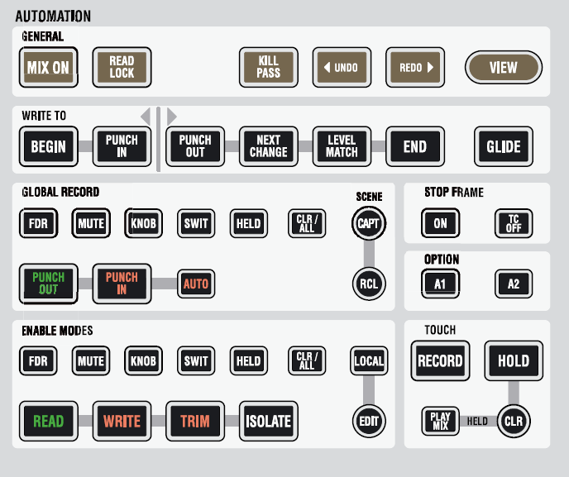
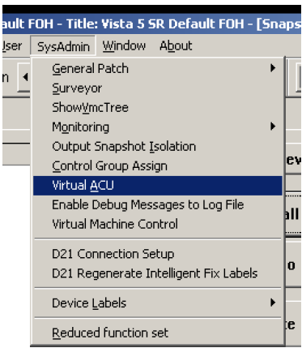
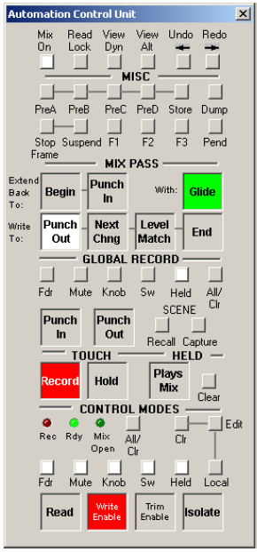
Dynamic Automation (Autotouch+) on Vista 5
„Virtual“ Automation Control Panel is used on GC Screen
Vista5 – Virtual ACU window on GC Screen
Vista7 and Vista8 – ACU buttons on desk surface

Slide 6
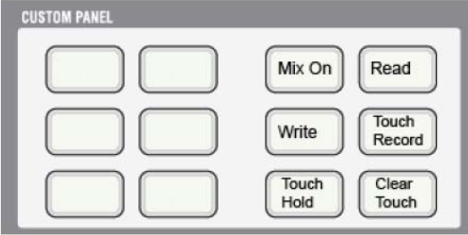
Dynamic Automation (Autotouch+) on Vista 5
The most important buttons also on the Vista 5 desk surface
Vista5 – Custom Panel buttons
Vista7 and Vista8 – ACU buttons on desk surface

Slide 7
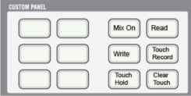
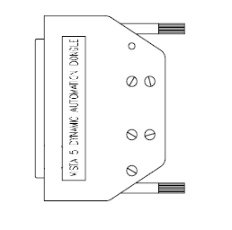
Dynamic Automation (Autotouch+) on Vista 5
Dongle needed to activate Custom Panel Buttons
Vista5 Desk – rear connector panel

Slide 8
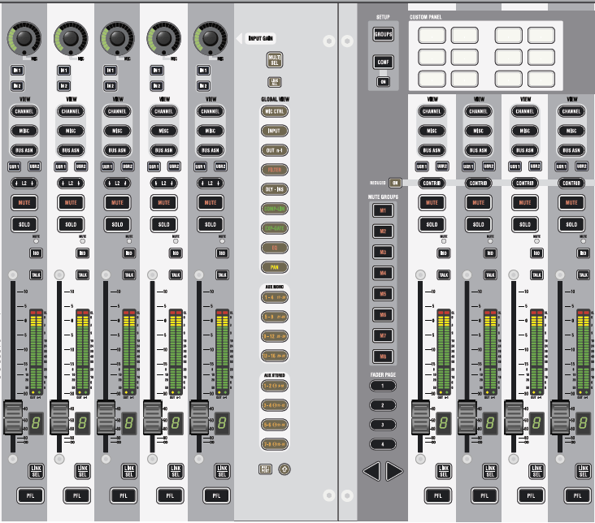
Dynamic Automation (Autotouch+) on Vista 5
These buttons are used
„ISO“ = Automation Mode

Slide 9
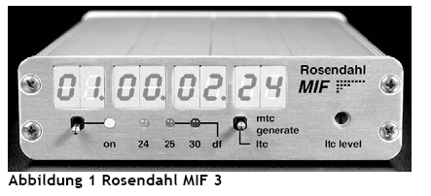
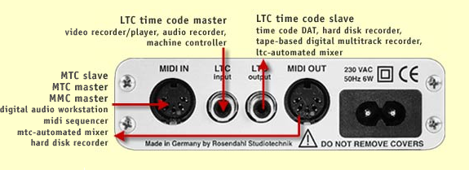
Dynamic Automation (Autotouch+) on Vista 5
Vista 5 uses MIDI Timecode (MTC)
When LTC should to be used, a third party converter needs to be purchased :

Slide 10
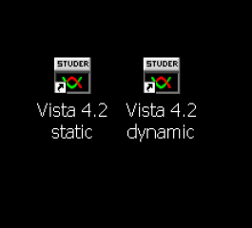
Dynamic Automation (Autotouch+) on Vista 5
Use ‚static‘ and ‚dynamic‘ shortcut on desktop

Slide 11
Peter Weber
Product Manager Vista Series Consoles
30.06.2009

Slide 12
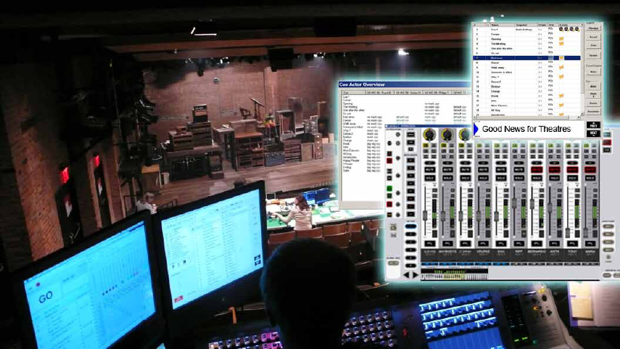
Theatre Features
Virtual Vista
Theatre VCAs
Theatre Mute Groups
Hard- and Soft Mutes
Isolate Labels
Enhanced Theatre Cuelist :
Timer Events
MIDI Events
Library Events
VCA/Mute Events
Dynamic Cue Events

Slide 13
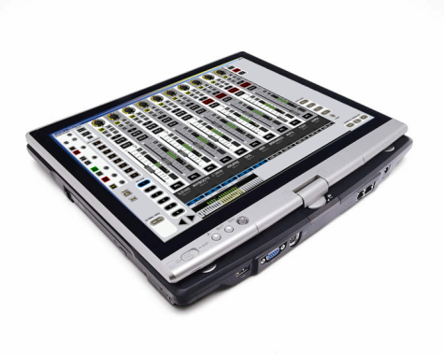
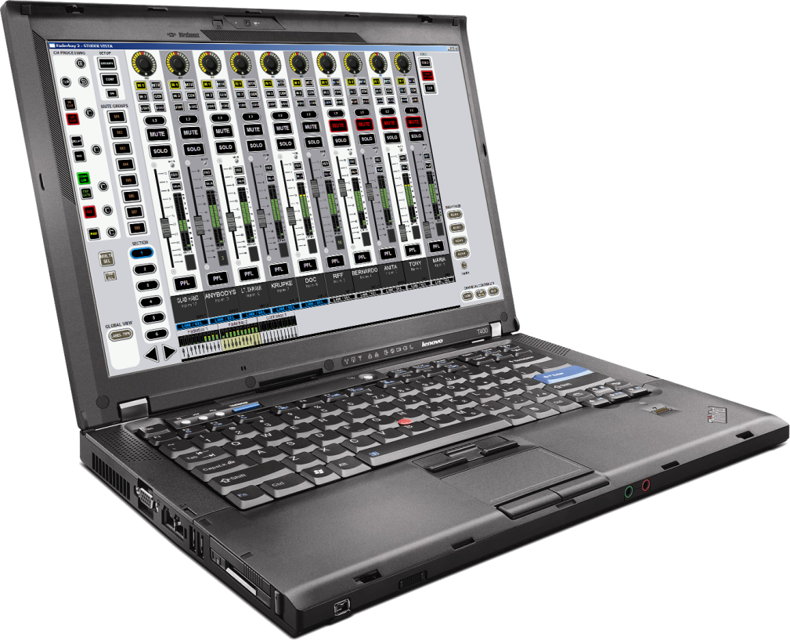
Virtual Vista
Runs on XP/Vista tablet pc‘s/notebooks with a preferable screen resolution of 1440x900

Slide 14
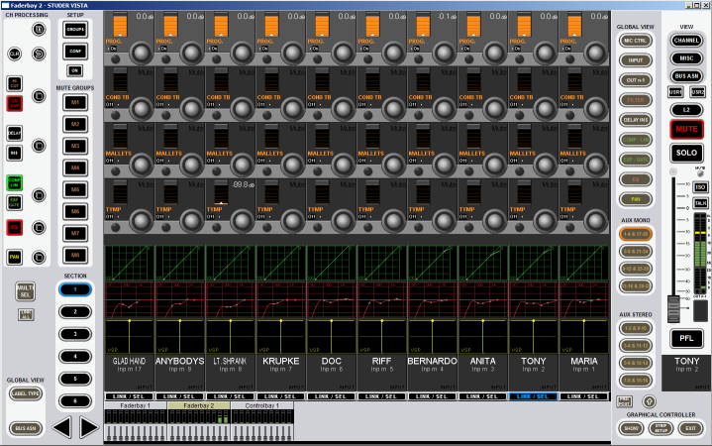
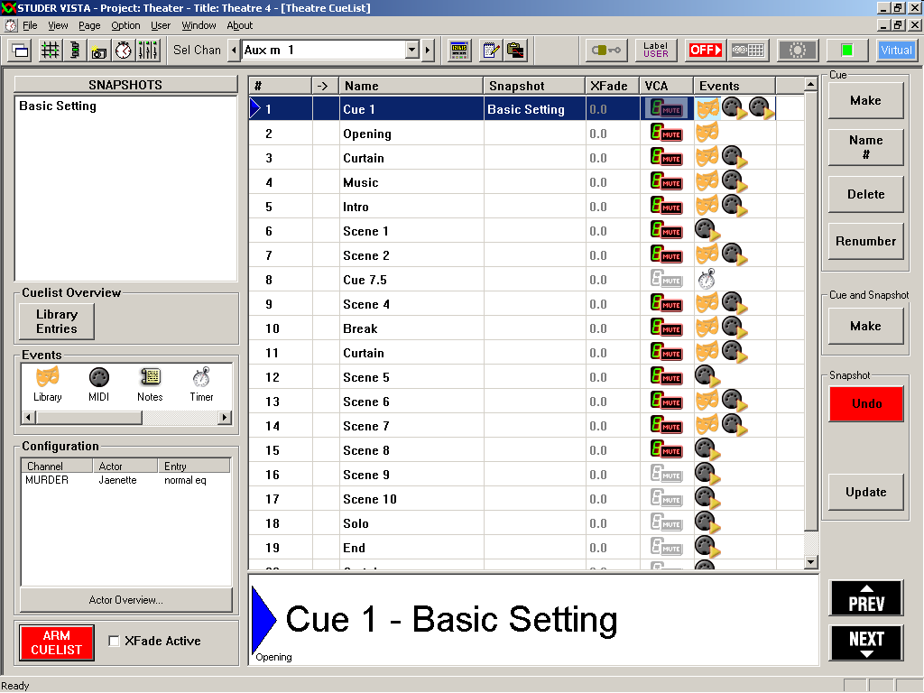
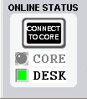
Virtual Vista
Two views : GC view / Virtual desk view :

Slide 15
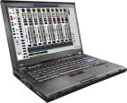
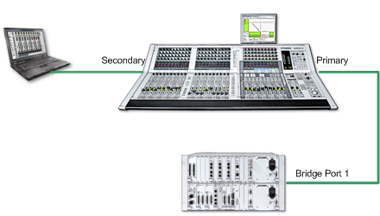
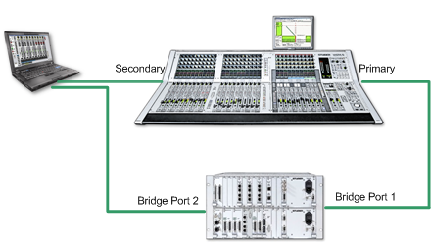
Virtual Vista – modes of operation
Offline
Online with Desk
Online with Desk / Takeover of Core

Slide 16
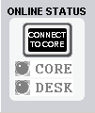
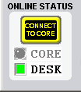
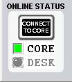
Virtual Vista
Online Status indication
„Connect to Core“ button
Use of ‚TightVNC‘ remote desktop server
Installer .exe installs complete D950 folders including demo title and config
D950System.ini files – on console and on Virtual Vista PC

Slide 17
Theatre VCAs
VCA master levels not in snapshots
„Autocomplete“ naming of VCA masters
Edit VCA labels via touch
Isolate VCA master labels
Isolate VCA assigns per channel
Real analog VCA behaviour

Slide 18
Theatre Mute Groups
Mute Group mutes are not stored in Snapshots (assign also not)
Mute Group mutes are not overwritten by Snapshots or VCA/Mute events
Mute Groups are a setup independant tool to mute a group of channels which originally have not been programmed to be muted.
Example : The string section today is only 5 musicians instead of the programmed 8 – so the 3 not used channels can be muted by a Mute Group. And they stay muted throughout all the cues of the production – doesn‘t matter how they were programmed.

Slide 19
Hard- and Soft Mutes
A new state of Mute introduced
Priority over programmed mutes
As a Mute Group – but applicaple to every channel at any time, without the need to setup a Mute Group
Hard Mute makes sure that no audio is passing through the channel – independent of what is recalled via Snapshot or VCA/Mute Events
Needed as a problem solver – e.g. when a radio mic is defective, etc ..

Slide 20
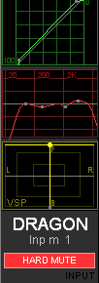
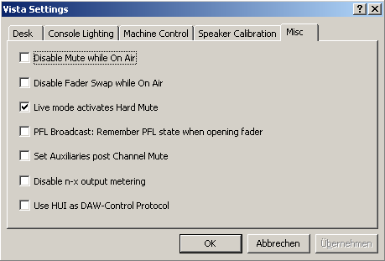
Hard- and Soft Mutes
Needs option activation

Slide 21
Isolate Labels
Isolate dedicated Input Port user labels
Isolate Aux user labels
-> this enables the operator to update just certain user labels to a number of Snapshots.

Slide 22
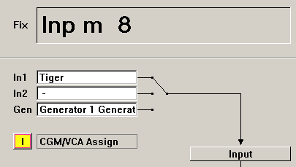
Isolate CGM / VCA assign per channel
-> this enables the operator to update just certain VCA assigns to a number of Snapshots.

Slide 23
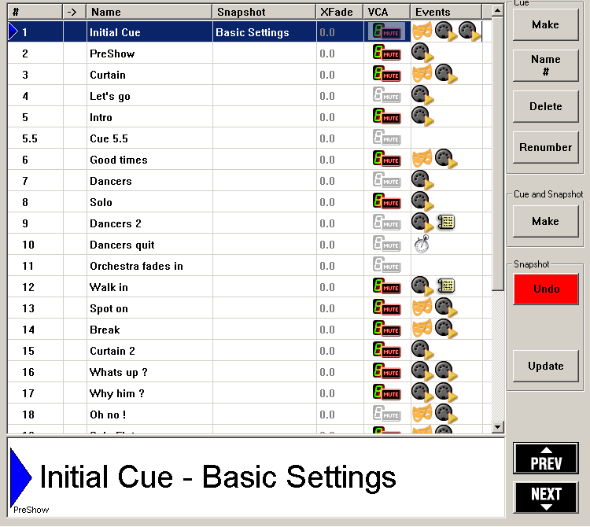
Enhanced Theatre Cuelist
New types of Events
Renumbering of Cues
Make a Cue and Snapshot with one buttonpress
Update Snapshot of current Cue
Large display of active Cue

Slide 24
Desk Buttons

Slide 25
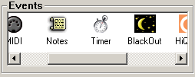
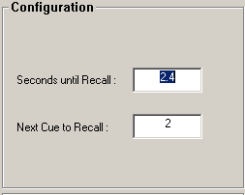
Enhanced Theatre Cuelist
Timer Events

Slide 26
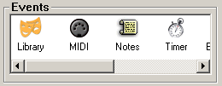
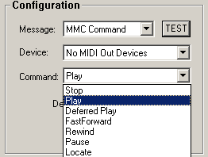
Enhanced Theatre Cuelist
MIDI Machine Control (MMC) Events

Slide 27
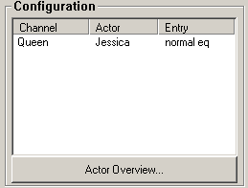
Enhanced Theatre Cuelist
Library Events

Slide 28
Work with Library Events
Cue based theatre productions need exceptional parameter changes per channel, usually for a number of subsequential cues.
Example : in scene 2, the character „Queen“ is wearing a bulky crown – therefore the lav mic sound gets changed due to reflections. The solution is to change the EQ of this channel to make up for the changed response of the mic. This is only valid for the cues within scene2 – in scene3 the original EQ settings can be applied again – since the „Queen“ is not wearing the crown anymore.
This can be achieved with Library Events
The good thing with Library Events is that they can be adjusted while running the show – without the need to update the settings into cues which still lay ahead of the current cue.

Slide 29
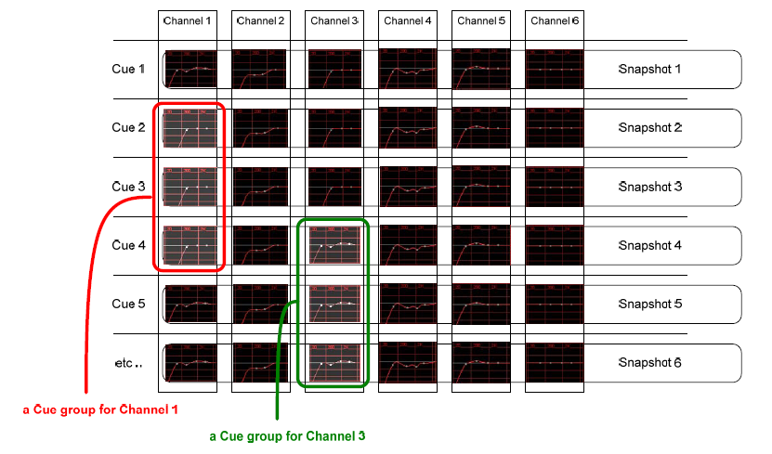
Work with Library Events

Slide 30
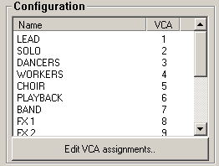
Enhanced Theatre Cuelist
VCA/Mute Events

Slide 31
Work with VCA/Mute Events
In cue based theatre productions - especially in the big musicals – sound designers have made the possibility to assign channels to VCA masters the basis of their mixing console cue list.
Its very easy for them just to use a small number of VCA masters during the show, reassigning slave channels from cue to cue – instead of working on the very large number of input channels directly.
This implies that the large work of setting up a cue list for a production – is assigning the appropriate channels to VCA masters on every single cue.
This can be achieved with VCA/Mute Events very easily

Slide 32
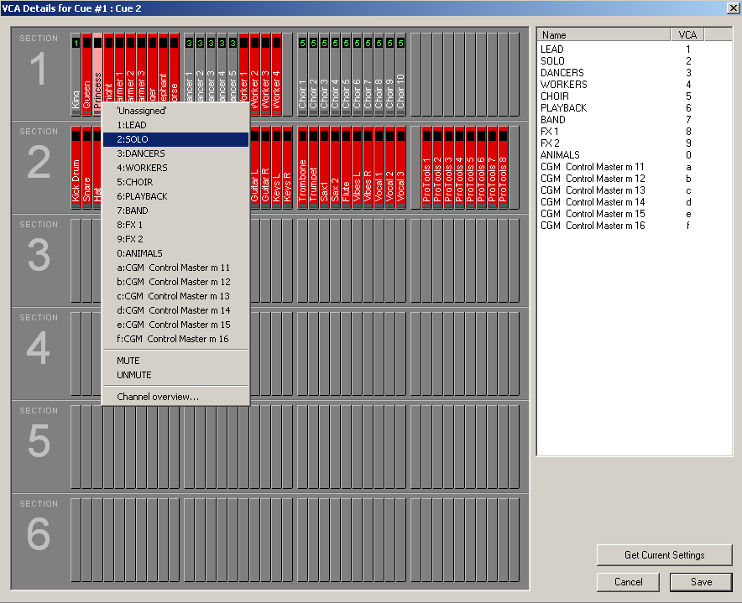
Work with VCA/Mute Events

Slide 33
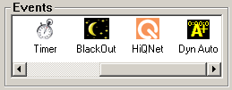
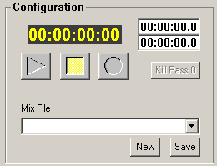
Enhanced Theatre Cuelist
Dynamic Cue Event

Slide 34
Theatre Features
Virtual Vista
Theatre VCAs
Theatre Mute Groups
Hard- and Soft Mutes
Isolate Labels
Enhanced Theatre Cuelist :
Timer Events
MIDI Events
Library Events
VCA/Mute Events
Dynamic Cue Events

Slide 35
Part 2 : Practical Examples
Library Events
VCA/Mute Events

Slide 36
Practical example abstract – Library Events
Make a basic setting (Patch, Labels, Bus assign, Gains, EQ, etc.)
Enter a few actors names, explain that an actor is always tied to a certain input channel
Make a number of cues
In a certain cue tweak the EQ on one channel because the character (channel) is in this cue speaking through a large beard.
Copy this EQ to the library of that particular actor and name it „beard EQ“
Show the two new Vistonics controls and search for the actor and apply the EQ setting to the cue
Repeat further down or on other channels
Tweak these settings while go through the play several times
Show Actor Character overview and change entries from here
Demonstrate „End show“ button
Create a ‚understudy‘-actor
Replace an actor by an understudy

Slide 37
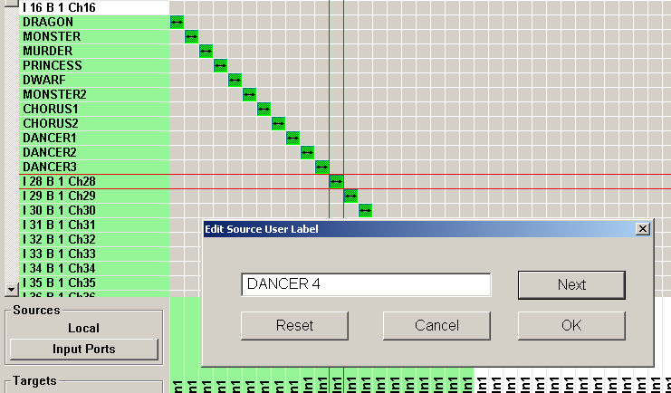
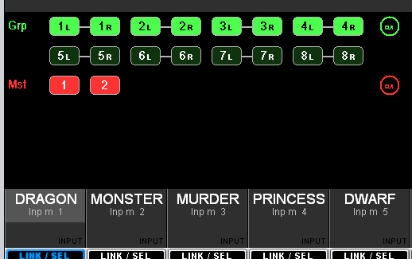
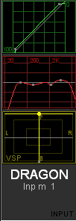
Practical example – Library Events
Make a basic setting (Patch, Labels, Bus assign, Gains, EQ, etc.)
Store as a snapshot

Slide 38
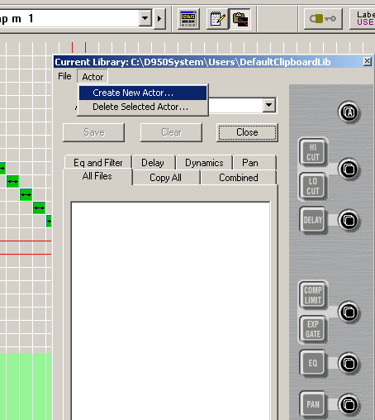
Practical example – Library Events
Enter Actor names
Remember that every actor is tied to one input channel / one microphone

Slide 39
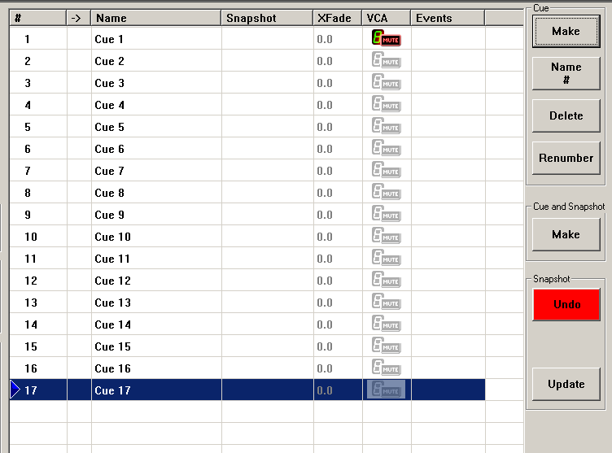
Practical example – Library Events
Make the required number of cues

Slide 40
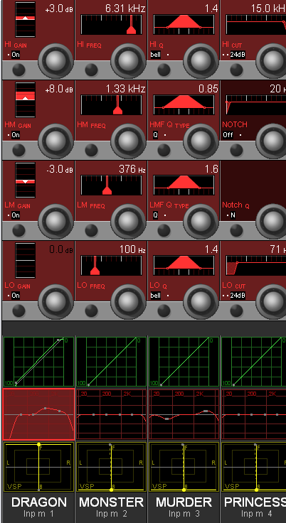
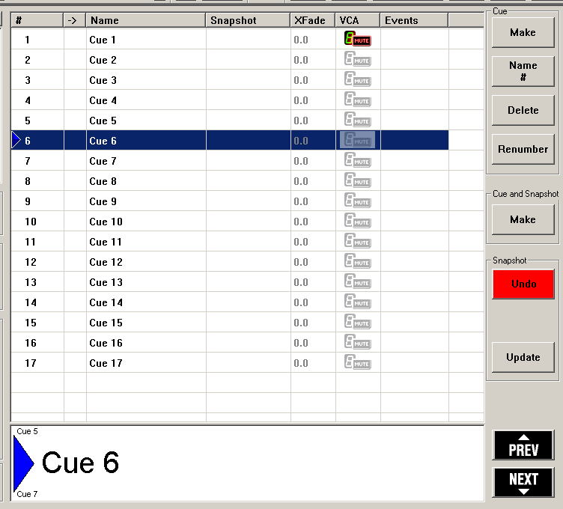
Practical example – Library Events
In a certain cue tweak the EQ on one channel because the character (channel) is in this cue speaking through a large beard.

Slide 41
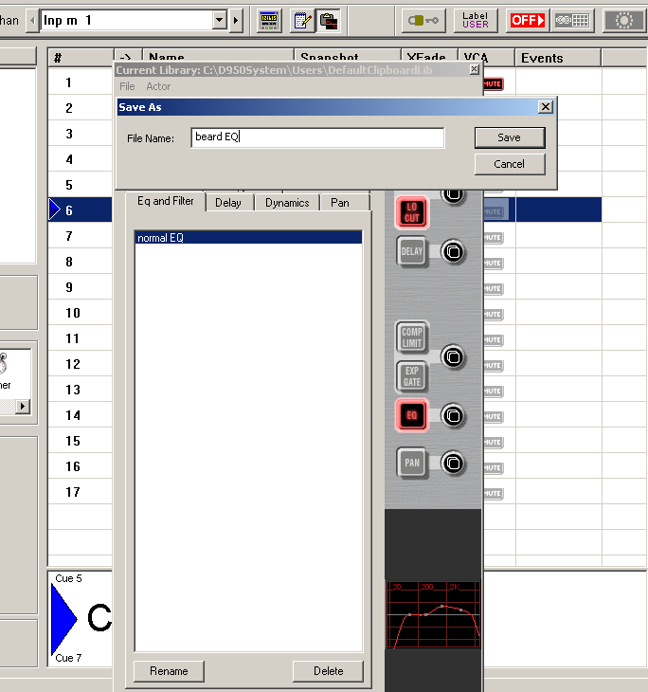
Practical example – Library Events
Copy this EQ to the library of that particular actor and name it „beard EQ“

Slide 42
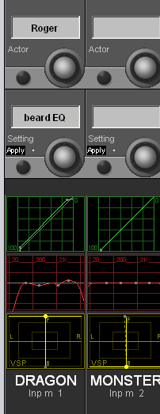
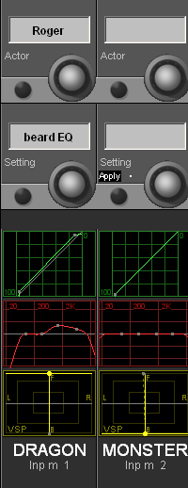
Practical example – Library Events
Search for the actor and apply the EQ setting to the cue

Slide 43
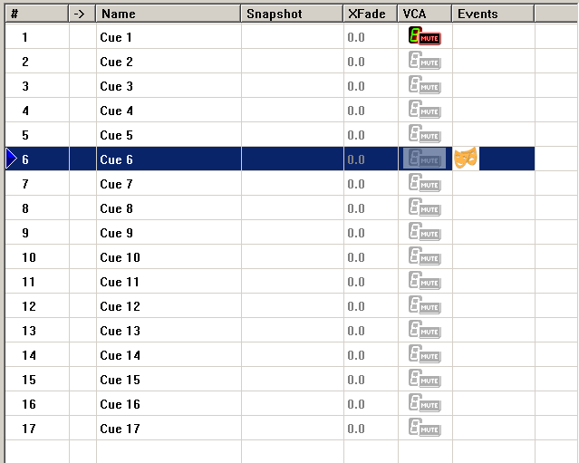
Practical example – Library Events
Event Icon is added to the Cue

Slide 44
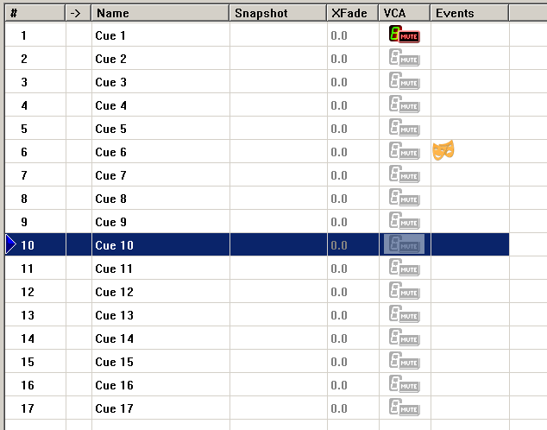
Practical example – Library Events
Advance a few Cues

Slide 45
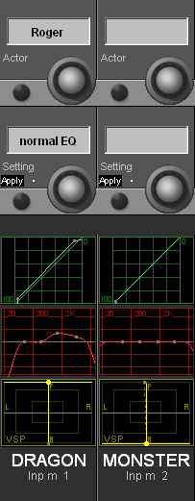
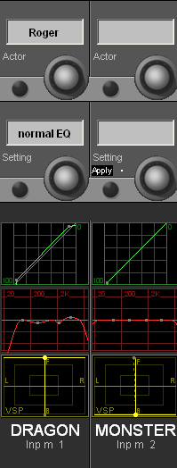
Practical example – Library Events
Apply the “normal EQ” setting in this cue

Slide 46
Practical example – Library Events
Event Icon is added to the Cue

Slide 47
Practical example – Library Events
Click on Library Event Icon and get Configuration view

Slide 48
Practical example – Library Events
Click on “Actor Overview” and get overview throughout all cues

Slide 49
Practical example – Library Events
Run through show again and tweak settings

Slide 50
Practical example – Library Events
Run through show again and tweaked settings stay !
Changes can be saved or reverted back to the original setting

Slide 51
Practical example – Library Events
Changes can also be saved or reverted at the End of the Show

Slide 52
Practical example – Library Events
When we have several Library Events which have been tweaked :

Slide 53
Practical example – Library Events
Create a “replacement” Actor (often called unterstudy)
Copy of Library settings are created with the same name !

Slide 54
Practical example – Library Events
Replace an Actor by an understudy

Slide 55
Practical example abstract – VCA/Mute Events
Open a ready prepared cuelist
Open the VCA/Mute window of the first cue
Type in VCA names
Assign the input channels (auto-unmute = on)
Open VCA/Mute window of next cue
Do the labels an assign on the desk , then „get current settings“ (also with F5 button)
Copy this VCA/mute event to other cues
Open the VCA/Mute window of the another cue
Type in further VCA names to show autocomplete
Show channel overview on one single channel

Slide 56
Practical example – VCA/Mute Events
Enable options

Slide 57
Practical example – VCA/Mute Events
Open the ready prepared cuelist
Click on the VCA/Mute Event icon of the first cue

Slide 58
Practical example – VCA/Mute Events
Doubleclick on VCA/Mute Event icon :
VCA/Mute Event window
VCA names
Channel view

Slide 59
Practical example – VCA/Mute Events
Name VCA masters

Slide 60
Practical example – VCA/Mute Events
Assign VCA’s
Mute and Unmute channels

Slide 61
Practical example – VCA/Mute Events
Go to next cue
Change VCA names and assign according to script
VCA names and assign can also be done on the desk and the copied to the VCA/Mute Event

Slide 62
Practical example – VCA/Mute Events
VCA/Mute Events can also be copied and pasted – from one cue to another

Slide 63
Practical example – VCA/Mute Events
Single channel overview

Slide 64
Practical example – VCA/Mute Events
Change single channel VCA assign in the overview window

