Slide 1
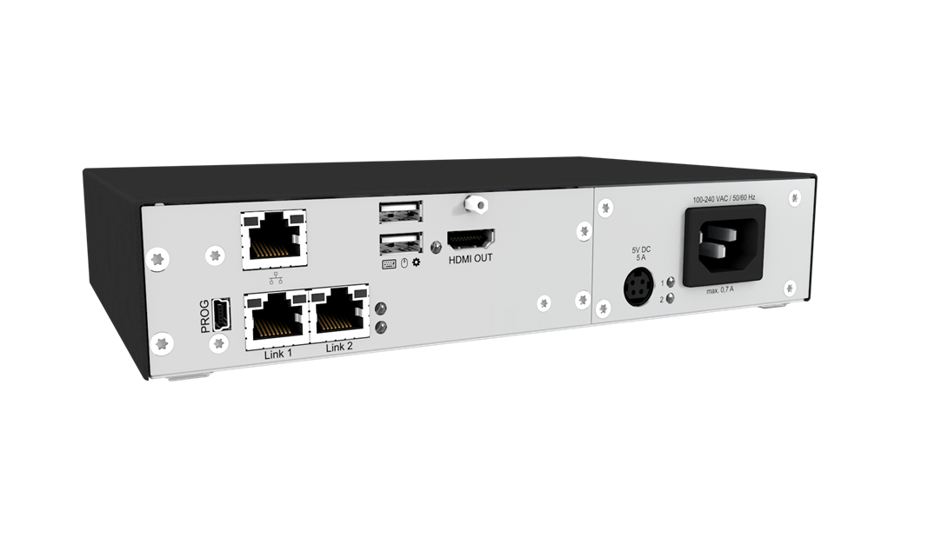

Draco SIRA
Nice to know – Tech Bits

Slide 2
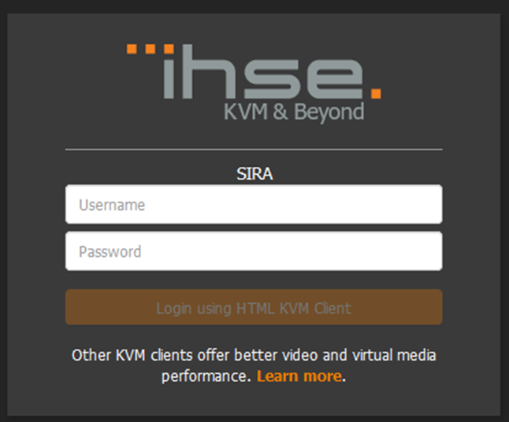
Connecting to SIRA - Login
Open a Browser and type in the IP address of the Draco SIRA !
Default IP address is:
192.168.100.88/24
Enter the Username and Password
Default: admin/admin
Click „Login and use HTML Client“
admin
admin

Slide 3
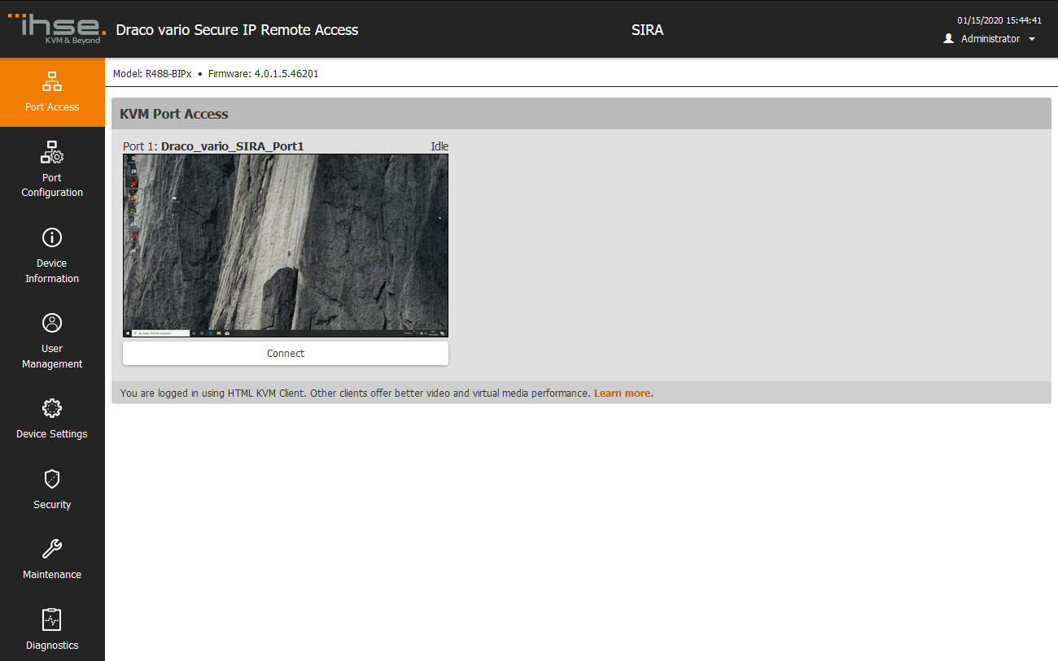
Connecting to SIRA – Starting site
You will be prompted to the following screen showing the Port Access with a Preview Image, if a source is connected!
Clicking the „Connect“ button will start a Browser session allowing KVM access to the source.
Clicking any of the options of the left task bar will prompt you to other configuration menus.

Slide 4
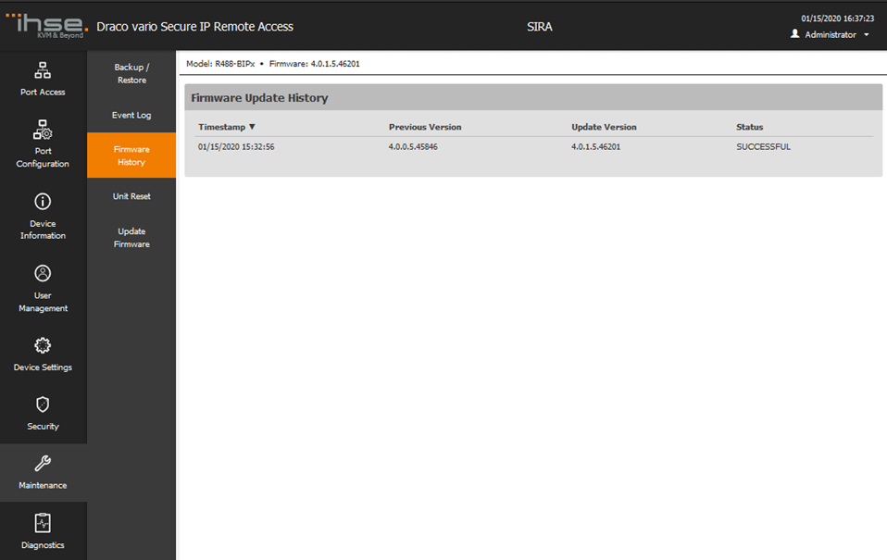
Checking / Updating Firmware
Select Maintenance and choose „Firmware History“ of the sub menu
here you can check for previous updates
Now select „Update Firmware“ of the sub menu
Notes:
Firmware Files have a signature for security reasons!
Firmware therefore can not be manipulated!
SIRA recognizes invalid Firmware and block illegal upload!

Slide 5
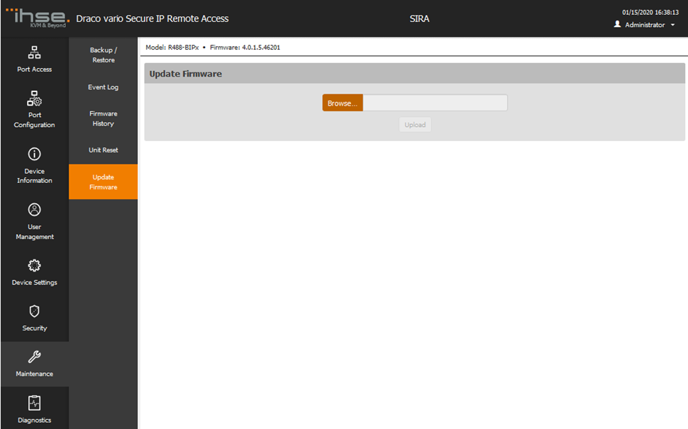

Checking / Updating Firmware
The top line always shows the current Firmware version
If there is newer Firmware available, click on and select the corresponding Firmware file
xyz.RFP
A two step process starts now!
1. Firmware is being uploaded to SIRA
2. Current and new revision info is shown for comparison.
Choose „Update now“, if all is correct.
Notes:
Updating process will take about 2 minutes! A progress bar will indicate outstanding update process.
After the update, the unit will reboot and the use will need to login again!
All previous settings will remain as configured!

Slide 6
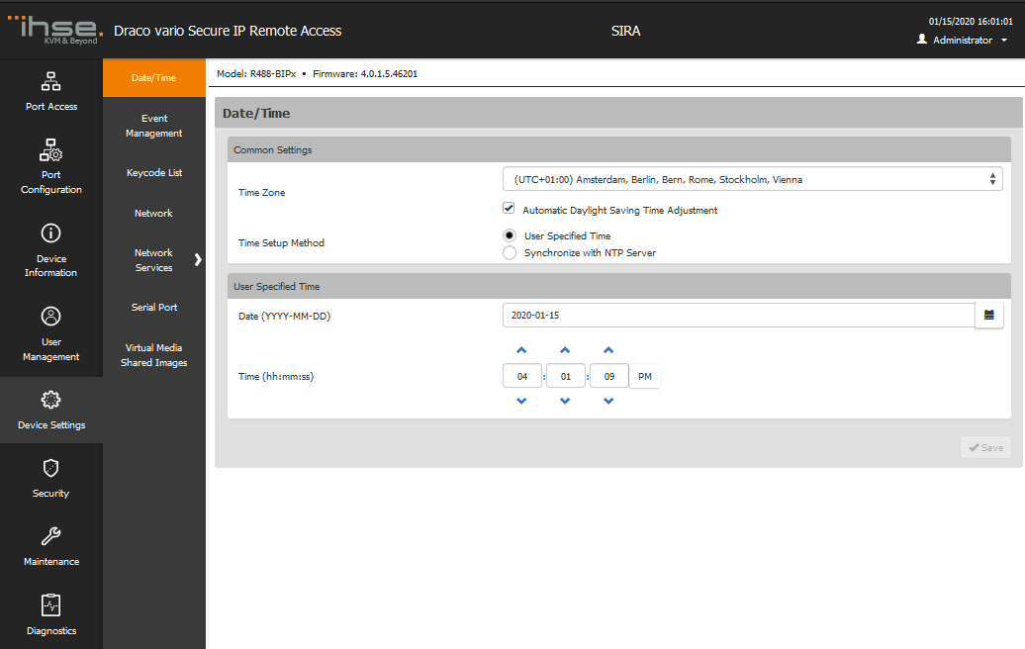
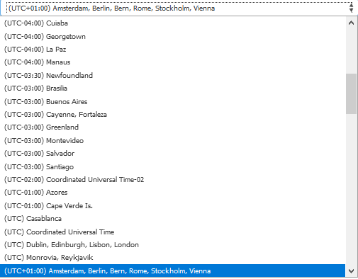
Basic Configurations – Time and Date
Choose form either internal clock or NTP server synchronization and pick the time zone!

Slide 7
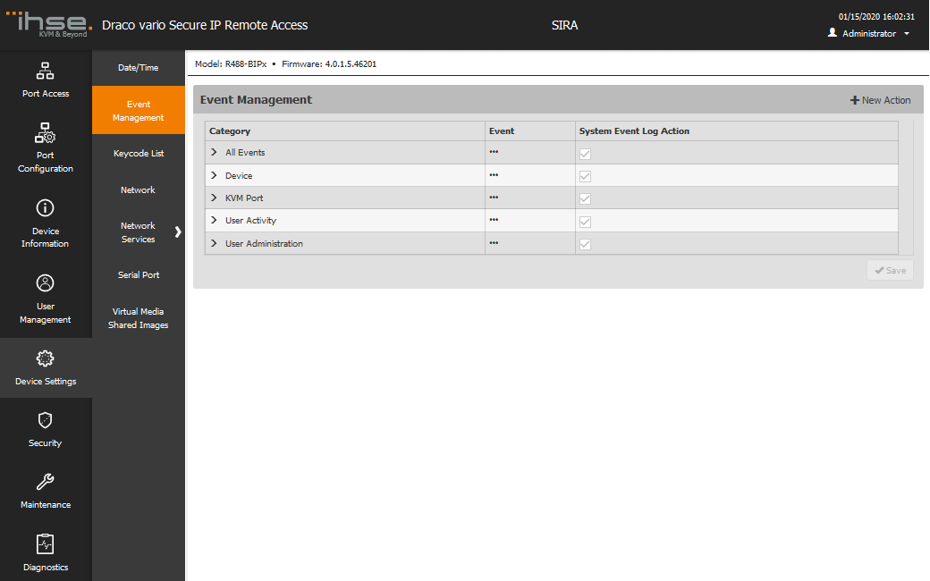
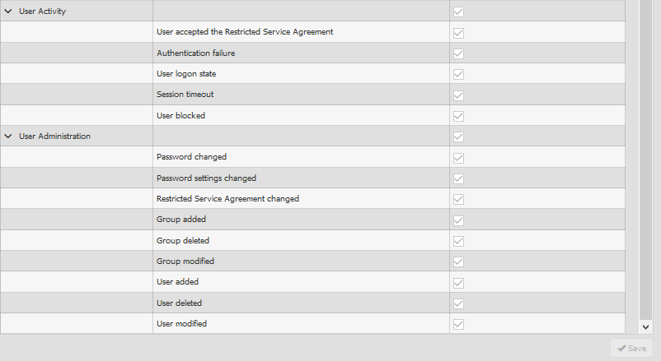
Event Management – Trap Settings
Choose, which events need to be monitored and generate an action!

Slide 8
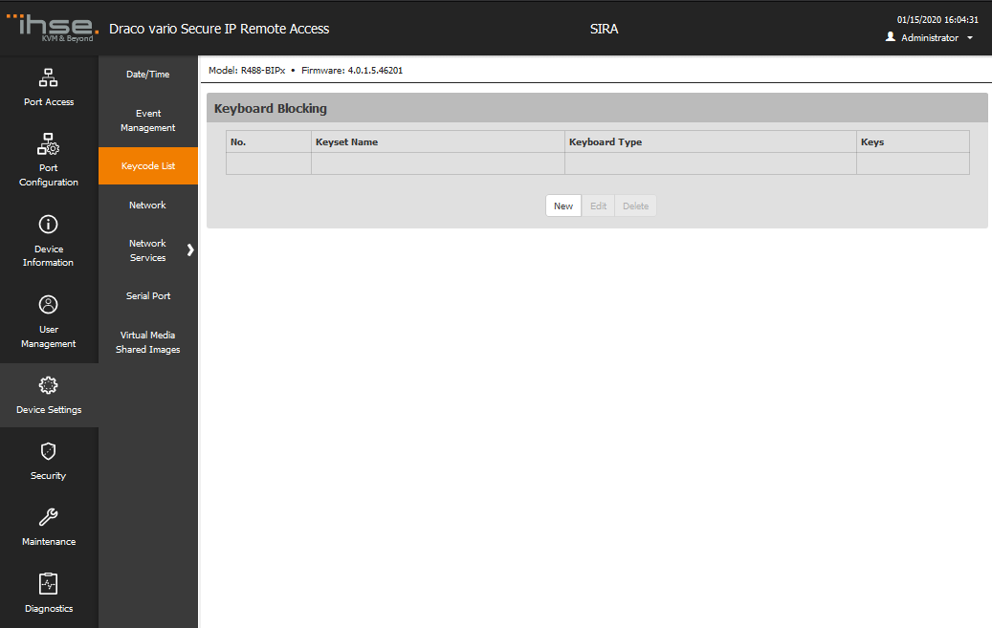
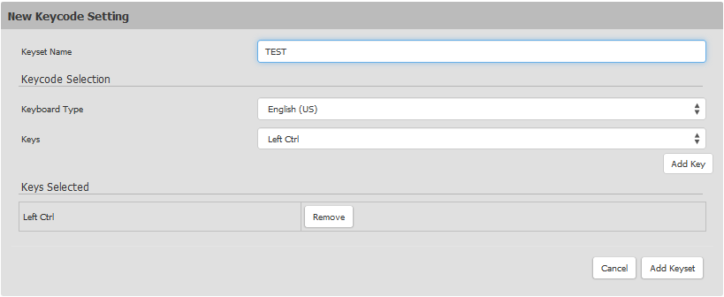
Keycode List – Restricts keys from being transmitted
…simply click NEW and define new lists and pick the necessary keys and add or remove them..
Notes:
The Keycode lists only define certain keys which are to be excempted from being transmitted during a remote session. The list need to be assigned to a user group to become active! Per user group only a single list can be assigned. See also Slide User groups.
Restricting keystrokes to be transmitted will limit operator capabilites to operate remote PCs! This option should carefully be used! E.g. in mission critical environments avoiding unwanted actions.

Slide 9
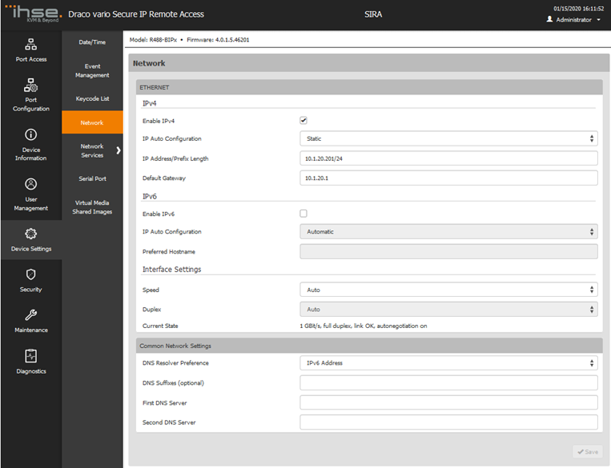
Basic Configurations – IP Address
Choose „Device Settings“ from the left menu bar
Then select „Network“ from the submenu
Choose from IPv4 or IPv6 settings and enter either a Static IP address or use DHCP and set the Default Gateway.
The network interface can be configured to utilize max. 10/100 or 1GBit as network speed. Also Half-Duplex or Full-Duplex mode can be chosen, if not set to Auto.

Slide 10
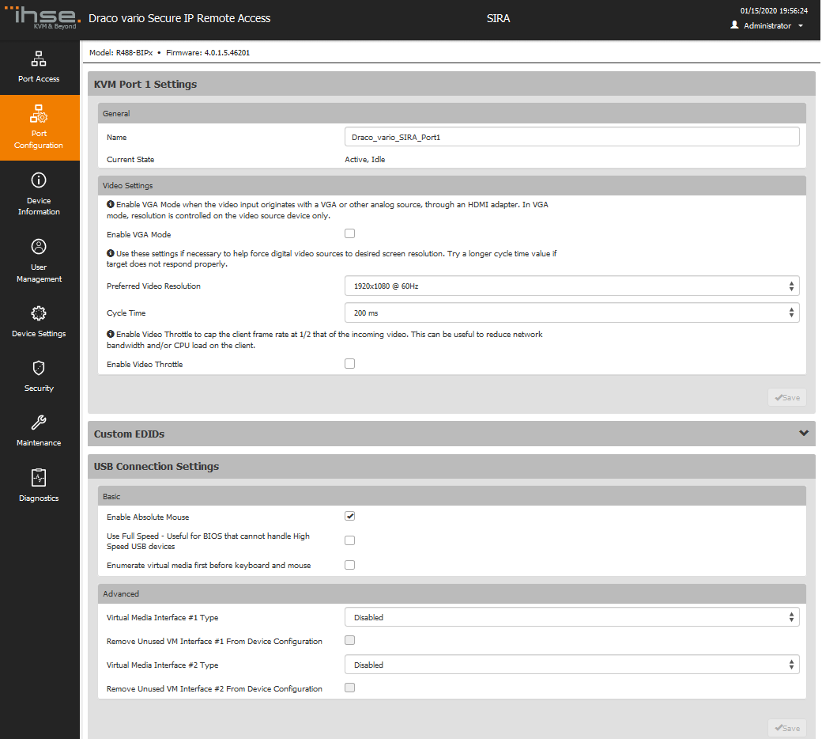
Basic Configurations – Port Configuration
The logical name (also DNS name) of the device can be determined here!
Video settings allow to choose from several options.
- Key is the EDID setting responsible for optimal image reception from the source.
- VGA mode is only relevant, if an A/D converter is in front of the HDMI input filtering noise
- Enabling Video throttle reduces the resource requirements at the decoders end by using only half the frames
➔e.g. 1080p60 sends only 30 fps
a 4K30 source signal sends only 15fps
Custom EDIDs: please refer to advanced settings!

Slide 11
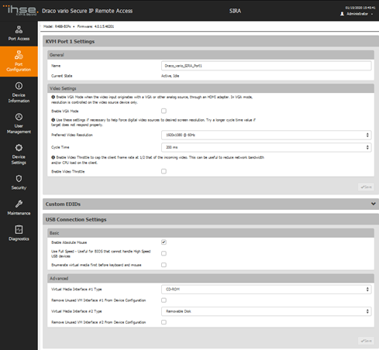
Basic Configurations – Port Configuration
USB Connection Settings
Absolute Mouse is ideal when being directly attached to a PC. This should be the default setting!
Especially when using R488-BIPHHL
Advanced
Virtual Media Interfaces should be disabled on R488-BIPx(R)!
Virtual Media devices can be enabled and will allow file transfer between the Remote Users PC running the Decoder (Browser, Client) and the target PC (source) connected to the R488-BIPHHL.
If VM devices are disabled, SIRA applies to the source PC only as HID device with no security risk!
Notes:
Two virtual devices can be configured and will be emulated accordingly. ( HDD, NAS, CD-ROM/DVD/BluRay, Thumbdrives are supported!

Slide 12
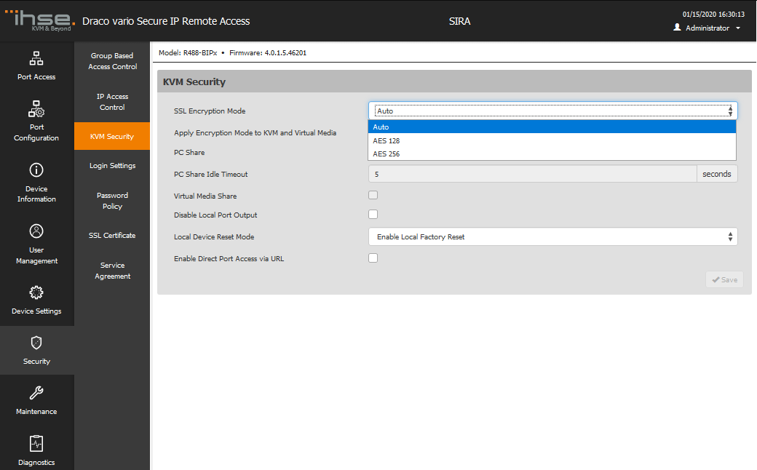
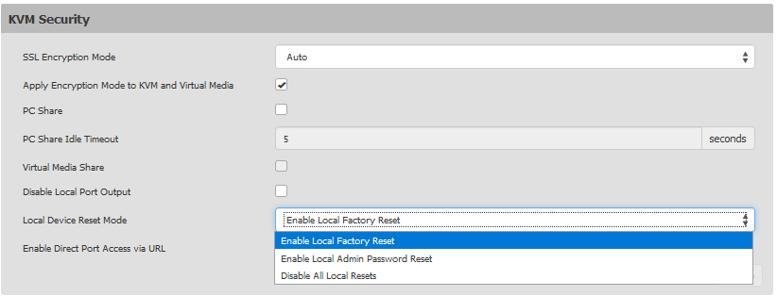
Basic Configuration – KVM Security
In order to allow shared KVM sessions, the PC Share option needs to be checked!
In order to also share embedded audio signal, Virtual Media Share needs to be checked as well!
To prevent from unwanted reset of the unit, several modes can be chosen from!
The local feed-through port can be disabled checking this option
Notes:
Once PC Share is enabled, uip to 8 streams of KVM(A,U) can concurrently be started. All streams are send out in UNICAST. Streams can be started from different clients or the same. Streams may be started in Browser, WinClient and LinuxClient or from SIRA User Station, also concurrently!

Slide 13
Basic Configuration – KVM Security
Enable Direct Port Mode allows to kick-start a session without further interaction, given all security mechanisms are inplace (e.g.certificates).
This works for Browser access and Client Access.
(See slides towards the end)
Notes:
Once PC Share is enabled, uip to 8 streams of KVM(A,U) can concurrently be started. All streams are send out in UNICAST. Streams can be started from different clients or the same. Streams may be started in Browser, WinClient and LinuxClient or from SIRA User Station, also concurrently!

Slide 14
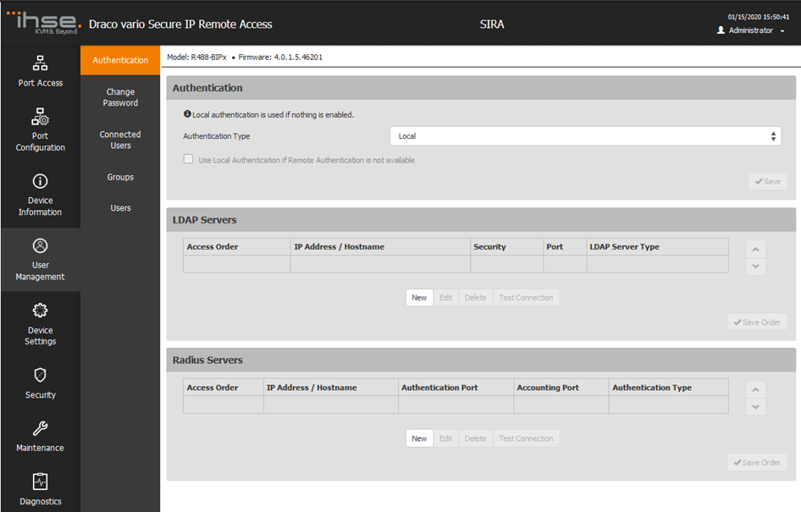
Basic Configurations – Access Rights
User Management
Defines authentication methods such as
- local
- LDAP
- RADIUS
The default setting is local and sufficient for basic configuration!
It is important to start setting up Groups and then Users. Default Groups are „Users“ with minimal rights and „Admin“ with full rights.
Notes:
Two virtual devices can be configured and will be emulated accordingly. ( HDD, NAS, CD-ROM/DVD/BluRay, Thumbdrives are supported!

Slide 15
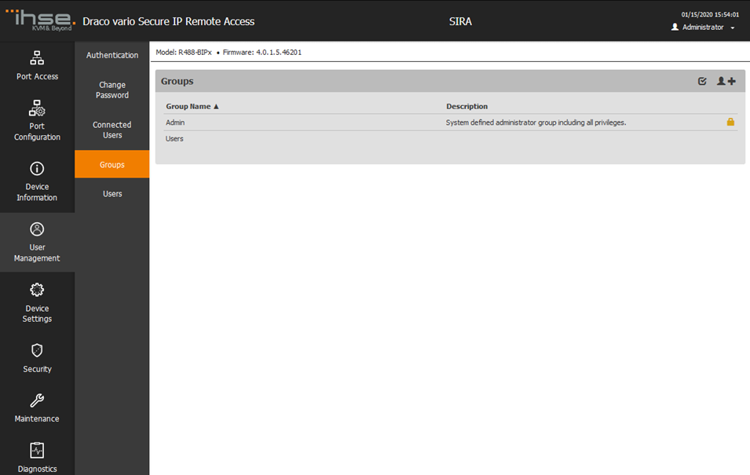
Basic Configurations – Access Rights
User Management
Defines authentication methods such as
- local
- LDAP
- RADIUS
The default setting is local and sufficient for basic configuration!
It is important to start setting up Groups and then Users. Default Groups are „Users“ with minimal rights and „Admin“ with full rights.
Notes:
Two virtual devices can be configured and will be emulated accordingly. ( HDD, NAS, CD-ROM/DVD/BluRay, Thumbdrives are supported!

Slide 16
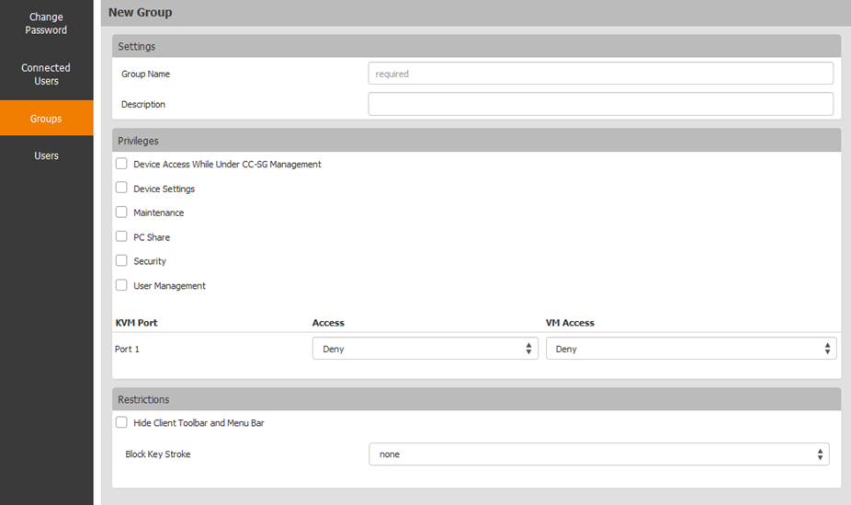
Basic Configurations – Access Rights: Groups
Define a new Group by assigning a group name
Pick from the Priviliges for
- maintaining the unit
- accessing it!
Restrictions reduce the clients menu and tool bar and allow blocking of defined keystrokes
Notes:
Keystroke Blocking Lists are being defined at the „Device Settings“ submenu „Keycode List“.
Several lists of different keycodes can be setup. Per User Group only one of these lists can be assigned!

Slide 17
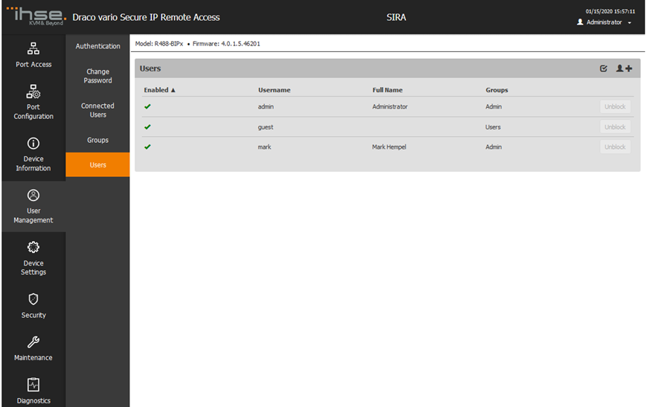

Basic Configurations – Access Rights: Users
New Users can easily be added clicking

Slide 18
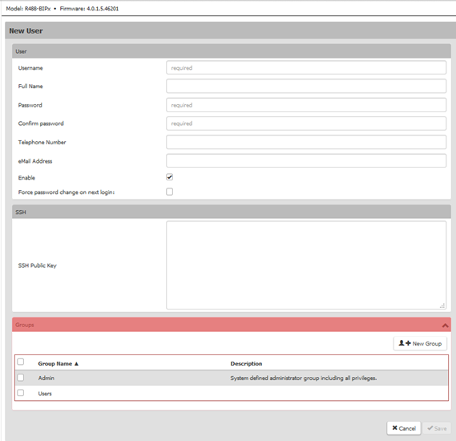
Basic Configurations – Access Rights: Users
Simply assign Username and proceed entering the required data
It is recommended to setup an initial password! The User can be forced to change the PWD with next login to pick his own.
Users can be Enabled (active) or Disabled (inactive). Inactive Users will remain witin the configuration but will not be able to access SIRA.
Finally assign the User to a Group!

Slide 19
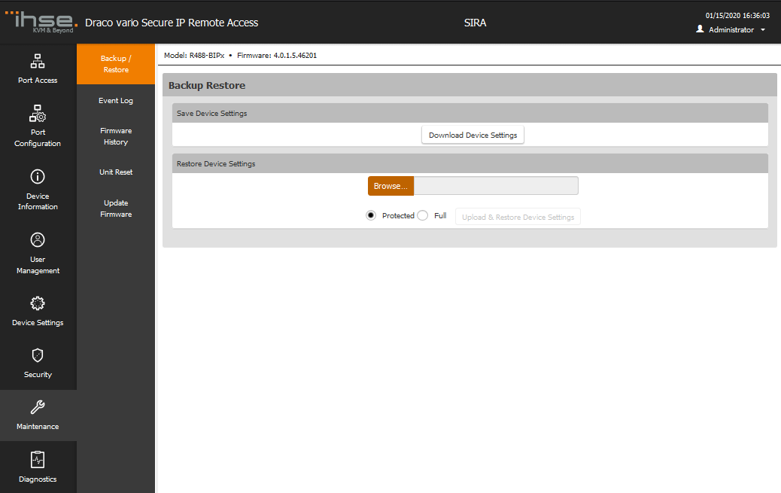

Basic Configurations – Backing Up/Restoring the Unit
A backup of the units configuration can be saved to local or network attached storage ba selecting „Download Device Settings“
Restoring the unit is possible by simply browsing and selecting an appropriate Backup file.
Notes:
Protected Restoration:
Restores all settings except for device specific settings: network information, names, preferred resolution.
Full Restoration:
Restores all settings including network information, names, preferred resolution.

Slide 20
Basic Configurations – Resetting the Unit
Resetting the unit is possible via the Maintenance option
Choose Unit Reset from the submenu

Slide 21
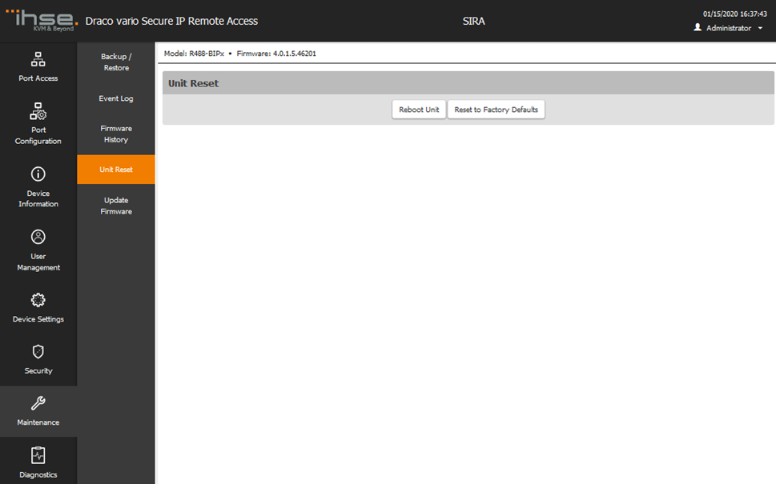
Basic Configurations – Resetting the Unit
There are two options available:
- Rebooting the unit
-Resetting the unit to Factory Default
Select from the options and proceed as prompted by the unit.

Slide 22
Connecting to SIRA via Browser - Login
Open a Browser and type in the IP address of the Draco SIRA !
Default IP address is:
192.168.100.88/24
Enter the Username and Password
Default: admin/admin
Click „Login and use HTML Client“
admin
admin

Slide 23
Connecting to SIRA – Starting site
You will be prompted to the following screen showing the Port Access with a Preview Image, if a source is connected!
Clicking the „Connect“ button will start a Browser session allowing KVM access to the source.

Slide 24
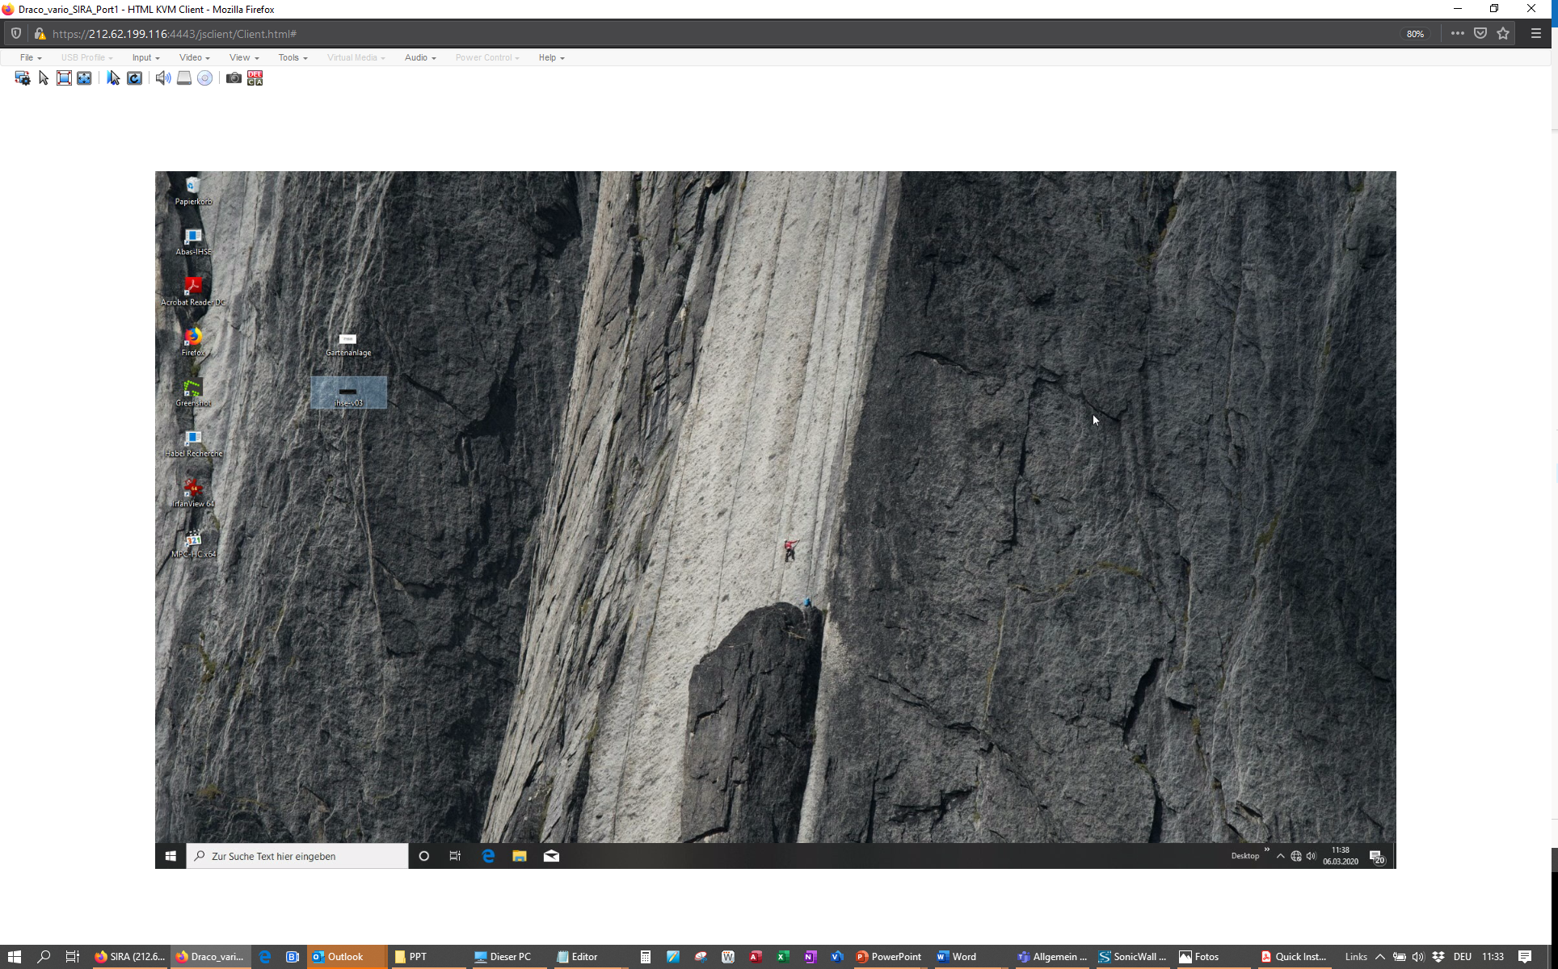
Making a Browser Connection – Basic Setup Options
…and another Browser window will open with the remote connection to the target server…
Depending on whether you are connected to a single computer or to a KVM system, mouse settings need to be configured!

Slide 25
Basic Configurations – Single Mouse Mode
…when using
Single Mouse Mode
the mouse pointer is „caught“ inside the remote session window!
Press ESC to exit SMM.

Slide 26
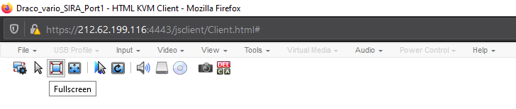
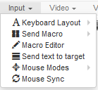

Basic Configurations – Mouse Mode Selection
Absolute Mouse
is the preferred and default setup, ideal for use with R488-BIPHHL connected directly to a remote computer!
If SIRA is attached to a KVM system such as Draco tera, the mouse mode needs to configured to:
Single Mouse Mode
Selecting Single Mouse Mode
Notes:
Absolute and Single Mouse Mode are the only viable modes to choose from as they don‘t need any synchronization of the mouse !

Slide 27
Connecting to SIRA via Windows Client dynamically
Open a Browser and type in the IP address of the Draco SIRA,
followed by „/akc“!
https://192.168.100.88:443/akc
Ignore and confirm the security notifications, if no certificates have been installed ,yet – then open „AKC deployment“.
➔ the Client will start
admin
admin

Slide 28

Connecting to SIRA via Windows Client staticly
Use the extracted Version of the Sira Windows Client as provided by IHSE.
Unzip the SIRA-Client.ZIP file and create a link of kxgui.exe and copy it to the desktop
Right-click the kxgui.exe icon and follow the instructions on the next slide

Slide 29
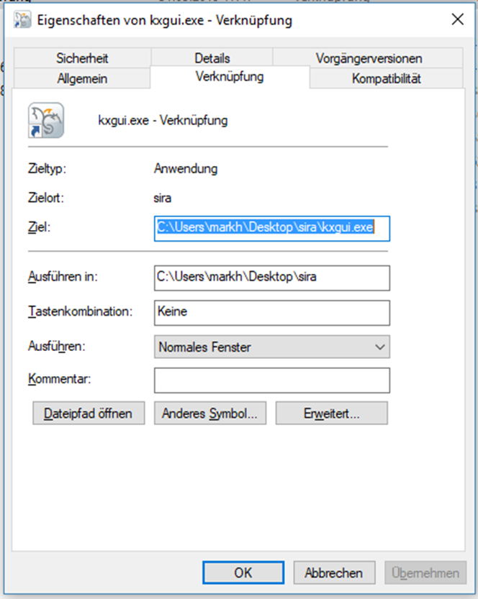
Connecting to SIRA via Windows Client staticly
Select the field „Ziel“ („Target“) as high-lighted in the screenshot to the left
Change the parameters right after kxgui.exe as follows (in red):
"\\directory of unzipped SIRA resource files\kxgui.exe" /host IP address of SIRA /port 443 /ssl false /username admin /password admin /portid 1 /portname "Port 1“
Apply the changes and doubleclick the icon to start a remote connection

Slide 30
Connecting via Windows/Linux Client dynamically
Direc Port Access using a Linux Client
https://IPaddress/dpa.asp?username=username&password=password&port=1&client=vkcs
Direct Access using the Windows Client
https://IPaddress/dpa.asp?username=username&password=password&port=1&client=akc
e.g. Logging in on Windows Client Direct Access for user „admin“ with pwd „admin“
https://IPaddress/dpa.asp?username=admin&password=admin&port=1&client=akc
Notes:
Direct Port Access needs to be enabled in KVM Security in order to be able to allow for that!

Slide 31
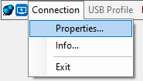
Using the SIRA Windows Client – The Dock
The Client offers different modes of operation. These are available via the Dock located at the upper edge of the screen.
Best to start of with the connection properties:

Slide 32
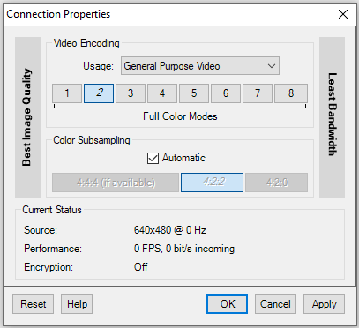
Using the SIRA Windows Client – Connection Properties
The connection properties show the current video encoding settings and allow changing the encoder parameters to optimize performance and usibility.
Usually „Automatic“ deals with all circumstances.
The current status inof shows the video resolution transmitted, the delivered framerate and the bandwidth utilization.

Slide 33
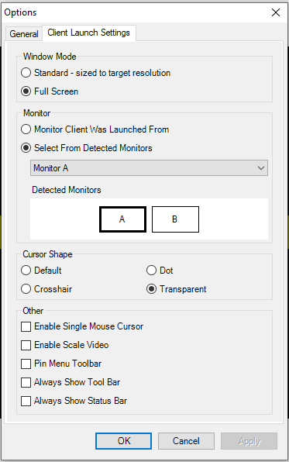
Using the SIRA Windows Client – Tools-Options
Client launch parameters can be defined within the menu „Tools“, submenu „Options“.
Window Mode:
- FullScreen or 1:1 target resolution
Monitor:
- if the client PC has multiple monitors, even the monitor can be chosen where the client starts the session.
Cursor Shape:
- defines the style of the „local/leading“ mouse pointer.
Other:
- choose the appearence of the session window
- Enable „Single Mouse Cursor“
Notes:
Single Mouse Cursor should be chosen, if SIRA provides access to a connected KVM system such as Draco tera.

Slide 34
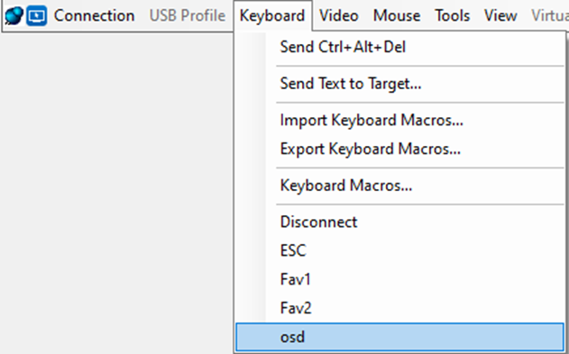
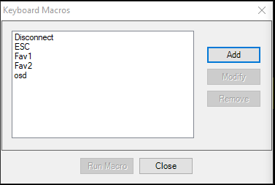
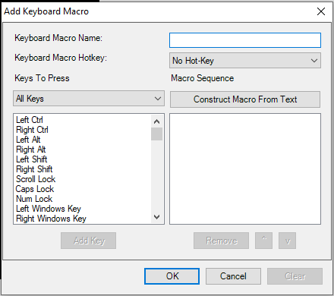
Using the SIRA Windows Client – Keyboard Menu
Some keystroke commands can not simply be transferred to the
remote PC. Special Macros are required, such as the preconfigured
CTRL-ALT-DEL.
Additional Macros can be edited under this menu option quite easily.
Simply follow the Wizard. (e.g. Hotkey commands to bring the Draco tera OSD or execute a switching command. Defined Macros can be exported and imported for backup reason or deployment.
Also complete text can be pasted into the Send Text to Target window and all characters will be transfered to the target.

Slide 35

Using the SIRA Windows Client – Video Menu
Refresh Screen:
In case artifacts occur on the screen and remain there, a screen refresh can be triggered.
Screenshot from Target:
A screenshot of the target computer can be made and stored at the client PC.

Slide 36
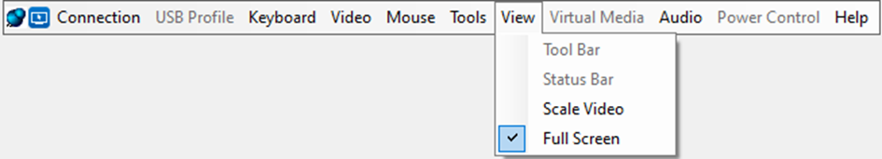
Using the SIRA Windows Client – View Menu
Depending on the User rights, up to four options are available in this menu:
Tool Bar: Show or Hide Toolbar
Status Bar: Show or Hide Status Bar
Scale Video: Scales the source video output into the Windows Client window size
Full Screen: Maximizes the Client window to fit the pysical screen resolution – no window frames are visible.

Slide 37
Using the SIRA Windows Client – Mouse Menu
Mouse settings are impportant for proper usibility of remote sessions as th emouse pointer of the client and the target computer need to be aligned.
When using SIRA as a gsteway to a KVM system, then Single Mouse Cursor must be chosen!
If SIRA is used straight connected to a PC (R488-BIPHHL only) best resuklts are achieved with „Absolute“ setting.
The Cursor Shape can also be defined in four variations.
When using Single Mouse Cursor mode, the mouse is caught inside the session window. Inorder to escape, the hotkey LCTRL-LALT-O is to be used!
Notes:
Single Mouse Cursor should be chosen, if SIRA provides access to a connected KVM system such as Draco tera.

Slide 38
Using the SIRA Windows Client – Important Hotkeys
Hotkeys available in SIRA Windows Client:
Terminating the session: LCTRL-LALT-Q
Toggle between Single Mouse Cursor and Absolute mode: LCTRL-LALT-O
Toggle between Fullscreen and Window mode: LCTRL-LALT-M
Toggle image scaling: LCTRL-LALT-S
All Hotkeys are user configurable! The above listed commands are the default Hotkeys and may be changed!
Notes:
LCTRL-LALT-Q means all three keys needs to be pressed and released together!
LCTRL: left CTRL or STRG key
LALT: left ALT key

