Slide 1
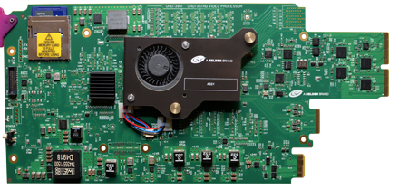
Technical Support training
UHD-3901-UC v1.0
Sylvain Marcotte, July 2016
COMPANY CONFIDENTIAL – INTERNAL USE ONLY

Slide 2
Purpose of UHD-3901-UC
Dual Channel HD/3G to 4K UHD upconverter with optional HDR processor
Notes:
The Densité UHD-3901-UC is a revolutionary product designed to complement existing applications, providing a simple way to move between HD/3G and 4K UHD formats as well as from SDR to HDR. The UHD-3901-UC cards accommodate a gradual adoption of HD production elements into 4K UHD broadcasting workflows, while protecting investment in installed equipment. These cards are useful in several applications.

Slide 3
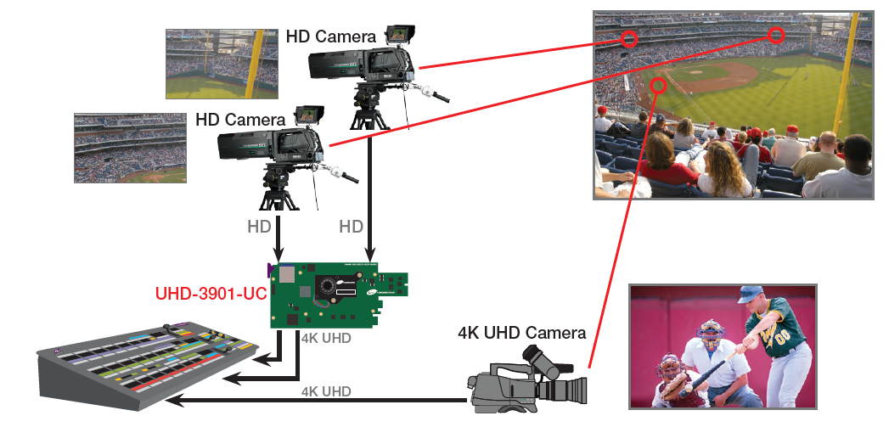
1) Up-conversion application in live sports
Notes:
When you need to produce content in 4K UHD, but have a mix of HD, 3G and 4K UHD cameras, the UHD-3901-UC provides the ability to create a common format for the final production. This is a great solution for live sports or other applications that often produce in HD along with 4K UHD and utilize a mix of cameras.
The card offers dual channels of upconversion and supports both two sample interleave (2SI) and square division quad split (SDQS) 4K UHD. The 4K UHD card easily enables conversion between the two formats for simplified interoperability.

Slide 4
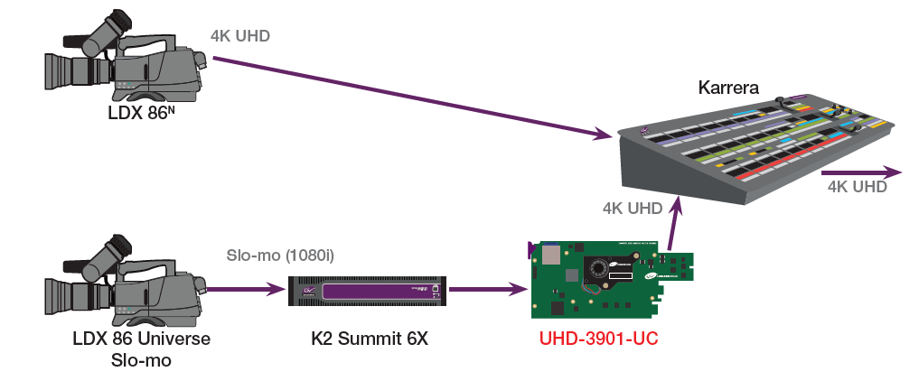
2) Slowmo in UHD Production
Notes:
When you want to use HD or 3G slo-mo in a 4K UHD production, the UHD- 3901-UC processing module allows regular and slow motion HD or 3G cameras as well as other HD/3G sources to be used in 4K UHD productions by upconverting to a common 4K UHD format.
By utilizing the card in combination with HD/3G cameras enables use of 6X slow motion in a 4K UHD workflow. The UHD-3901-UC provides a method to take the slo-mo output from a 6X K2 Dyno Replay System server to create a 4K UHD slo-mo version.

Slide 5
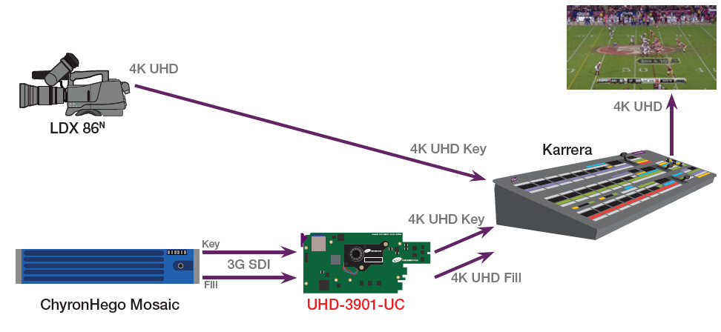
3) Live CG
Notes:
When you need to integrate 3G SDI computer graphics with live 4K UHD production, the UHD-3901-UC can take the output of the graphics generator during production and produce the 4K UHD fill and key for the switcher. The UHD-3901-UC provides a readily available and simple solution for adding CG graphics to a 4K UHD production.

Slide 6
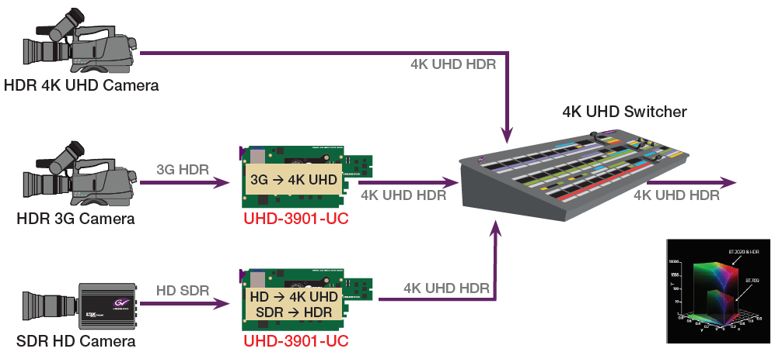
4) HDR Production in 4K with HDR Option
Notes:
When producing 4K UHD productions that not only use HDR 4K UHD cameras, but also HDR 3G cameras and SDR HD cameras, the UHD-3901-UC can bring all sources to a common format, not just in resolution but also in color space. The UHD-3901-UC can convert from 3G or HD to 4K UHD, and it can convert from SDR to HDR, supporting HLG, PQ and S-Log.

Slide 7
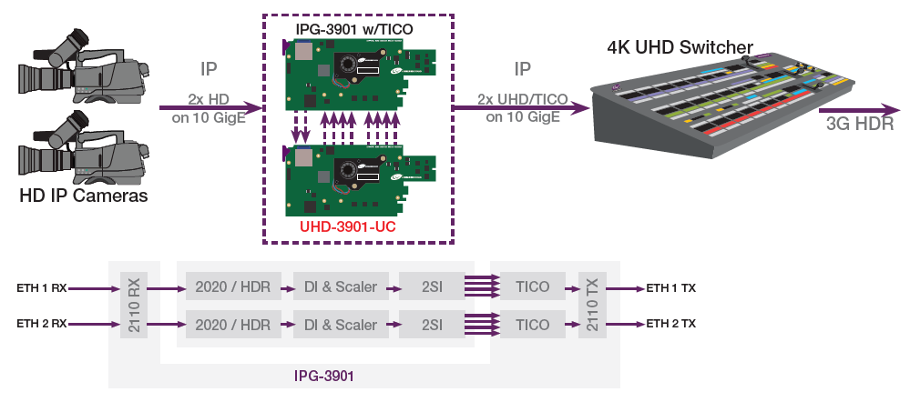
6) UHD-3901-UC in IP production environment
Notes:
When you want to add 4K UHD to your HD workflow that already uses IP cameras over 10G Ethernet, you can pair an IPG-3901 with TICO along with the UHD-3901-UC, and feed that into a 4K UHD switcher for instant 4K UHD production over IP.

Slide 8
Feature Summary

Slide 9
UHD-3901-UC Features Summary
Dual Channel Broadcast quality up-converter
HD 1080i/720p/3G to UHD 3840x2160 @ 59.94/50Hz
Support 4K link 2SI or SDQS output (3G level A and B)
Integrated frame buffer for output alignment
External reference or URS frame reference
Hi-quality scaler and de-interlacer
Broadcast quality color conversion (ITU BT rec 709 - rec 2020)
SDR to HDR optional processing
Embedded audio and metadata delay and synchronization

Slide 10
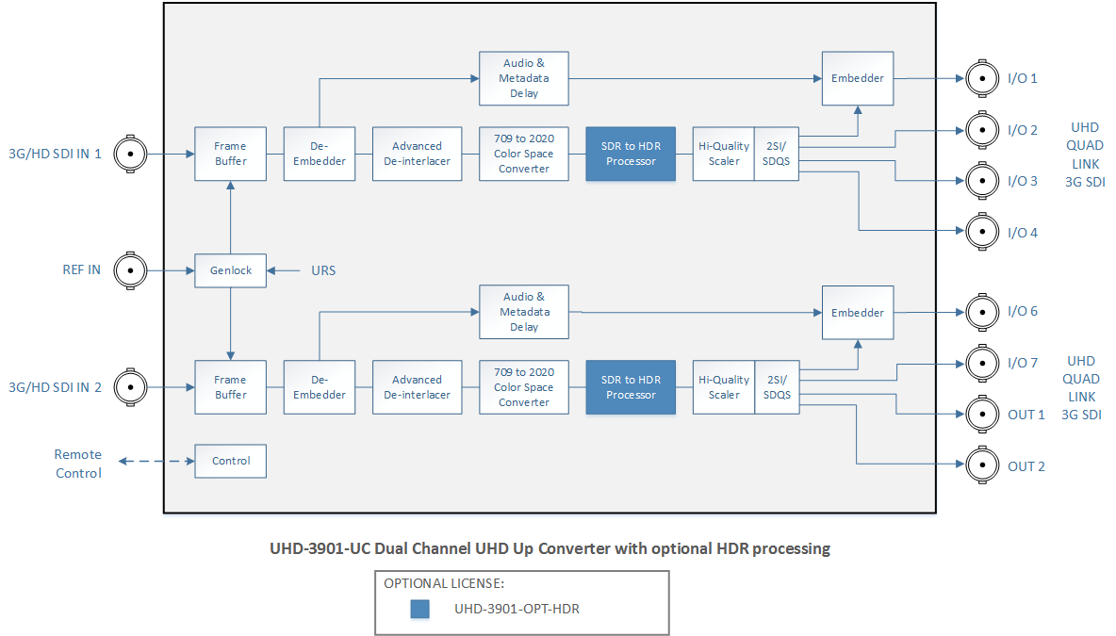
UHD-3901-UC Block Diagram

Slide 11
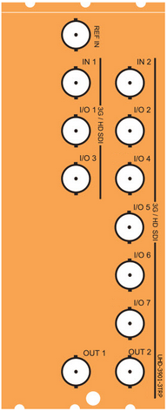
UHD-3901 Rears
UHD-3901-3TRP
UHD-3901-3+DRP

Slide 12
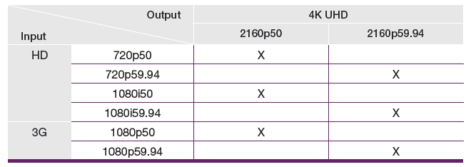
UHD-3901-UC Video Formats Supported

Slide 13
Color processing
Color Space conversion:
Standard feature
Bypass or Rec.709 to BT.2020 (ST 2087)
Optional HDR processing (UHD-3901-OPT-HDR)
Bypass
SDR to HDR HLG (BT.2100)*
SDR to HDR PQ @ 100 nits to 1000 nits max (ST 2084)
PQ (BT.2100) to HLG (BT.2100)*
HLG (BT.2100) to PQ (BT.2100)*
Slog3/S-Gamut3 to Rec. 709 800%*
Slog3/S-Gamut3 to PQ (BT.2100)*
Slog3/S-Gamut3 to HLG (BT.2100)*
* color space setting ignored.

Slide 14
Sales information

Slide 15
Densité UHD-3901-UC ordering code
Ordering Code | Description
UHD-3901-UC | Dual Channel UHD Up Converter
UHD-3901-3TRP | Triple rear connector panel
UHD-3901-3+DRP | Double rear panel for Densité 3+
UHD-3901-OPT-HDR | High Dynamic Range processing option

Slide 16
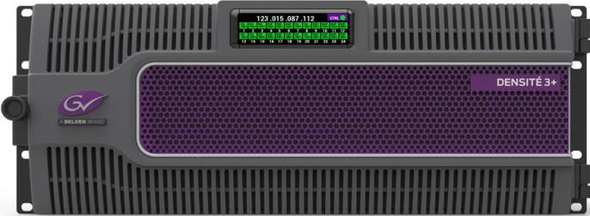
Densité Chassis supported & Density
3 slots in Densité 3
= 12 UHD UC channels in 3RU
2 slots in Densité 3+ FR1
= 4 UHD UC channels in 1RU
2 slots in Densité 3+ FR4
= 24 UHD UC channels in 4RU

Slide 17
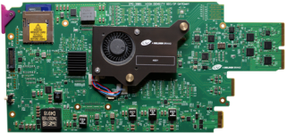
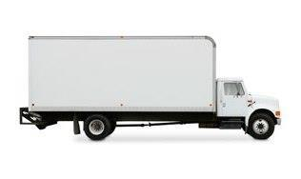
UHD-3901-UC delivery
Shipping:
July 2017

Slide 18
Ressources
Updated product information and datasheet on web.
Support portal:
Release notes
User Guide

Slide 19
UHD-3901-UC version 1.0.0
Technical information

Slide 20
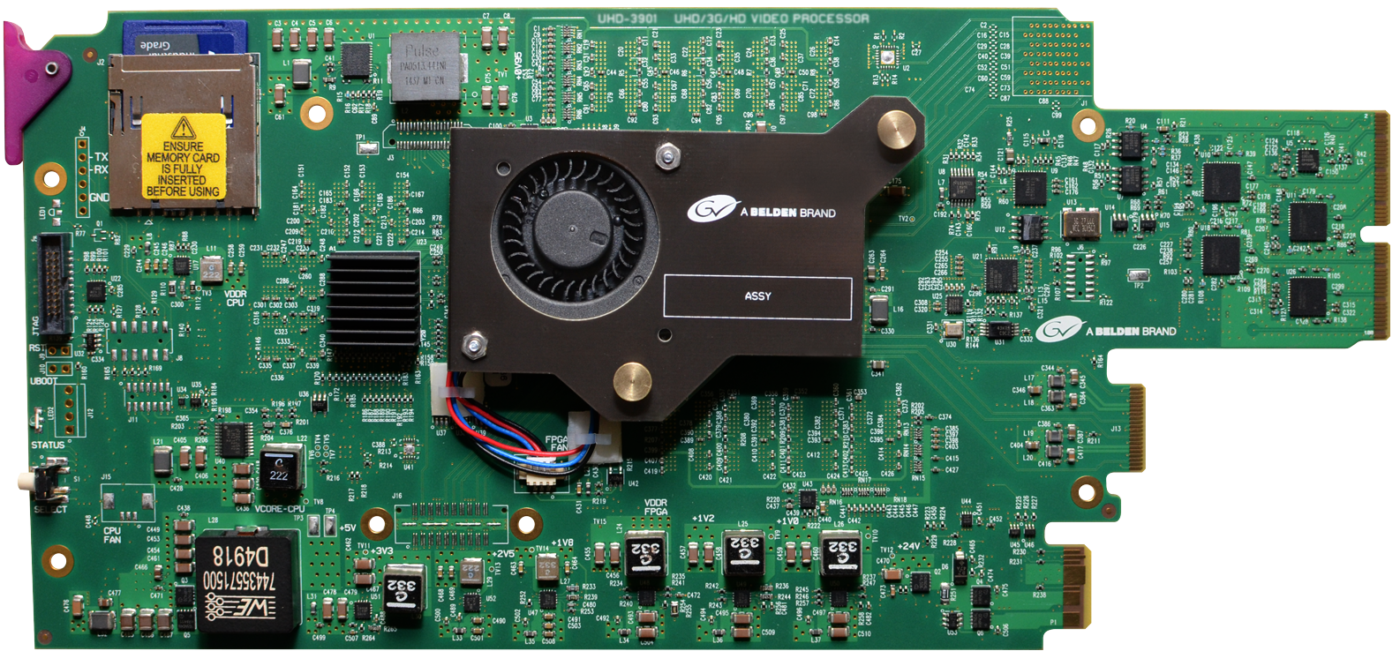
Hardware

Slide 21
Hardware
UHD-3901-UC uses the IPG-3901 hardware
New assembly with unique Dev ID:
user cannot change IPG to UHD.
Card name is UHD-3901: UHD/3G/HD Video Processor
Ejector says UHD-3901

Slide 22
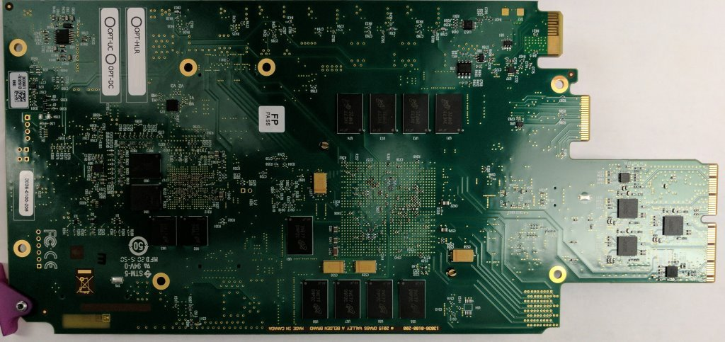
Hardware
Sticker on board tells if card is configured as a dual Up-Converter with OPT-UC checked.
OPT-DC for dual Down-Converter reserved for future – not planned today.
OPT-HDR indicates if HDR processing option is enabled.

Slide 23
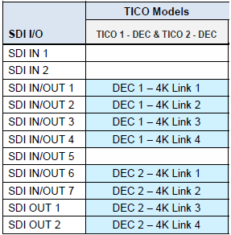
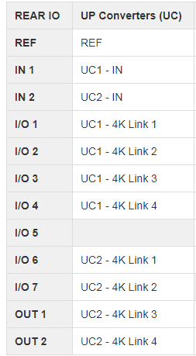
Rears
Same rears as IPG except without SFP+ cages.
Same pinout as IPG with TICO dual-Decoder
UHD-3901-UC
IPG-3901 TICO dual decoders

Slide 24
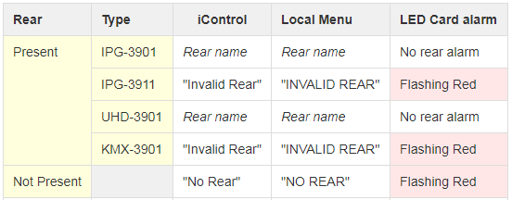
Rears
UHD-3901 will support IPG-3901 rears
IPG-3901 will not support UHD-3901 rears.

Slide 25
Firmware upgrade / iControl service
Need to install v1.0.0 service bundle to see UHD in iControl / iControl solo 7.10 +
Future versions:
Firmware upgrade on SD-Card like IPG-3901.
With Densite 3+ FR4 ADV and GV Node, can update the UHD-3901-UC with DUM like XIO-4901.

Slide 26
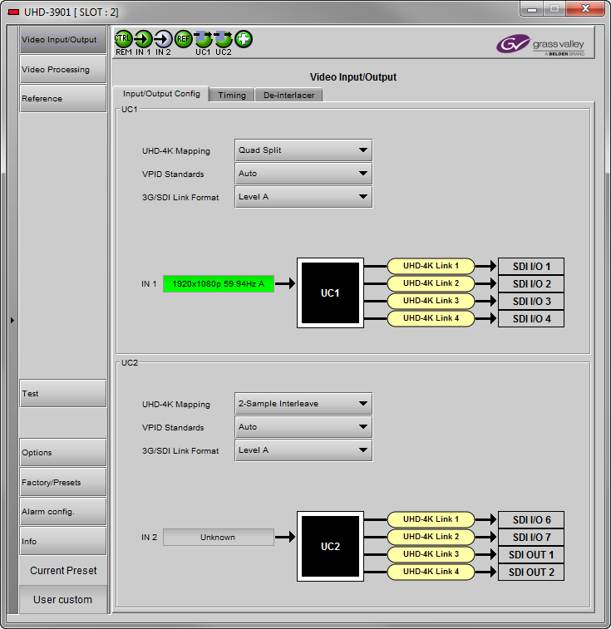
iControl Panel overview

Slide 27
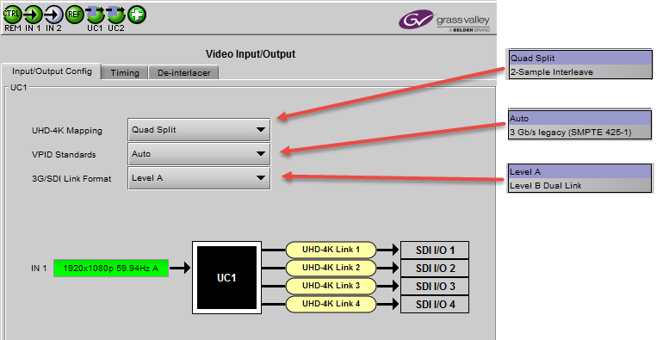
iControl Video Input / Output Config
2nd path UC2 not shown here

Slide 28
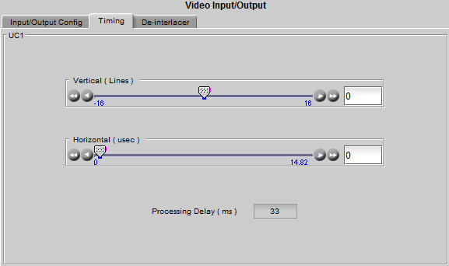
iControl Video Timing
Timing control same as XVP-3901:
2nd path UC2 not shown here

Slide 29
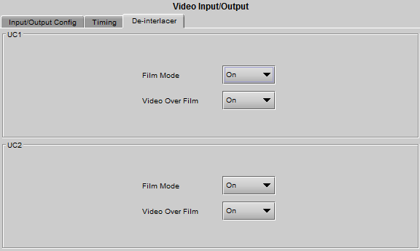
iControl De-Interlacer
De-Interlacer controls same as XVP-3901:

Slide 30
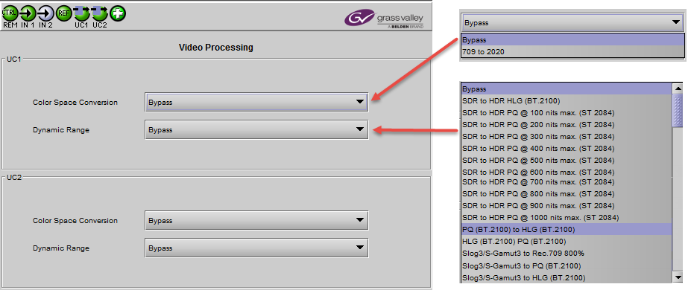
Video Processing
Dynamic Range available only with UHD-3901-OPT-HDR

Slide 31
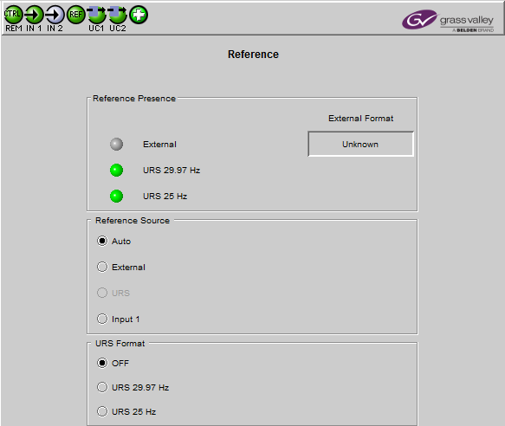
Reference – same as IPG-3901

Slide 32
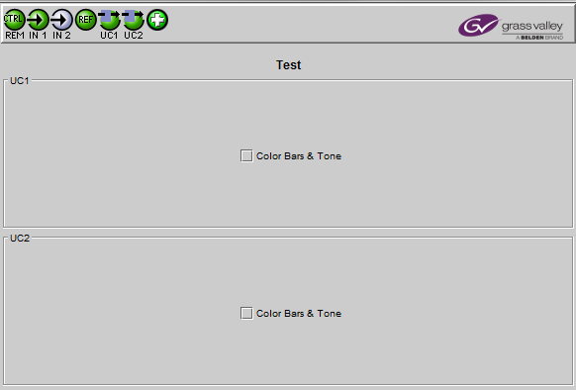
Test

Slide 33
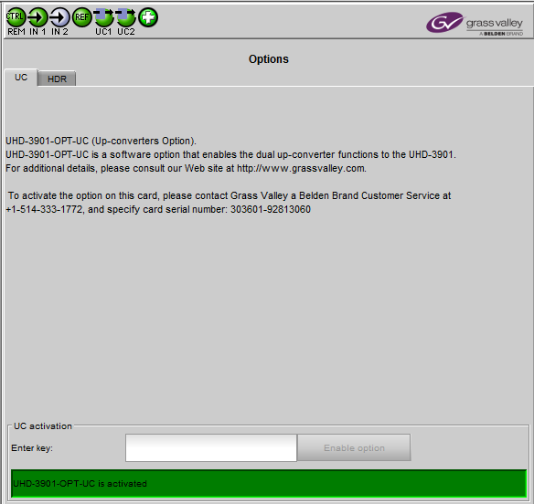
Options - UC
Always activated on
shipping UHD-3901-UC.
For future use only.

Slide 34
Options - HDR
For optional HDR
processing with
UHD-3901-OPT-HDR
purchase.
Standard Densité
licensing key model.

Slide 35
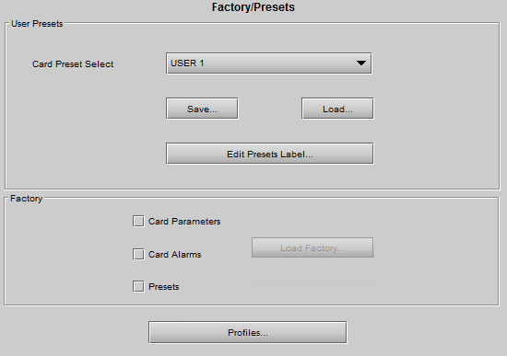
Factory/Presets
Same like IPG-3901:
- 5 users presets,
Factory
Profiles

Slide 36
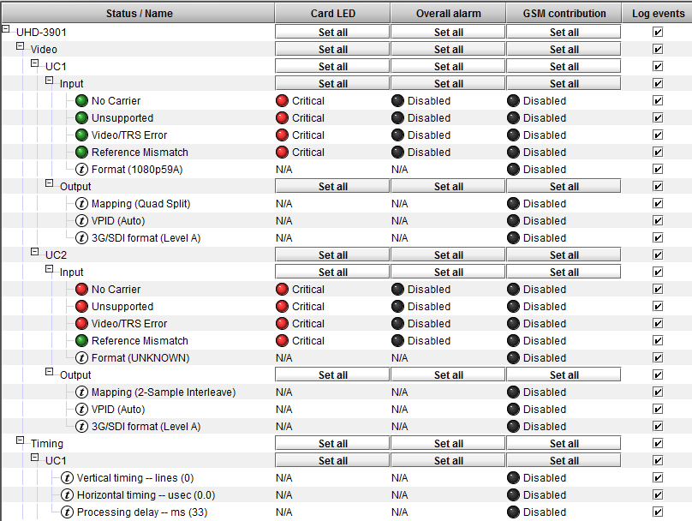
Exhaustive Alarm Configuration (1 of 2)

Slide 37
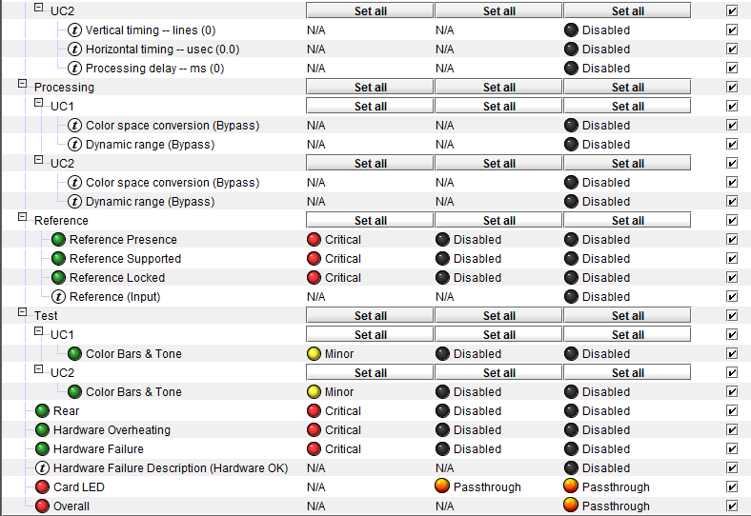
Exhaustive Alarm Configuration (2 of 2)

Slide 38
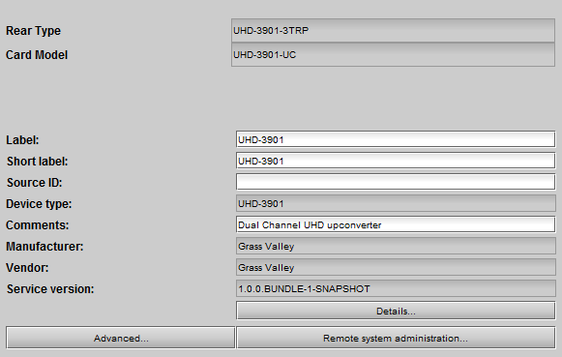
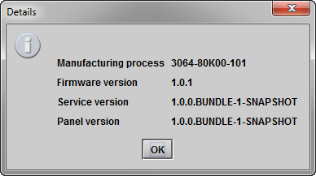
Info Tab

Slide 39
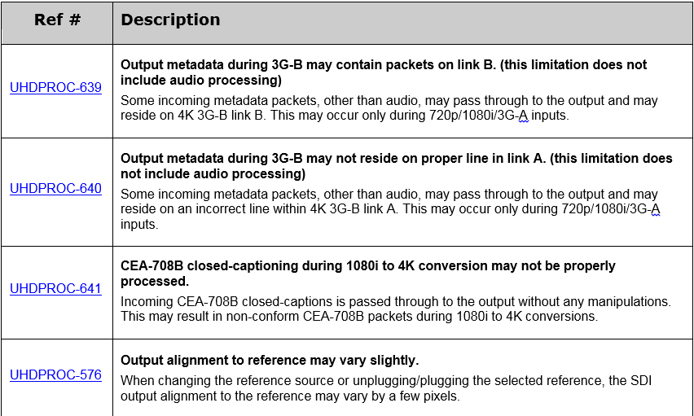
Release notes

Slide 40
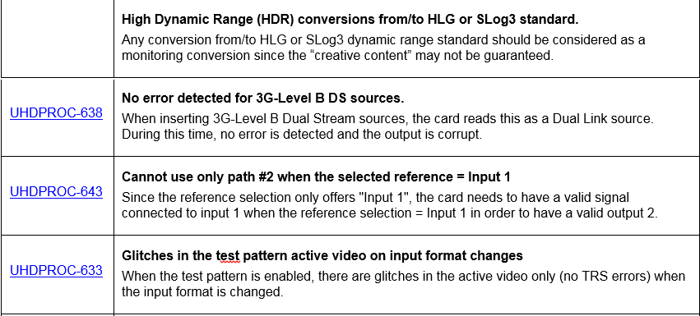
Release notes

Slide 41
Demo

Slide 42
Questions?

